Slide 1
人教精通版四年级上册
This is my new friend
WWW.PPT818.COM

Slide 2
Let’s sing: The finger family

Slide 3
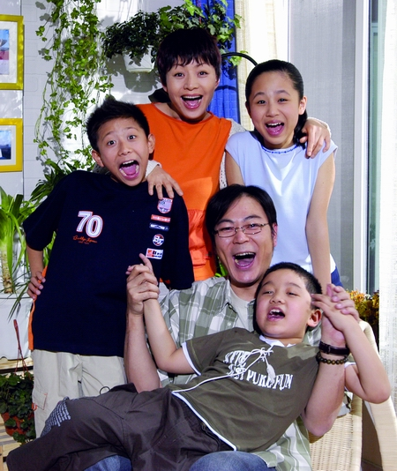
This is Liu Xing’s family. Let’s listen to Liu Xing.

Slide 4
This is my mother.
This is my sister.
Hello! My name is Liu Xing. This is a photo of my family.
This is my father.
This is my brother.

Slide 5
听完介绍，你会像刘星那样介绍你的家人了吗？同学们赶紧拿出自己的全家福，同桌之间一问一答互相介绍下自己的家人吧！
例如：
Who’s this?
He’s my father.
Who’s this girl?
She’s my sister.

Slide 6
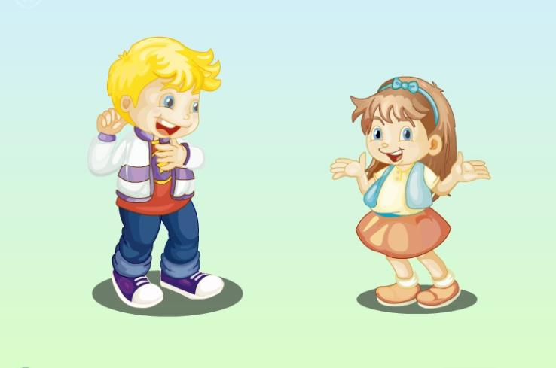

Slide 7
boy
Who’s this boy?

Slide 8
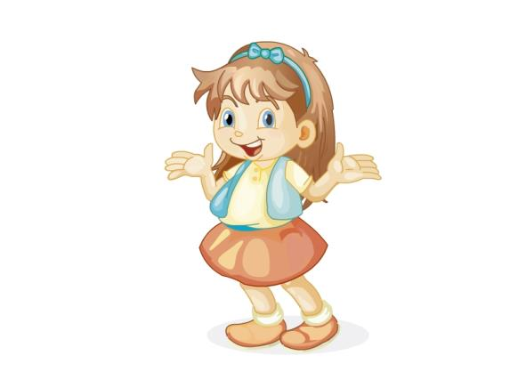
girl
Who’s this girl?

Slide 9
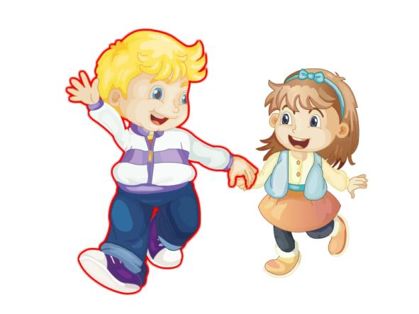
brother
He is my brother.

Slide 10
sister
She is my sister.

Slide 11
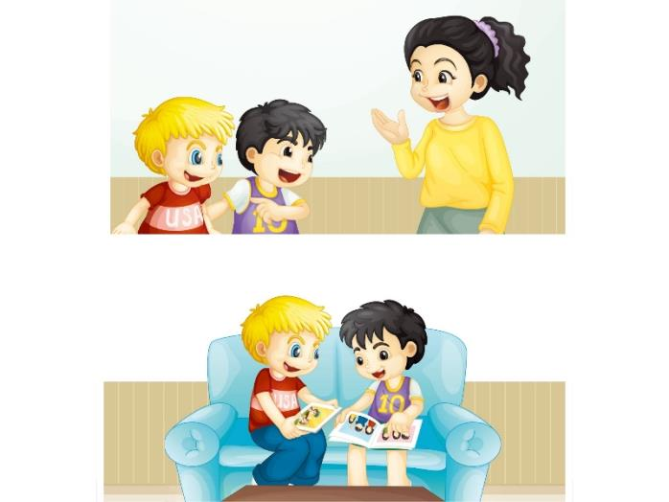
看图，思考问题:
Who are the people in the picture?
Where are they?
What are they talking about?

Slide 12
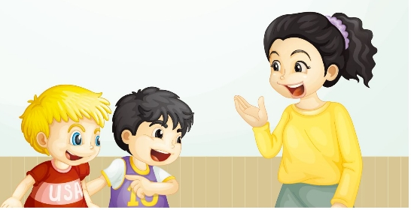
听录音，找出问题的答案
Mum! This is my new friend, Jim.
Welcome to our home, Jim.

Slide 13
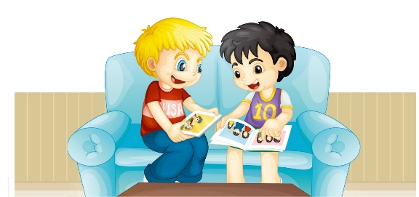
听录音，找出问题的答案
Who’s this boy?
He’s my brother.
She’s my sister.
Who’s this girl?

Slide 14
Practice
Role play
三人一组分角色表演对话，询问某人的身份。
用到的句型：
Who’s…?
He/ She’s…
Tips: Who的意思是“谁”，who’s是who is 的缩写形式。 who’s后面可以根据具体的对象来选择使用相应的名词或代词。

Slide 15
Let’s chant
Brother, brother, this is my brother.
I love my brother.
Sister, sister, this is my sister.
I love my sister.
Brother, sister, we play together.

Slide 16
