Slide 1
Module 7 Summer in Los Angeles
Unit 2 Fill out our form and
come to learn English in Los Angeles (L.A.)
WWW.PPT818.COM

Slide 2
Learning Aims
1. 识记本课基础词汇、词组：last, guest, prefer, provide, form close friendship with, depend on, as well as, daily life, stay in touch (with sb.), fill out forms 等
2. 正确使用略读的阅读方法理解文章大意
3. 了解境外暑期英语课程信息，增强学习英语的热情。

Slide 3
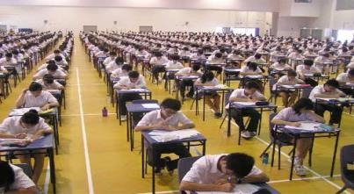
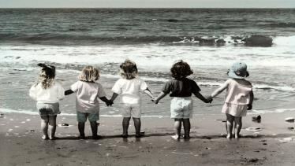
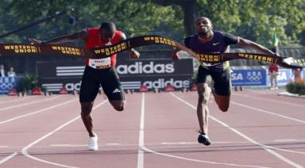
Look at the pictures and speak out the words
prefer
test
v. 更喜爱；钟爱
n.v. 测验；考试
friendship
at the same time
同时
n. 友谊；友好
Step 1 Revision

Slide 4
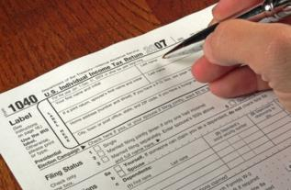
Look at the pictures and speak out the words
last
culture
v. 持续；延续
n. 文化
fill out
progress
填写；填充
n.v. 进步；进展
Step 1 Revision

Slide 5
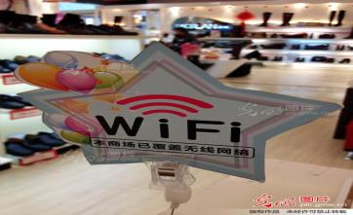
Look at the pictures and speak out the words
certain
daily life
adj. 确定的；无疑的
日常生活
provide
depend on
v. 提供；供应
取决于；决定于
Step 1 Revision

Slide 6
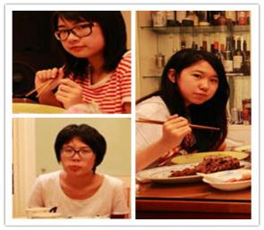
Look at the pictures and speak out the words
guest
n. 客人；宾客
form
n.表格；v.形成
stay in touch (with sb.)
保持联络
Step 1 Revision

Slide 7
Brainstorm
If you are going to study English in L.A. in this summer holiday;
before you go,
what information do you want to know about before you go?
Step 2 Warming-Up

Slide 8
Read the passage in 2 min and finish the following exercises.
1. Choose the best answer.
2. Match the headings with the paragraphs.
main idea !
The passage is about___.
a. a guide to L.A.
b. information about English courses
c. a story of life in L.A.
d. a newspaper story about language courses
2
Teaching
Free time
Places to stay
More information
Study English with us
4
3
5
1
Step 3 Reading

Slide 9
Paragraph One
1. Translate the sentence （翻译句子）
You will love coming to Los Angeles to learn about American culture and improve your English at the same time.
2. Rewrite the sentence（改写句子）
You will love coming to Los Angeles to learn about American culture and improve your English at the same time.
(as well as)
Step 4 Detailed Study of the Passage

Slide 10
Paragraph One
1. Translate the sentence （翻译句子）
2. Rewrite the following sentence（改写句子）
You will love coming to Los Angeles to learn about American culture and improve your English at the same time.
(as well as)
You will love coming to Los Angeles to learn about American culture as well as improve your English at the same time.
Step 4 Detailed Study of the Passage

Slide 11
Paragraph Two
Fill in the blanks.
给某人提供某物
provide sb sth=
provide sth sb
①The courses l____ for four, six or eight weeks.② They start at the e_____of July. ③Our teachers are well trained and have a lot of experience. They teach English classes for four hours a day. ④You can work in small or large groups: it d ______ on your personal choice.⑤We p_____ books, and we set t_____ every week to check your p_______. ⑥There are also computers for personal study.
ast
nd
with
for
epends
rovide
ests
rogress
Step 4 Detailed Study of the Passage

Slide 12
Paragraph Three
Work in pairs and find out the following words and phrases.
1. 既……又……
2. 客人
3. 日常生活
4. 和……形成亲密的友谊
5. 和......保持联络
6. 更喜欢
Step 4 Detailed Study of the Passage

Slide 13
① As well as learning English, we want you to experience life in the US. ②You can stay as a guest with an American family and take part in their daily life .③You will have meals with the family and do some activities with them too. ④ For many of our students this is the best part of the course. ⑤Many families form close friendships with the students and stay in touch with them.⑥ But if you prefer , of course, you can stay in a hotel.
Complete the paragraph.
既...又...
客人
日常生活
比起B来更喜欢A
prefer A B
to
和……形成亲密的友谊
更喜欢
和......保持联络
Step 4 Detailed Study of the Passage

Slide 14
Paragraph Four & Five
When should you pay for the course?
You must pay for your course at least one month before it starts.
Step 4 Detailed Study of the Passage

Slide 15
1
2
6
3
5
4
Step 5 Exercises

Slide 16
He as well as I ____ to take part in the football match this Sunday.
A. are going B. am going
C. goes D. is going
1 point
当as well as 连接两个主语时，谓语动词要使用就远原则
Step 5 Exercises

Slide 17
The sun provides us with light and heat.
（改为同义句）
The sun________ light and heat _____us.
provides
for
2 points
provide sb with sth=
provide sth for sb
Step 5 Exercises

Slide 18
Complete sentences.
Chinese c_______ is becoming more and more popular around the world.
ulture
3 points
Which one do you p______ , apple juice or orange juice?
refer
prefer A to B
rogress
I have made great p_________in my English.
Step 5 Exercises

Slide 19
Choose the best answer.
-Goodbye, everyone. _____.
-Bye, Sally! Don't forget to write.
A. Stay in touch B.Just wait and see
C. Sounds great D.Come this way
4 points
-Shall we go for a picnic?
-Well, it all ____ the weather.
A. belongs to B. depends on
C. happens to D. concentrates on
Step 5 Exercises

Slide 20
Complete sentences.
这对双胞胎姐妹总是同时生病。
The twin sisters always fall ill
______ ______ ______ ______ .
at the same time
4 points
我和玛丽建立了亲密的友谊。
I _______ ________ __________ _____ Mary.
formed close friendship with
Step 5 Exercises

Slide 21
Passage Structure
Learn English in L.A.
An introduction to English courses in L.A.
1
Study English with us
2
Teaching
3
Places to stay
4
Free time
5
More information
Step 6 Writing Exercises

Slide 22
Think about a course for foreign students learning Chinese in your town or city, write a short composition in groups.
小组合作：写一篇作文向外国学生介绍中文课程
Step 6 Writing Exercises

Slide 23
Referring structure
Come to Learn Chinese in...
教学
Teaching:
The courses lasts for... The teachers are ...
吃、住
Where to stay and what to eat：
Students live either...or... You can choose to eat...or...
课余时间如何度过
What to see and what to do：
There are many things to do in... For example, ...
Why students will enjoy themselves learning Chinese：
All our students have a wonderful time learning Chinese in...
课程能够给学生带来什么好处
Step 6 Writing Exercises

Slide 24
Summarize
words:
culture;provide;progress;guest;prefer
What have you learned today?
I have learned......
expressions:
at the same time; last for; at the end of;depend on; as well as; daily life; form close friendship with sb.; stay in touch with sb.; at least; fill out forms
skills:
skimming-to get main idea
others (about English learning):
Step 7 Summary

Slide 25
Homework
熟读或复述课文
背诵本课词汇、词组
进一步完善小组作文

Slide 26
Thanks
See You Next Time!

