Slide 1
Module 2 My home town and my country
Unit 2 Cambridge is a beautiful city in the east of England.
WWW.PPT818.COM

Slide 2
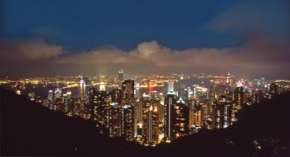
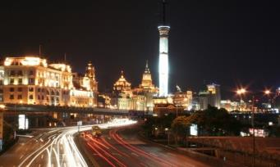
Make sentences with the comparison.
Hong Kong
7 million people
Hong Kong is big.
Shenzhen
10 million people
Shenzhen is bigger than
Hong Kong.

Slide 3
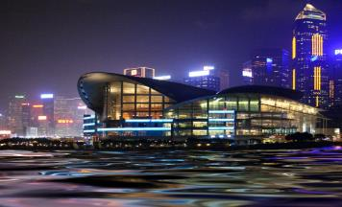
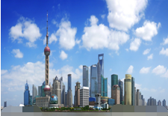
Hong Kong
about 150 years old
Hong Kong is old.
Shanghai
700 years old
Shanghai is older than
Hong Kong.

Slide 4
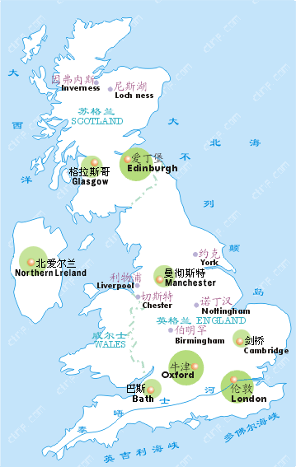
Which country is it?
Britain
England
England is
a region
of Britain.
Cambridge
London

Slide 5
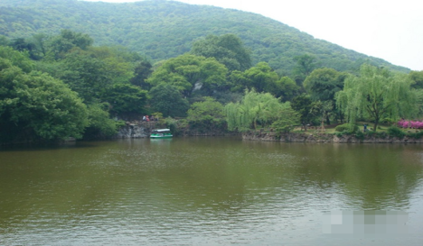
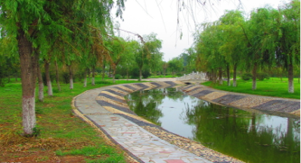
mountain
lake
river

Slide 6
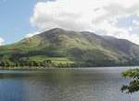
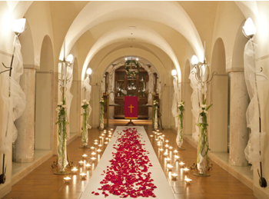
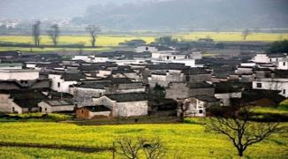
low
church
village

Slide 7
Guess: What do the letters stand for?
north
northwest
northeast
NW
NE
west
east
southwest
SW
SE
southeast
south

Slide 9
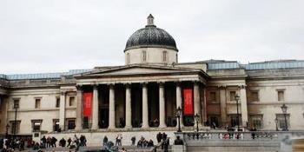
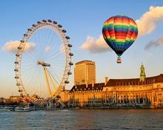
National Gallery
国家美术馆
London Eye
伦敦眼

Slide 10
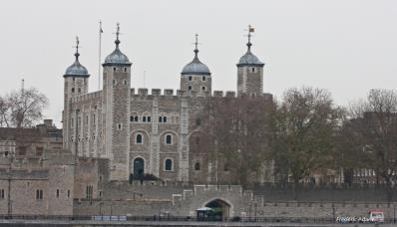
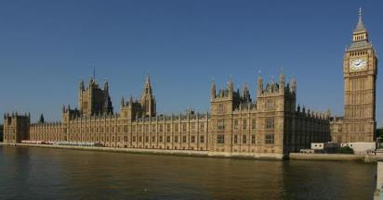
Tower of London
伦敦塔
Houses of Parliament
议会大厦

Slide 11
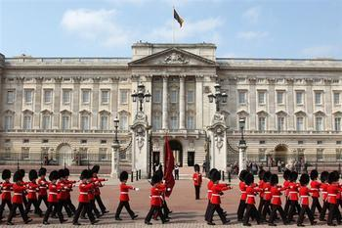
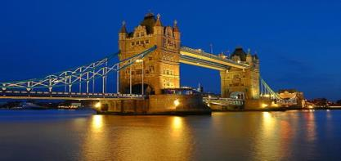
Buckingham Palace
白金汉宫
Tower of Bridge
塔桥

Slide 12
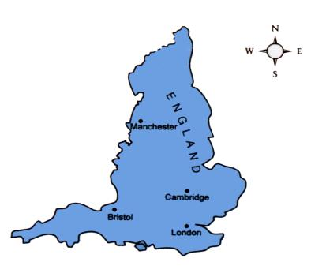
1 Look at the map and read these sentences.
Cambridge is in the east of England.
2. London is in the south of England.
3. Bristol is in the west of England.
4. Manchester is in the north of England.

Slide 13
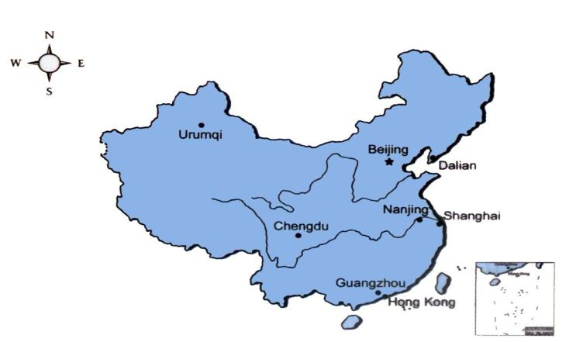
Work in pairs. Where are these cities in China?
Beijing
Guangzhou
Nanjing
Urumqi
Dalian
Chengdu
Hong Kong

Slide 14
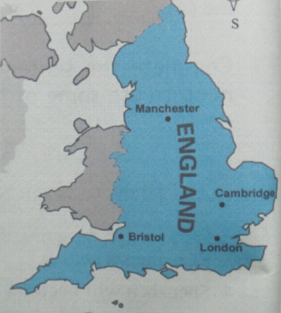
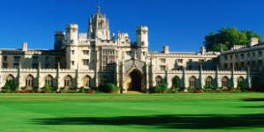
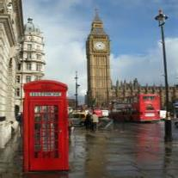
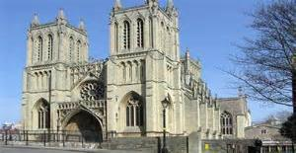
Cambridge University
剑桥大学
Mancheser United
曼联
Bristol Cathedral
布里斯托大教堂
Big Ben
大本钟

Slide 15
Answers:
Beijing is in the north of China.
Guangzhou is in the south of China.
Nanjing is in the east of China.
Urumqi is in the west of China.
Dalian is in the northeast of China.
Chengdu is in the southwest of China.
Hong Kong is in the southeast of China.

Slide 16
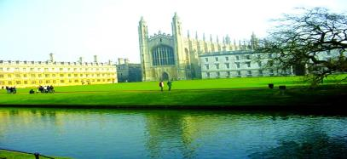
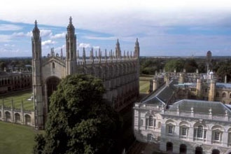
Do you know these places?
Cambridge University
Cambridge University is a famous university.
Cambridge University is near the River Cam.

Slide 17
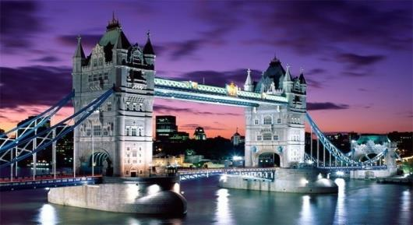
Tower Bridge
Tower Bridge is above the River Thames.
Tower Bridge is in London.

Slide 18
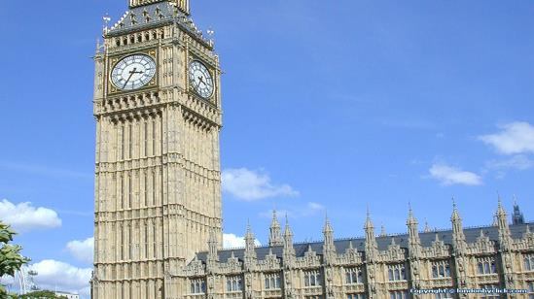
Big Ben
London is famous for Big Ben.

Slide 19
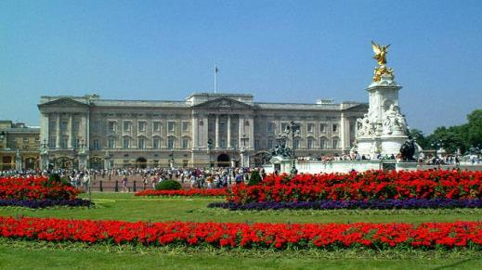
Buckingham Palace
Buckingham Palace is in London.

Slide 20
2 Read the passage and choose a title
for each picture below.

Slide 21
1 Tower Bridge and the River Thames
2 Cambridge University and the River Cam
1
2

Slide 22
3 Complete the table comparing Cambridge with London.
 | Cambridge | London
Location
Population
Famous
River
In the east
of England
In the south of England
120,000
About 7.5million
Big Ben, Buckingham Palace and
Tower Bridge
University，
Old buildings
and churches
River Cam
River Thames

Slide 23
4 Complete the passage with the words and expression in the box.
countryside east hometown island London
mountains south university
England is part of a(n) ________. It is famous for its beautiful green __________ with_________ and lakes in the north, and hills and villages in the south. My___________ is Cambridge, in the ________of England. It has lots of old buildings and churches, and a well-known ___________. It is smaller than________ ,which is in the ________ of England.
island
countryside
mountains
home town
east
university
London
south

Slide 24
Writing
5 Answer the questions and write
notes about your hometown.
1. Where is it ?
2. What’s its population?
3. Is it big or small?
4. What is it famous for?
5. How old is it?
6. What’s the weather like?

Slide 25
6 Use your notes and write answers to the questions in Activity 5.
Dalian is in the northeast of China.
It has a population of over six million.

Slide 26
7 Write a passage called My hometown.
…. is in the ….. of China
and it has a population of ….
It’s on the River … / near …
It’s famous for …
There are …
It’s never very hot / cold …

Slide 27
Quiz
一、根据句意及首字母, 写出相应的单词。
I missed my h_________ very much.
They want their daughter to go to u________.
We spent a week on the i_____.
I’m living in a house just s_____ of Market Street.
He grew up in the c__________.
ome town
niversity
sland
outh
ountryside

Slide 28
二 根据所给单词，完成以下句子。
– John, is Henry your twin brother?
- Oh, yes. He is twenty minutes _____(old) than me.
2.- The cake looks _____(good).
- Yes, and it tastes even _____(good).
3. Summer is coming. The day is getting ______ (long).
4. The left one is _______ (pretty) than the right one.
5. Ge You is ______ ___(famous) his humour.
older
good
better
longer
prettier
famous for

Slide 29
三 完成下列的练习
1、南京在中国的东部。
Nanjing is _____________ China.
2、伦敦在英国的南部。
London is _____________ England.
3、北京以长城而著名。
Beijing ____________ the Great Wall.
4、北京是中国的首都。
Beijing ________________ China.
5、伦敦比剑桥繁忙。
London _______________ Cambridge.
in the east of
in the south of
is famous for
is the capital of
is busier than

Slide 30
四. 根据汉语提示完成下列句子。
1.Do you know ___ __________ __ _______
(北京的人口数)?
2. Fujian is ____ ____ ____ ____ (在东部) China.
3. —What’s ____ ____ ____ (省会) Shandong province? —It’s Jinan.
4. The girl ____ ____ ____ (留长发的) is my sister.
5. The building is___ ____ ______ (三十米高).
the population of Beijing
in the east of
the capital of
with long hair
30 meters high

Slide 31
五. 单项选择
1. ____ is the population of Tianjin?
A. How many B. How much
C. What D. Which
2. The population of China is ____than that of American.
A. small B. smaller C. large D. larger
3. My uncle has a house ____ a small garden.
A. with B. of C. near D. in
4. Yao Ming is famous ____ a basketball player.
A. for B. with C. as D. to
5. The mountain is about 1,543 meters____.
A. near B. low C. high D. long
C
D
A
C
C

Slide 32
六 .句型转换。
1.The city has one million people.
(改为同义句)
The city has__ __________ __ ____ ________.
2. London is famous for Cambridge.
(改为同义句)
London is __________ ____Cambridge.
3. The population of shanghai is 13 million.
(对划线部分提问)
_______ ____ ___________ ____ shanghai?
4. Lily is 1.5 meters tall. (对划线部分提问)
____ ____ is Lily?
a population of one million
well-known for
What’s the population of
How tall

Slide 33
Homework
Write a short passage about your hometown.
Notes:
33
中国英语教师网

