Slide 1
Unit 3 Topic 2
Some things usually have different meanings in different cultures.
Section B
WWW.PPT818.COM

Slide 2
Michael sees a stranger putting out his hand with his thumb raised.
with his thumb raised
mean
ask for a ride
body language
gesture

Slide 3
What’s the function of knowing about body language?
It can help us communicate better and avoid misunderstanding.

Slide 4
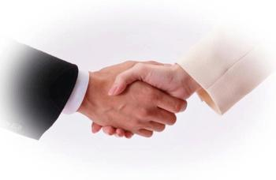
When do we usually hold hands with others?
We usually hold hands when we meet some new friends for the first time.
What does this gesture show ?
hold hands
It shows a warm welcome and respect.

Slide 5
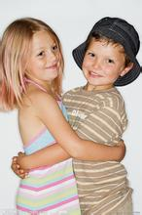
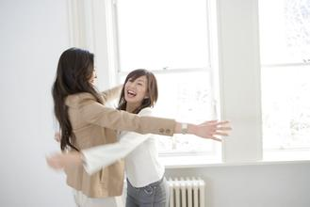
What does the body language show ?
hug
It shows friendliness and happiness.
It is a sign of happiness and friendliness.
……的标志

Slide 6
stamp one’s foot
What does the body language show ?
It shows one’s anger.
It is a typical sign of showing one’s anger.
adj.典型的，有代表性的

Slide 7
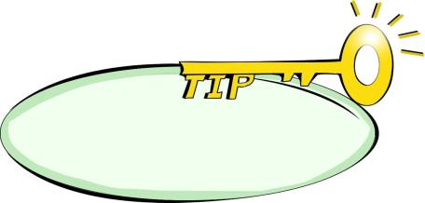
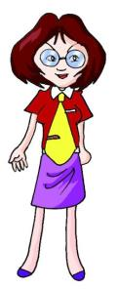
Intensive listening
Use your body language to help express yourself.
( )1.How does Jane say “hi”?
A. She waves her hand.
B. She smiles.
C. She bows.
( )2.How does Miss Wang show her unhappiness?
A. She raises her voice.
B. She crosses her arms and stamps her foot.
C. She puts her hands on her hips.
A
C
Will she praise or punish us?

Slide 8
Extensive listening
1b Listen to 1a and mark T (true) or F (False).
When Yukio says “hi” he waves his hand. ( )
Bowing is a sign of peace. ( )
When Miss Wang puts her hands on her hips, she will punish students. ( )
When Jane’s sister stamps her foot, she may be angry.( )
The three kids are talking about body language. ( )
F
F
T
T
T

Slide 9
1c Read 1a and fill in the blanks.
Waving and bowing are examples of _______ language. In Japan, people bow as a sign of __________. In Canada, people wave as a sign of _________ and ____________. In all cultures, people smile when they are _______. Body language can mean different things in different ________________. If we understood body language from different countries, we could _____________ better.
body
respect
peace
friendship
happy
cultures/countries
communicate

Slide 10
Language points:
1. I think that is known as body language.我觉得这就是肢体语言。
be known for
be famous for
因为……而出名
=
be known as
=
be famous as
作为……而出名
be known to sb.
被某人所……熟知
e.g.
(1)重庆因为火锅而出名。
Chongqing ___________________ hot pot.
is known/famous for
(2)重庆作为山城出名。
Chongqing ____________________ a mountain city.
is known/famous as

Slide 11
Language points:
2. We use body language to communicate how we feel, even if
there is silence.我们用肢体语言表达我们的感受，即使是沉默的时候。
even if= even though 意为“即使、纵然”, 引导让步状语从句
即使她回家很晚，她每晚也要给母亲打电话。
e.g. Even if she returns home quite late, she calls her mother
every night.
3. we should do some research.我们应该做些研究。
do some research (on) 做关于……的研究
Jane 最近在做一些关于英式英语和美式英语差异的研究。
e.g. Recently Jane ___________________ the differences
between British English and American English.
has done some research on

Slide 12
Discuss and report
Discuss the typical body language your teachers/classmates
often use with the following questions. Then report to the whole
class, paying attention to the pause, liaison and intonation.
1.What is his/ her body language?
2. When is it used?
3. What does it show?
You may begin like this:
Miss Wang’s typical body language is … It is a sign of … When she …,
she often uses this body language…

Slide 13
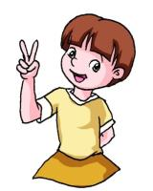
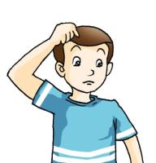
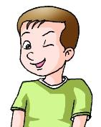
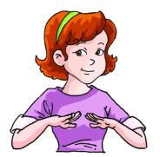
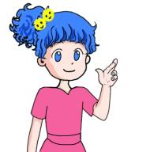
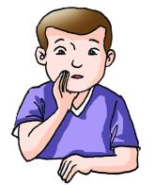
2a Look at these gestures that are common in the USA.
Discuss and match each gesture with its meaning below.
a
b
c
d
e
f
a
d
e
___ Good luck.
___ It’s a secret.
___ Calm down.
c
___ Have a victory.
b
___ I’m just kidding.
f
___ I’m puzzled.

Slide 14
What does the body language mean?
Showing agreement?
Can they have the same meaning?
Showing disagreement?

Slide 15
Put these sentences in the correct order to form a passage.
( ) Body language means different things in different cultures.
( ) In Canada, nodding your head shows agreement.
( ) But people shake their heads from side to side to show
agreement in India.
( ) So, to avoid misunderstanding, you should study both spoken
and body languages.
( ) However, in India, men often hold hands a sign of friendship.
( ) North American men seldom hold hands in public.
( ) For example, the signs of showing agreement and friendship
are different from culture to culture.
1
3
4
7
6
5
2

Slide 16
Group work
2b Do you know any other gestures? In groups, act them out and guess what they mean.

Slide 17
Choose the best answer.
Exercises
C
( ) 1. Yang Liwei, the national hero is known ____ all the Chinese.
A. for B. as C. to D. with
( )2.—Hi, Jane, tell you a piece of good news. I
____ America tomorrow.
—Wow, have a good trip!
A. am leaving for B. leaves for
C. have left for D. left for
( )3. _____she has failed for several times, she never
gives up.
A. If B. Because C. Even if D. As if
( )4.—I’m going to have an exam tomorrow.
—________
A. Calm down. B. Good luck.
C. You’re kidding. D. I’m puzzled.
A
C
B

Slide 18
Exercises
Fill in the blanks.
typical
5. Stamping her foot is my sister’s______ （典型的）
gesture.
6. Shaking hands is ____________（……的标志）
friendship in most of the countries.
7. They are busy _________________（做关于……的研
究） how to improve the environment.
8. Miss Wang usually raises her thumbs to _______
（表扬） us.
a sign of
doing some research on
praise

Slide 19
Summary:
We learn:
Some words: bow, silence, hip, praise, research,
secret, puzzled, victory, typical
misunderstanding,
2. Some phrases: a sign of, be known as, be known for,
even if, do some research
3. Some sentences:
(1)We bow when we are saying hello as a sign of respect.
(2)We use body language to communicate how we feel, even if there is silence.
We can:
(1)Know more about different culture.
(2)Express ourselves by proper body language.

Slide 20
Assignment
Read 1a.
Memorize the useful expressions and key sentences which we learn today.
Finish Section B in your workbook.
Preview Section C.

