Slide 1
It’s spring
Unit 4 Seasons
WWW.PPT818.COM

Slide 2
Let's think. 让我们想一想。
seven
We have _____days in a week.
我们一周有七天.
周

Slide 3
spring
It's spring.

Slide 4
summer
It's summer.

Slide 5
autumn
It's autumn.

Slide 6
winter
It's winter.

Slide 7
four seasons

Slide 8
season
季节
spring
summer
autumn
winter

Slide 9
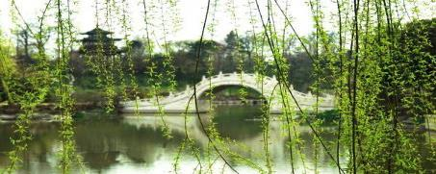
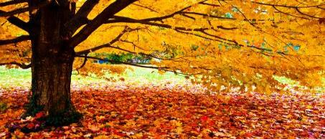
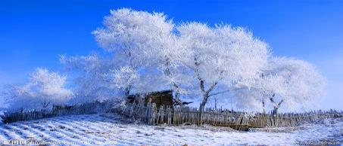
How many seasons in a year?
year
年
We have
seasons in a .
four

Slide 10
Let's chant.
spring, spring 春光明媚spring.
summer,summer 夏季summer 汗水淋。
autumn, autumn 秋高气爽autumn.
winter, winter 冬季winter 白如银。

Slide 11
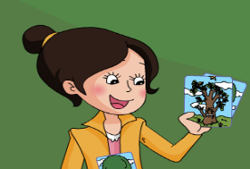
What season is it?
It’s spring.
It’s summer.
It’s autumn.
It’s winter.

Slide 12
What season is it?
It’s spring.
It’s summer.
It’s autumn.
It’s winter.

Slide 13
Play a guessing game:
What season is it?
It’s ……

Slide 14
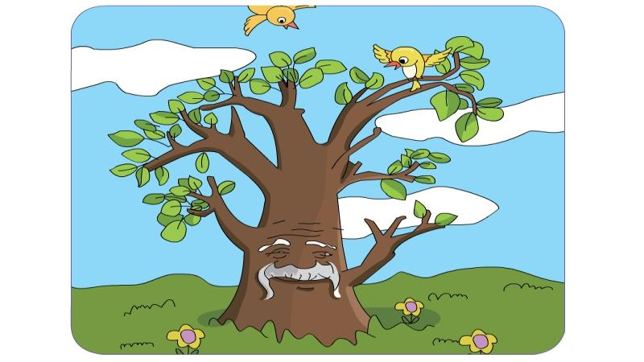

Slide 15
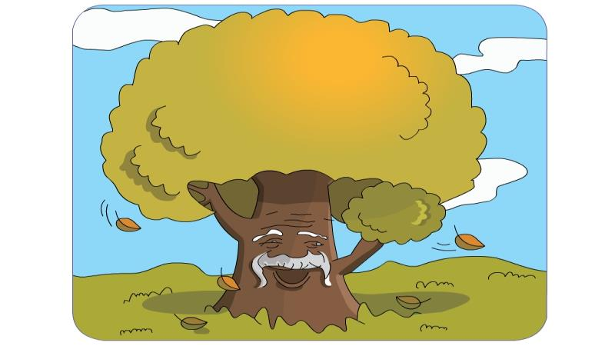

Slide 16
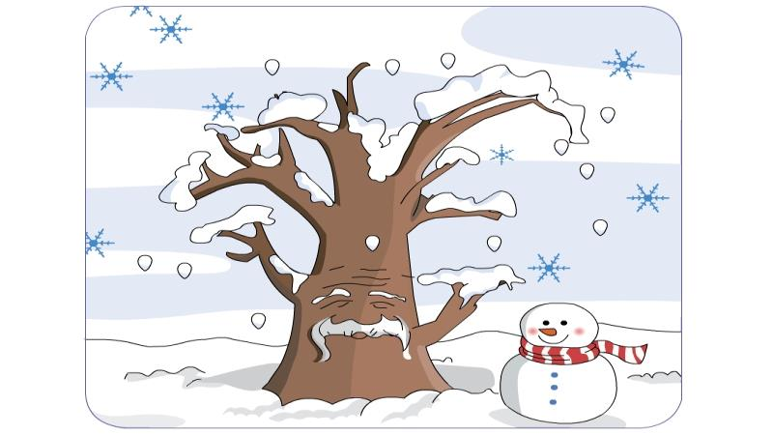

Slide 17
