Slide 1
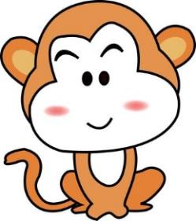
Unit1 My Body
陕旅版
三年级下册
Part A Color the toy
Part B Let’s learn more
Part C Complete and match
Ask and answer
WWW.PPT818.COM

Slide 2
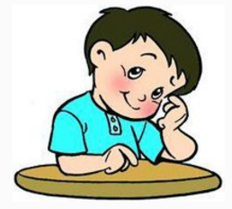
>>Review
Listen and touch
This is …
These are …
Touch your eye.

Slide 3
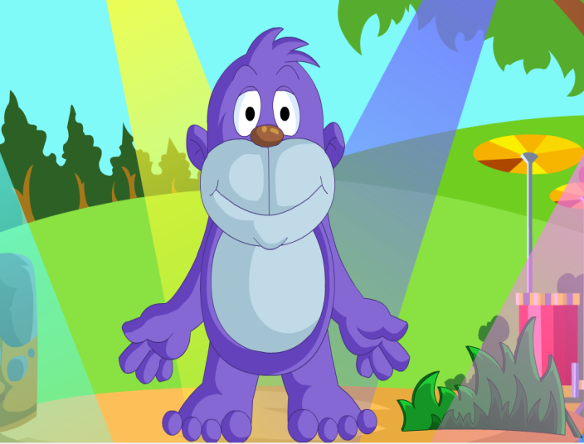
>>Warm-up
Let’s sing

Slide 4
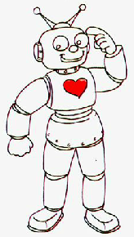
>>Presentation
Color the toy

Slide 5
>>Presentation
Let’s learn
hand
arm
body
leg
foot

Slide 6
>>Presentation
Look and learn
我会变复数
foot
feet
arm
arms
hand
hands
leg
legs
hair
hair(s)

Slide 7
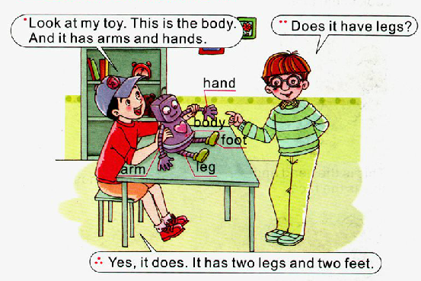
>>Presentation
Let’s learn more

Slide 8
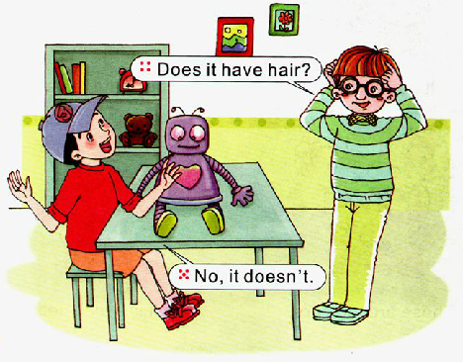
>>Presentation
Let’s learn more

Slide 9
>>Practice
Read it by yourselves for one minute .
自读课文一分钟。
一分钟倒计时
60
Learning tip :
10
50
当你自己朗读时，遇到不会读或不明白意思的单词或句子，可以把它圈起来，请教同学或老师！
20
40
30
开始

Slide 10
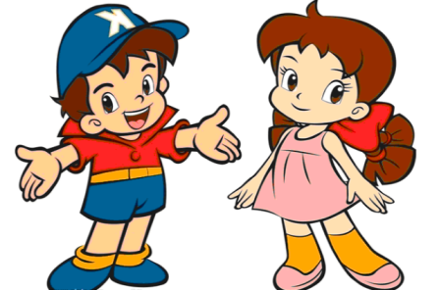
>>Practice
Role play
两人一组，练习对话，随后
表演出来吧！

Slide 11
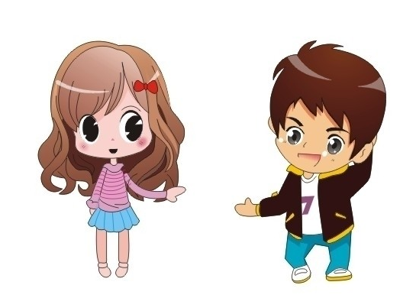
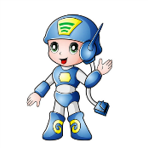
>>Practice
Game1
Make sentences
Yes, it does.
Does it have arms?

Slide 12
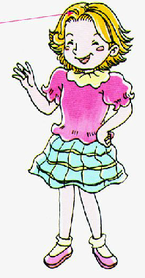
>>Practice
hair
h_ _ d
e
a
a
r
_ _m
f _ ce
a
h _nd
b_ dy
a
o
o
o
f _ _t
l _g
e

Slide 13
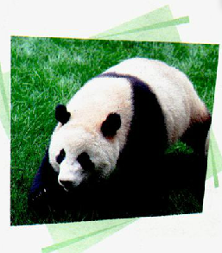
>>Practice
Ask and answer
A: Does a panda have …?
B: Yes, it has a …/two …
A: Does it have …?
B: No, it doesn’t.

Slide 14
>>Summary
如何用一般疑问句询问他人的身体部位？
Does it have …?
Yes, it has a/two …/No, it doesn’t.
例如
Does it have legs?
Yes, it does. It has two legs and two feet.

Slide 15
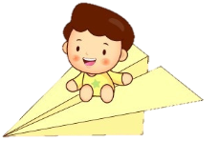
>>Homework
1.听课文录音并跟读，按照正确的语音、语调朗读并表演课文对话。 2.我是小小造句家，请学生用Does it have …?创编句子(3-5句)。
3.预习B Read a story。
close

