Slide 1
Module 1 Unit 2
What do you want to eat?
WWW.PPT818.COM

Slide 2
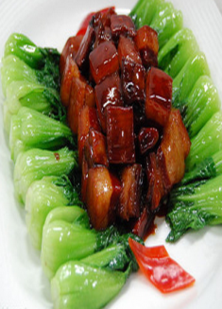
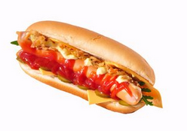
Listen and chant.
What do you want to eat?
I want to eat some meat.
And I want a hot dog, please.
With lots and lots of cheese.

Slide 3
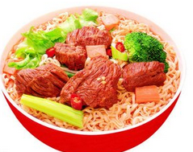
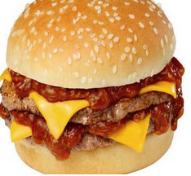
Listen and read.
Cashier: Can I help you?
Dad: I want noodles and a cola.
What do you want to eat, Lingling?
Lingling: I want a hamburger.

Slide 4
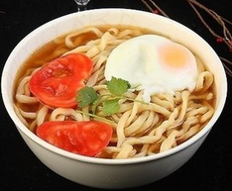
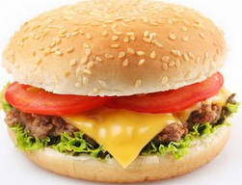
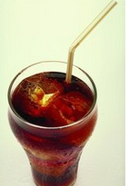
Listen and read.
Dad: And what do you want to drink?
Lingling: Milk, please.
Dad: So we want a hamburger, noodles, milk
and a cola, please.
Cashier: OK.

Slide 5
choose and write.
What do you want to eat?
＄2.00
＄3.75
__________
and
＄1.50
＄1.50
__________
, please.

Slide 6
choose and write.
And what do you want to drink?
I want
＄1.25
＄1.00,
please.

Slide 7
choose and write.
How much is it?
It’s ______________.
＄2.00
＄3.75
＄1.50
＄1.50
＄1.25
＄1.00

Slide 8
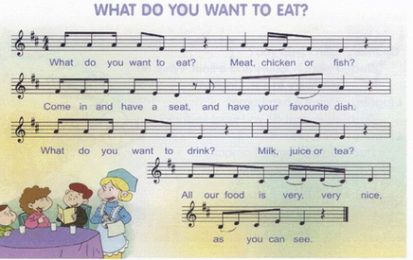
Listen and say.

Slide 9
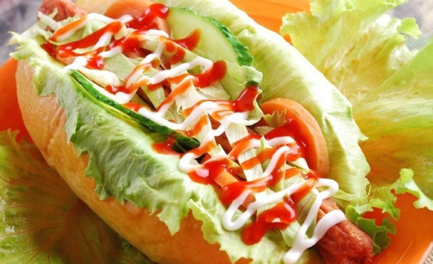
Follow and say.
What do you want?
I want a hot dog.

Slide 10
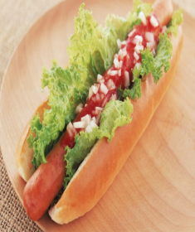
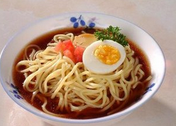
Follow and say.
I want a hot dog too. And I want some noodles.

Slide 11
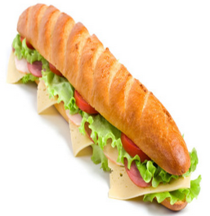
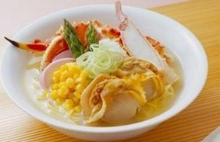
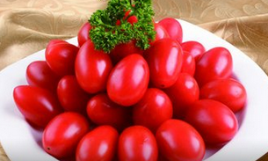
Follow and say.
I want a hot dog and some noodles too. And I want some vegetables.

Slide 12
Do and say.
Make a restaurant menu and role-play with your friend.
NSE Restaurant
Food Drinks
Hot dog ￥ 4 Orange juice ￥3
Hamburger ￥ 5 Milk ￥ 3
Noodles ￥ 5 Cola ￥ 3
Rice ￥ 1 Tea ￥ 2
Chicken ￥ 10
Fish ￥ 15
Vegetables ￥ 8

Slide 13
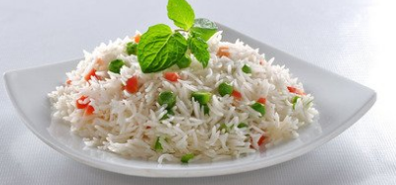
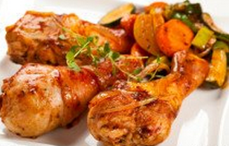
Do and say.
What do you want to eat?
I want chicken and rice, please.

Slide 14
Do and say.
What do you want to drink?
I want a cola, please.

Slide 15
Let’s practice more.

Slide 16
Homework:
1.记住本课新单词。
2.写5句话介绍家人的饮食爱好。

