Slide 1
Unit 8
Is there a post office near here?
第1课时
WWW.PPT818.COM

Slide 2
第1课时分层训练
课内基础自测
Ⅰ.根据句意及汉语提示完成句子
1．It's Sunday today. We can see a lot of people on the ________ (街道)．
2．____________ (大约) forty students are in the hall.
3．You need to ________ (支付) ten yuan for the book.
4．The nearest ________ (镇) is ten miles away.
5．Where is Mr. Green's ________(办公室)?
street
Around/About
pay
town
office

Slide 3
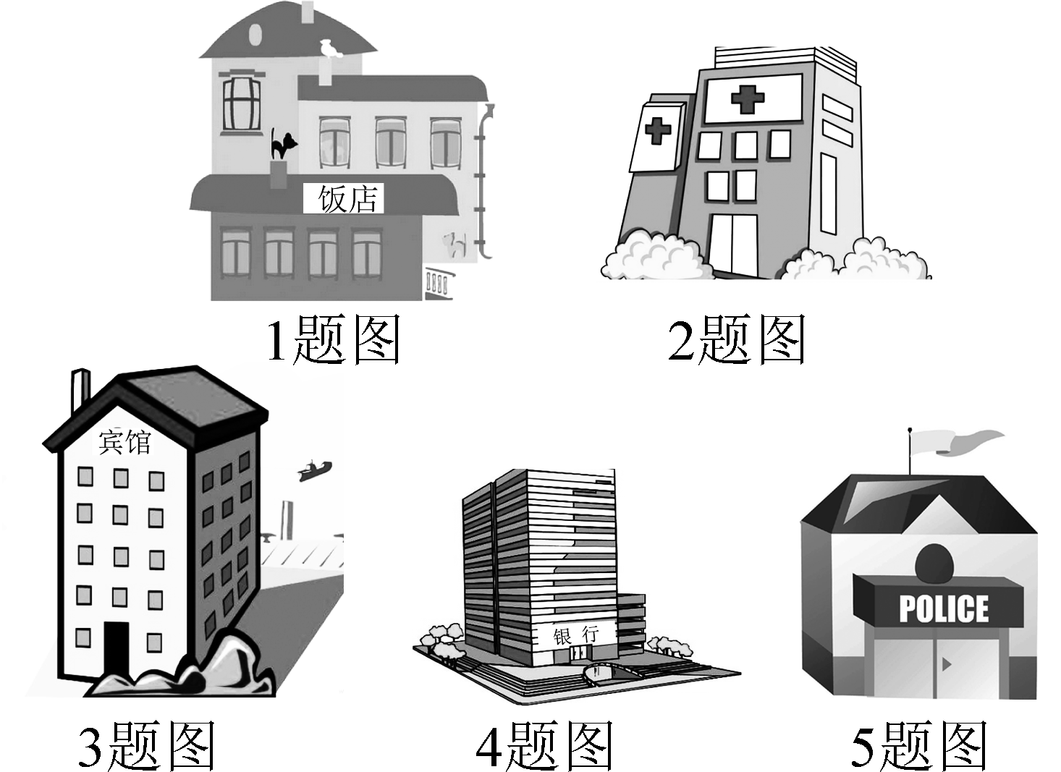
第1课时分层训练
Ⅱ.根据句意及图片提示，用适当的单词填空
1．The food in the ________ is very delicious.
2．Tina's sister works in a ________．
3．The post office is next to the ________．
4．—Is there a ________ near here?
—Yes, there is.
5．Can you tell me where the ________ station is?
restaurant
hospital
hotel
bank
police

Slide 4
第1课时分层训练
Ⅲ.用is或are填空
1．There________ some people on the bus.
2．There________ some milk in the glass.
3．________ there any birds in the park?
4．There________ a book and three pens on the desk.
5．What________ between the bank and the park?
are
is
Are
is
is

Slide 5
第1课时分层训练
Ⅳ.用适当的介词填空
1．The school is across________ the bank.
2．The supermarket is ________ the restaurant and the library.
3．Paul sits next ________ me.
4．There is a nice hotel____________ here.
5．The shop is________ Center Street.
6．We can't see the boy because he's ________ the door.
from
between
to
near/around
on
behind

Slide 6
第1课时分层训练
课后巩固提升
Ⅰ.单项填空
( )1.—Are there any hotels near here?
—Yes, ________ one on Green Street.
A．they are B．there are
C．it's D．there's
D

Slide 7
第1课时分层训练
( )2. —What do you often do ________ classes to relax?
—Listen to music or walk around the school.
A. over B. through
C. between D. among
C
【解析】考查介词的用法。问句句意：课间你们经常做什么来放松？between意为“两者之间”，符合句意。

Slide 8
第1课时分层训练
( )3.Jim sits behind me, so I sit ________ him.
A. at the top of B. at the end of
C. in the middle of D. in front of
D
【解析】根据“吉姆坐在我的后面”可知，“我”坐在他的前面。in front of意为“在……前面”。故选D。

Slide 9
第1课时分层训练
( )4. There________ a pen and two pencils in the pencil box.
A．is B．are
C．have D．be
A
【解析】考查there be句型。there be句型遵循“就近原则”，最靠近be动词的主语“a pen”是单数形式，谓语动词应用is。

Slide 10
第1课时分层训练
( )5.There is a big desk between________ and________．
A．he; I B．he; me
C．him; I D．him; me
D
【解析】between是介词，后接代词宾格，and后也接代词的宾格。

Slide 11
第1课时分层训练
( )6.My house is ________ the garden.
A．cross in B．across from
C．cross from D．across at
B
【解析】考查介词的用法。“在……对面”用across from，故选B。

Slide 12
第1课时分层训练
Ⅱ.句型转换
1．The pay phone is behind the library.(改为同义句)
The library is ________ ________ ________ the pay phone.
2．The bank is near the park．(对画线部分提问)
________ ________ the bank?
in front of
Where is

Slide 13
第1课时分层训练
3．There are three boys in the classroom.(对画线部分提问)
________ ________ boys ________ ________ in the classroom?
4．Are there any pencils on the desk？(作否定回答)
________， ________ ________．
5．There are some hotels on Bridge Street.(改为一般疑问句)
________ ________ ________ hotels on Bridge Street?
How many
are there
No there aren't
Are there any

