Slide 1
Unit8
Days of the week
第一课时
WWW.PPT818.COM

Slide 2
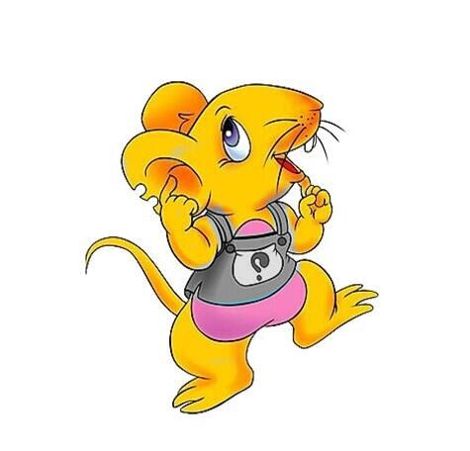
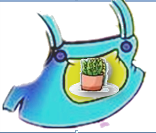
Why does Clare put on new clothes?
cl
Clare
pl
Clare put on new clothes.
The clothes has a plant on the plate,
hoohoo!
She is happy and claps, claps, claps.
clothes
plant
plate
claps

Slide 3
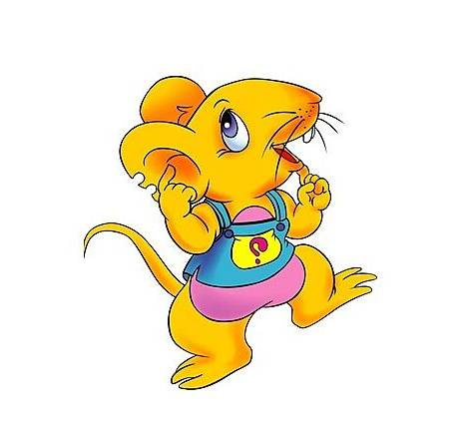
Hi ! I'm very happy today. I put on new clothes. I am going to Kitty’s school.
^{to} ^{Kitty’s school}

Slide 4
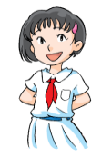
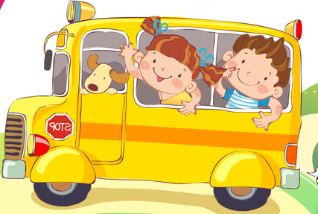
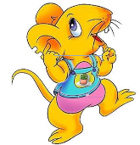
Clare! This is my school!
Let's go.
So cool!

Slide 5
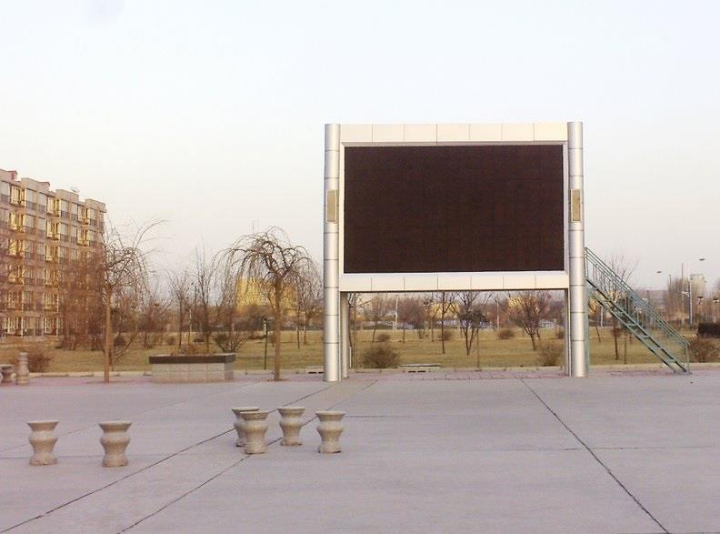
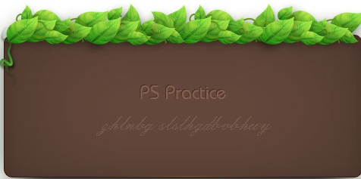
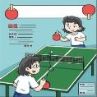
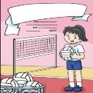
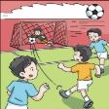
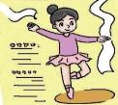
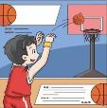
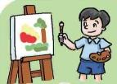
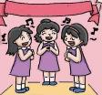
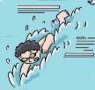
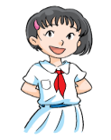
Yes, come and see the timetable.
Wow ! You do many things.

Slide 6
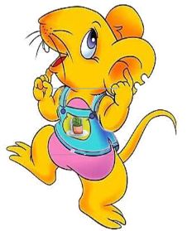
Look, this is my timetable.
On Monday , I play football with my friends.
On Tuesday , I swim. I like swimming.
On Wednesday, I join in the guitar club.
I like playing the guitar.
On Thursday, I read books. I like reading books in the library.
On Friday, I run and run.
I love my school days.
School days | Monday | Tuesday | Wednesday | Thursday | Friday
things we do | play football | swim | play guitar | read books | run
星期二
星期三
星期四
星期五
How colourful!

Slide 7
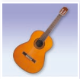
What does Kitty do at school days?
Read and answer:
How colourful!
nurse
music
On Tuesday, I swim. I like swimming.
On Thursday, I read books. I like reading books in the library.
Thursday
Tuesday
when?
when?
when?
when?
when?
Friday
Wednesday
d
five
Monday
On Monday, I play football.
On Friday,
I run and run.
On Wednesday, I join in the guitar club. I like playing guitar.
one
Wen
Ken

Slide 8
Monday
Mon. is for ______
Tuesday
Tue. is for ______
Wednesday
Wed. is for ______
Thur. is for ______
Thursday
Let's sing and dance.
Fri. is for ______
Friday
How to remember
the name of school days?

Slide 9
How colourful!
Monday, Monday, Monday,
I play football on Monday.
Tuesday, Tuesday, Tuesday,
I swim, swim on Tuesday.
Wednesday, Wednesday, Wednesday,
I play the guitar on Tuesday.
Thursday, Thursday, Thursday,
I read books, books on Thursday.
Friday, Friday, Friday,
I run, run, run on Friday.
Chant again

Slide 10
Retell Kitty's colourful school days
Today is Monday. Let's play football!
Look, this is my timetable. On _______, I ____________. On ________, I_______. I like __________. On _________, I join in ________. I like_________. On _________, I read books. I like reading books in the library. On________, I _______. I love my school days.

Slide 11
How happy!
I love school days, too!

Slide 12
Talk about your happy and colourful
school days!
1、Fill the time table.
2、 Talk about the time table.
3、Share with your partner.
School days | Monday | Tuesday | Wednesday | Thursday | Friday
things we do
Look, this is my timetable.
On _______, I ___________. I like_________.
On _______, I__________. I like __________.
On _______, I __________. I like__________.
On _______, I __________. I like___________.
On _______, I ___________. I like __________.
I love my school days.

Slide 13
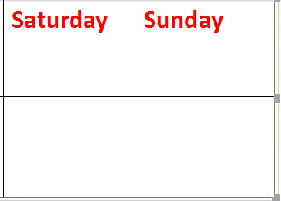
Sum-up: What did we learn?
weekend
?
?
Colourful life at school days
Next lesson, we will know!

Slide 14
Know more!
星期一： Monday，the day of the Moon，从Moonday发展至现在的Monday，“月亮日”。
星期二： Tuesday，源于Tiwesday，“战神日”。
星期三： Wednesday，源于Woden’s day，“Woden”是风暴之神，“风神日”。 星期四： Thursday，是为了纪念雷神(Thor)而命名的。故星期四又称为“雷神日”。
星期五： Friday，在古英文中Friday意思是Frigg’sday。Frigg是北欧神话中主司婚姻和生育的女神，也是Woden的妻子。
星期六： Saturday，the day of Saturn，(土星日)，一起土一下吧。同时Saturn也是罗马神话中的农神撒旦。
星期日： Sunday, the day of the Sun，“太阳日”。

Slide 15
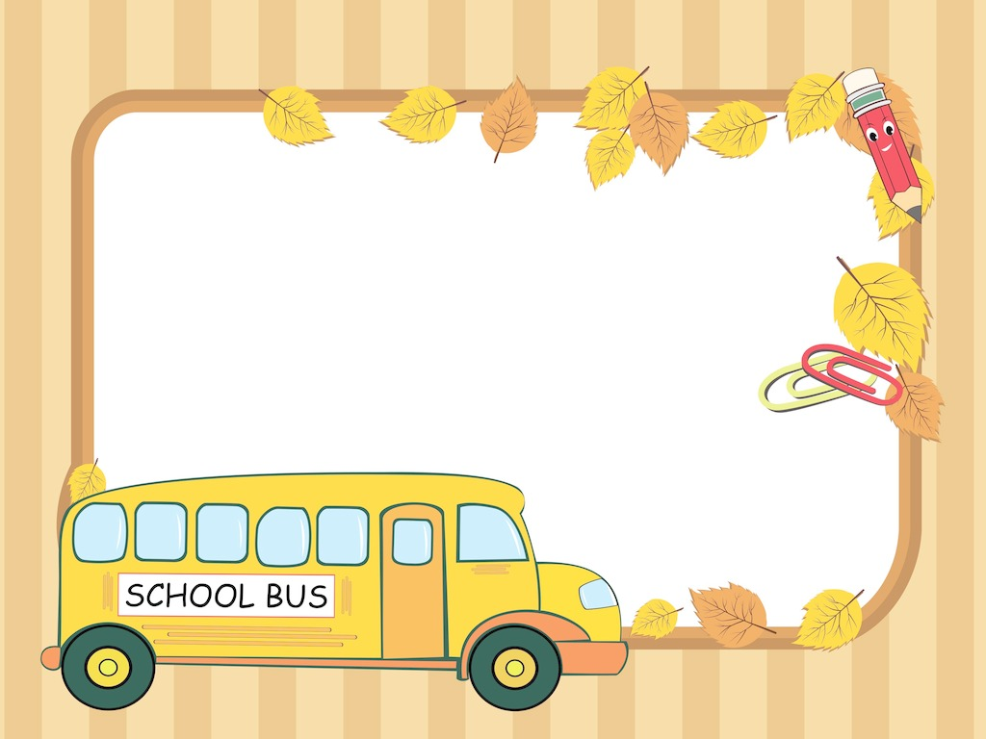
Homework:
1、Recite the name of the school days.
2、Recite Kitty's colour school days.
3、 Write about our school days.

