Slide 1
Steve Jobs
WWW.PPT818.COM

Slide 2
Introduction
changed the world. The first one seduced Eve. The second one Three Apples awakened Newton. The third one was in the hands of Steve Jobs.

Slide 3
Steve Jobs ( 1955-2011 ), inventor, entrepreneur, American co-founder, former CEO of Apple Corp. In 1976 Jobs and friends set up a Apple Com puter Inc, he accompanied the Apple Corp decades of ups and downs and rejuvenation, has leading and introduced the Macintosh computer, iMac, iPod, iPhone and other popular all over the world millions of electronic products, profoundly changed the modern communication, entertainment and even the way of life. In October 5, 2011 he died, at the age of 56. Jobs is to change the world of genius, he had a keen sense of touch and wisdom, the courage to change, innovation, leading the global information technology and electronic product trend, the computer and electronic product becomes simple, civilians, that used to be expensive rare electronic products become part of modern life.

Slide 4
The childhood of Steve Paul Jobs
In 1958, Jobs and her sister Patti
The old photograph is a picture of little Jobs and his sister Patti in the "Joe Grand Courtyard". Wear Headset small head of Jobs more than 3 years old, holding "iPod prototype", a small bench legs "

Slide 5
Ten years old
In 1965, Jobs of 10 years old good to learn. In primary school, Jobs is not very Until I met Hill in the fourth grade teacher when, to make efforts. Learning to soar, skip the fifth grade in junior high school.

Slide 6
The time of high school
In 1969, a class photo electronic It is the middle of the 14 year old Jobs, the first on the left is their teacher McCollum. Jobs entered the Holmes Ted after high school, he attended an electronic class. Jobs teacher is Mr McCollum, he later said, Jobs was a student on the telephone to David Hewlett "offer one's own services", which made him very shocked. Later, Jobs got a summer job in HP. Jobs's entrepreneurial ability demonstrated in their early life.

Slide 7
The Beginnings of Apple
After spending time in India in 1974, Jobs returned to America
Steve Jobs , Steve Wozniak And Ronald Gerald Wayne in 1976.
Apple I in 1976, Apple II in 1977, Stepped into positive growth

Slide 9
New Beginning Of Apple
2001, Apple launched iPod
A New Time For Music
Tens of million iPod sold all around the world
iTunes store become the largest online music store
Lead a new way of music industry

Slide 10
Re-Define The Phone
2007, Apple launched iPhone
2010, more than 50 ,000,000 iPhone was sold
App Store is the largest Online App market
Leading people to a time with simple-smart communication and entertainment

Slide 11
Living Without PC
2010, Apple launched iPod, with large touch screen and powerful processor
Has a trend to replace the PC
Leading a Pad-Time
A new challenge of competitors

Slide 12
Soul Of Apple
1984: National Medal of Technology
1987: Jefferson Award for Public Service
2007:the most powerful person in business by Fortune Magazine
2009: CEO of the decade by Fortune Magazine
2010: Financial Times named Jobs its person of the year for 2010
......

Slide 13
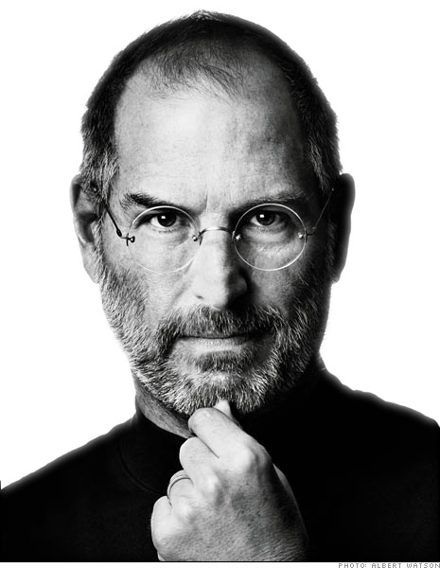
Steve jobs is to change the world of genius, he had a keen sense of touch and great wisdom, the courage to change, innovation, leading the global information technology and electronic product trend, the computer and electronic product getting contracted turn, accessible, and let was expensive rare electronic products into a part of the modern life.

Slide 14
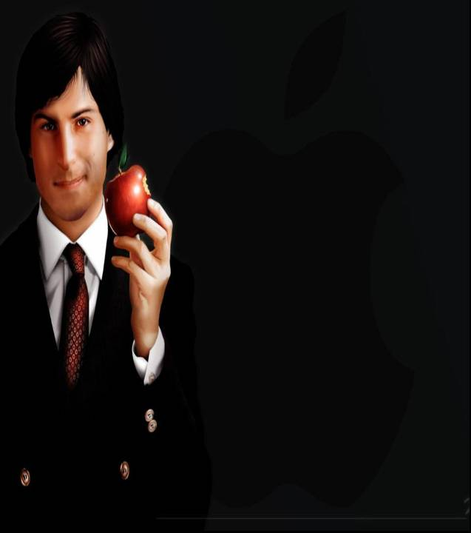

Slide 15
That’s all
Thank you

