Slide 1
Unit 3
Welcome to My House
WWW.PPT818.COM

Slide 2
使用说明
复习旧知
（1）Game: What can you see?
（2）层层深入，回忆物品的位置。

Slide 3
What can you see?
I can see a ….

Slide 4
What can you see?
I can see a ….

Slide 5
What can you see?
I can see a ….

Slide 6
What can you see?
I can see a ….

Slide 7
What can you see?
I can see some ….

Slide 8
What can you see?
I can see a ….

Slide 9
What can you see?
I can see a ….
Where is …?

Slide 10
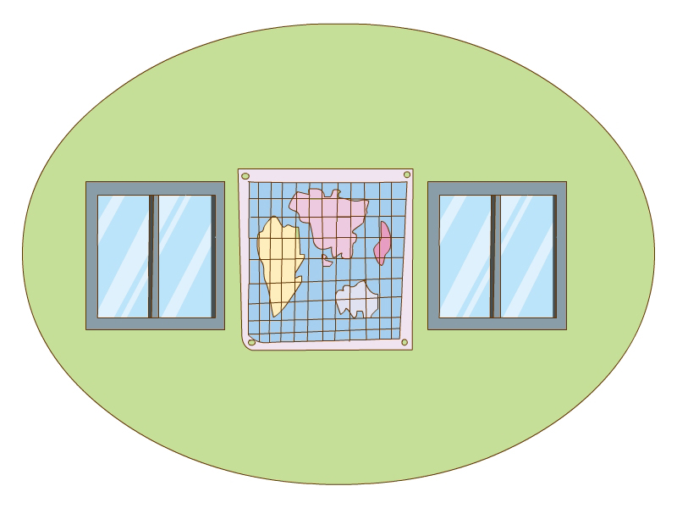
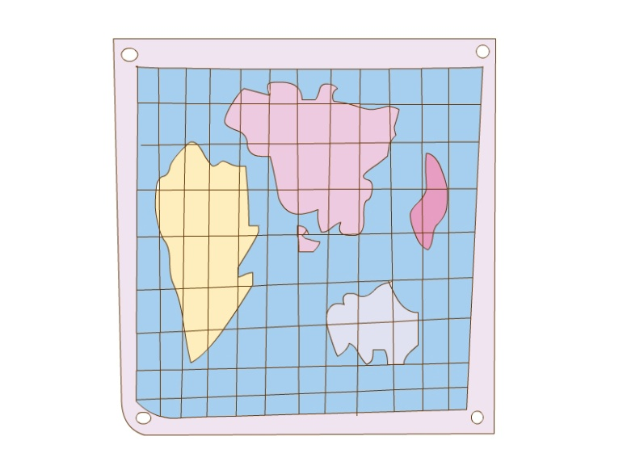
What can you see?
I can see a ….
Where is …?

Slide 11
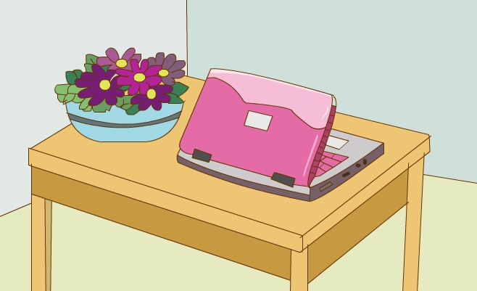
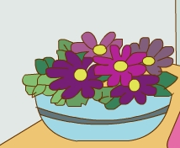
What can you see?
I can see a ….
Where is …?

Slide 12
使用说明
归纳梳理
（1）听光盘，完成英语书16页Ex.1。
（2）Let’s sing: a picture of me。
（3）梳理归纳如何介绍各房间。(幻灯片中4个窗户
都有链接，每间房子的右下放有返回按钮)
（4）小组操练英语书17页Ex.3。

Slide 13
A Picture of Me

Slide 14
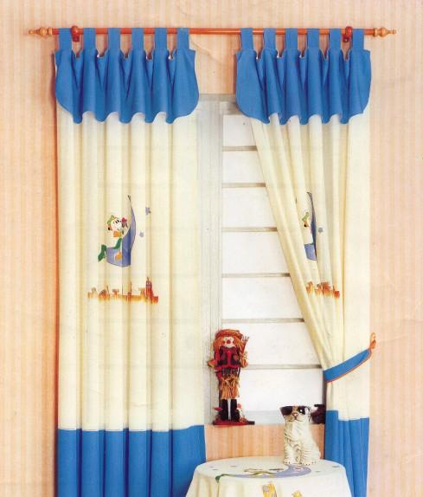
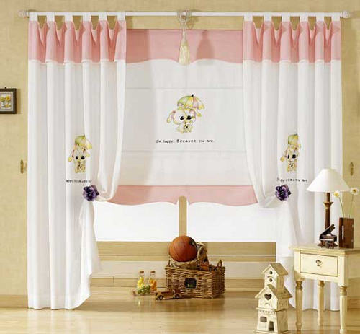
①
③
②
④

Slide 15
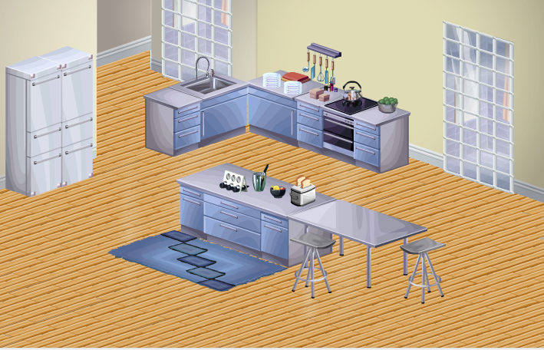
(1) Where is it?
(2) Is this … big/small/ …?
(3) What’s in/on/ … the …?
(4) Is/are there … in the …?
(5) How many … are there in the …?
(6) Where is/are the …?

Slide 16
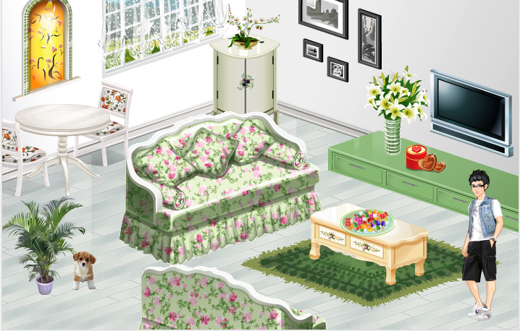
(1) Where is it?
(2) Is this … big/small/ …?
(3) What’s in/on/ … the …?
(4) Is/are there … in the …?
(5) How many … are there in the …?
(6) Where is/are the …?

Slide 17
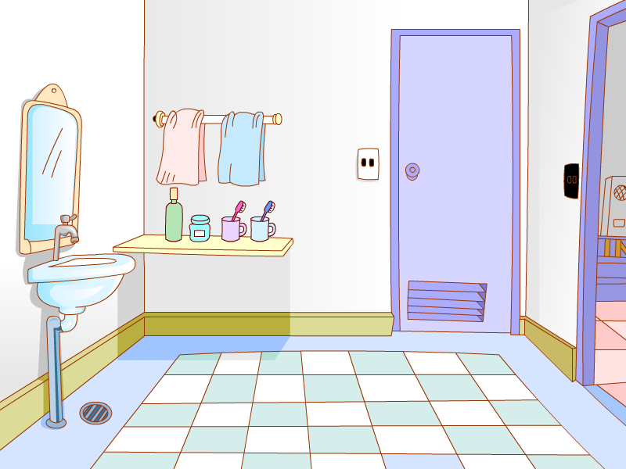
(1) Where is it?
(2) Is this … big/small/ …?
(3) What’s in/on/ … the …?
(4) Is/are there … in the …?
(5) How many … are there in the …?
(6) Where is/are the …?
sink
toilet

Slide 18
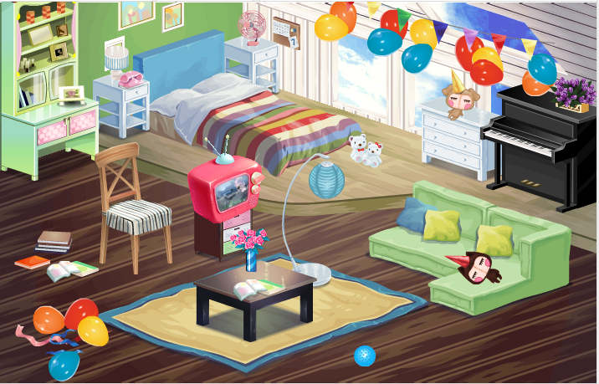
(1) Where is it?
(2) Is this … big/small/ …?
(3) What’s in/on/ … the …?
(4) Is/are there … in the …?
(5) How many … are there in the …?
(6) Where is/are the …?

Slide 19
使用说明
Homework
（1）读英语书17页Ex. 4的文章并完成填空。
（2）听光盘，学唱18页的歌曲。

