Slide 1
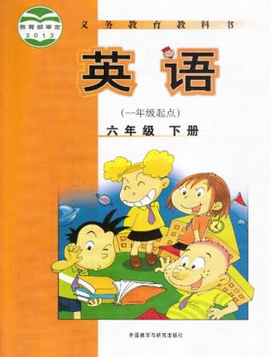
Module6 Unit 2
The name of the spaceship is Shenzhou.
WWW.PPT818.COM

Slide 2
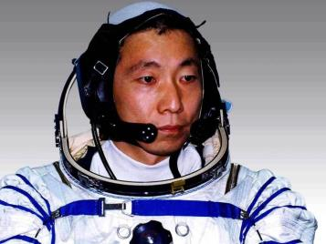
Who is he?
Yang Liwei

Slide 3
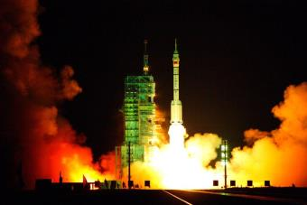
What’s its name?
Its name is Shenzhou.

Slide 4
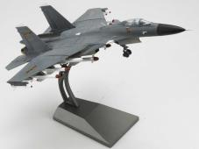
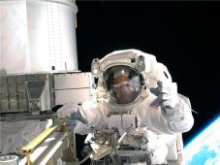
启发思考
Words about spaceship
national flag
model
taikonaut

Slide 5
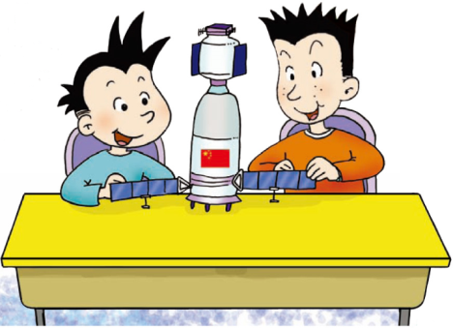
自主或小组探究
Do you like spaceships? Today, we are going to learn Chinese spaceship. The name of the spaceship is Shenzhou.

Slide 6
Ask and answer
1. What did Daming and Simon make?
Daming and Simon made a model of a Chinese spaceship.
2. What did Shenzhou V take into space for the first time?
It took a Chinese taikonaut into space for the first time.
3. When did Shenzhou V take Chinese taikonaut into space?
In 2003.
4. What else did Shenzhou take?
It took the national flag of China and some seeds, too.

Slide 7
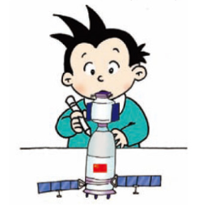
Look and write
What did they do yesterday?
Daming made a model of a Chinese spaceship.

Slide 8
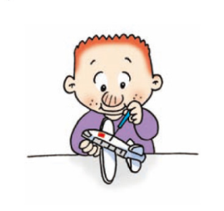
Sam made a model of a Chinese plane.

Slide 9
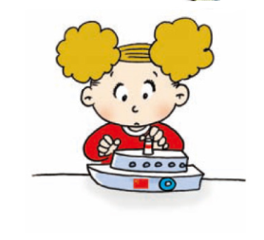
Amy made a model of a Chinese ship.

Slide 10
Do and guess

Slide 11
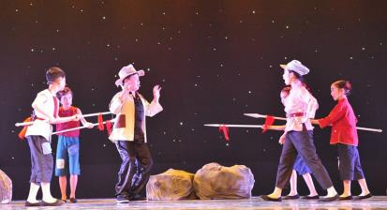
协作交流
Make up a play with dialogues according to the text and act out it!

Slide 12
Think of questions for a survey about birthday presents.

Slide 13
总结提高
重点句型：
I made a toy for you.
It took taikonaut into space.

Slide 14
Homework
1.完成 配套练习。
2.记诵本课出现的生词和句型。

