Slide 1
Unit4 Do you like candy?
人教精通版三年级下册
WWW.PPT818.COM

Slide 2
Review
Let’s chant

Slide 3
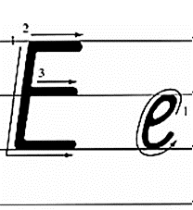
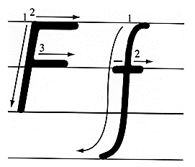
Presentation
Let’s learn

Slide 4
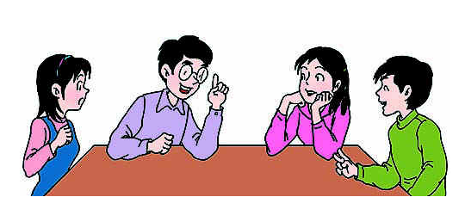
Presentation
Discussion
我们学过的哪些单词含有字母e或f呢？
ten eight nine one father four five……

Slide 5
Presentation
Let’s learn
egg
I like eggs.

Slide 6
Presentation
Let’s learn
coffee
I don’t like coffee.

Slide 7
Presentation
Let’s learn
fruit
I like fruit. What about you?

Slide 8
Practice
Game
大小声
egg coffee fruit

Slide 9
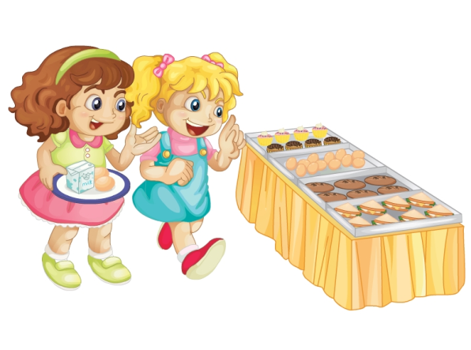
Presentation
Look and say
What are they talking about?

Slide 10
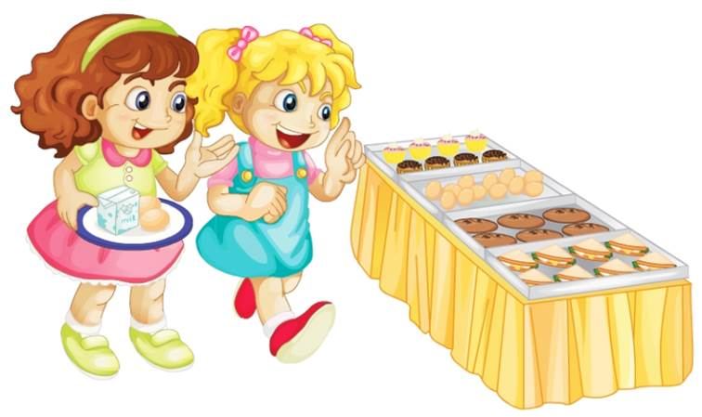
Presentation
Let’s learn
I like milk and eggs.
Me too. Do you like fruit?

Slide 11
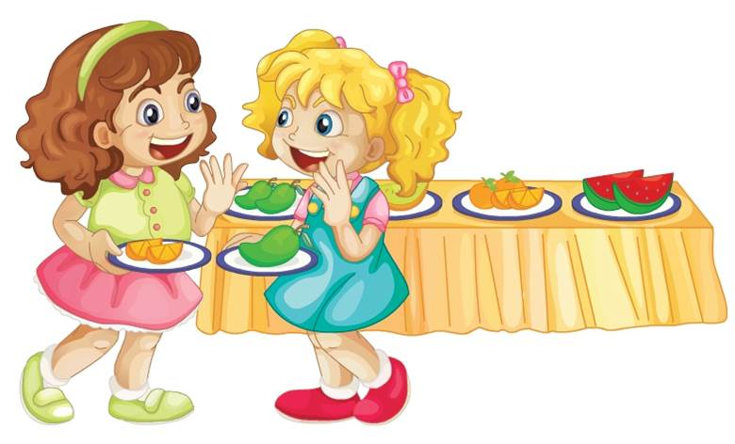
Presentation
Let’s learn
Yes, I do. I like oranges. What about you?
I like mangoes.

Slide 12
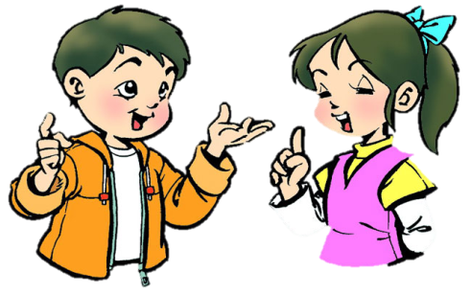
Practice
Role-play
分角色朗读对话，注意模仿语音语调。
两人一组，试着表演出来吧。

Slide 13
Practice
Look and say
egg
Do you like ________?
Yes, ______.
I do

Slide 14
Practice
Look and say
coffee
Do you like ________?
Yes, ______.
I do

Slide 15
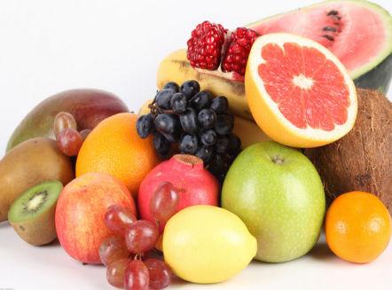
Practice
Look and say
fruit
Do you like ________?
Yes, ______.
I do

Slide 16
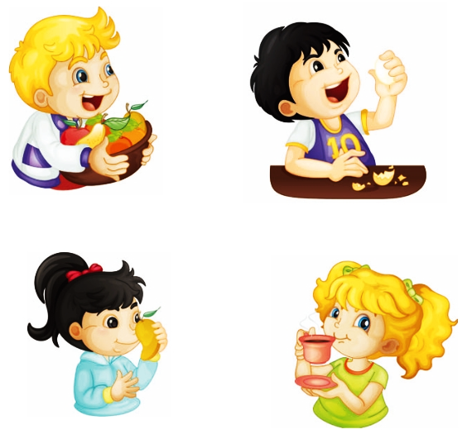
Practice
Let’s play
Show me your fruit.
Eat the egg.
Smell the mango.
Drink the coffee.

Slide 17
Summary
本课学到的重点单词：
egg coffee fruit
本课学到的重点句型：
—Do you like fruit?
—Yes, I do.

Slide 18
Homework
1. 跟读课文Just talk部分的录音，注意语音、语调。
2. 用本课所学句型“Do you like …?”来提问你的家人或朋友喜欢的东西。
3. 预习本单元Lesson 22的内容。
Close

