Slide 1
Unit 4
There are seven days
in a week.
WWW.PPT818.COM

Slide 2
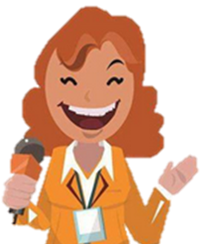
TV reporter

Slide 3
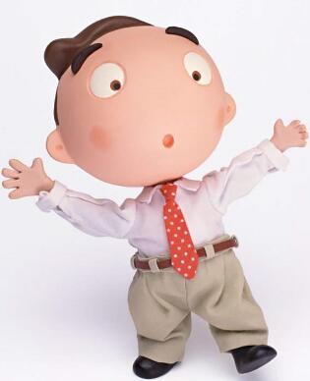
My name is Week.I have seven children.

Slide 4
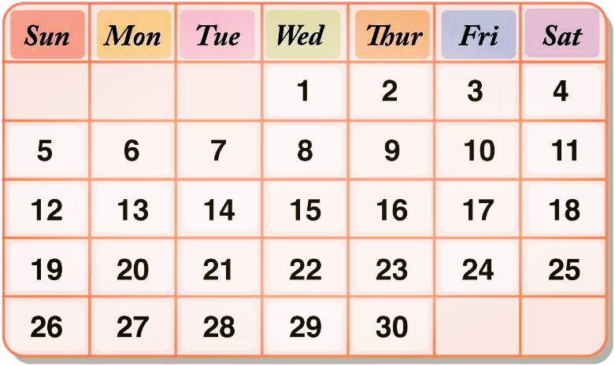
That makes a week.

Slide 5
What day is today?
Tuesday

Slide 6
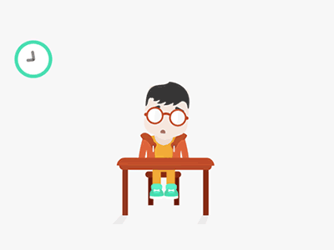
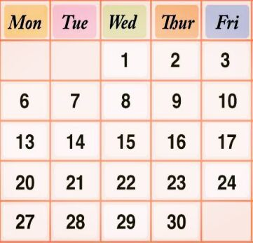
weekday
weekday
weekend

Slide 7
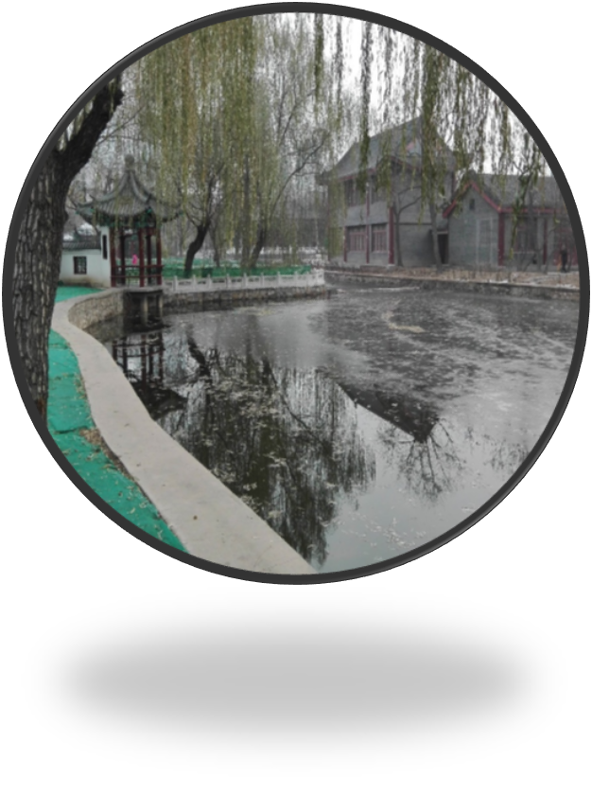
park
I go to the park.

Slide 8
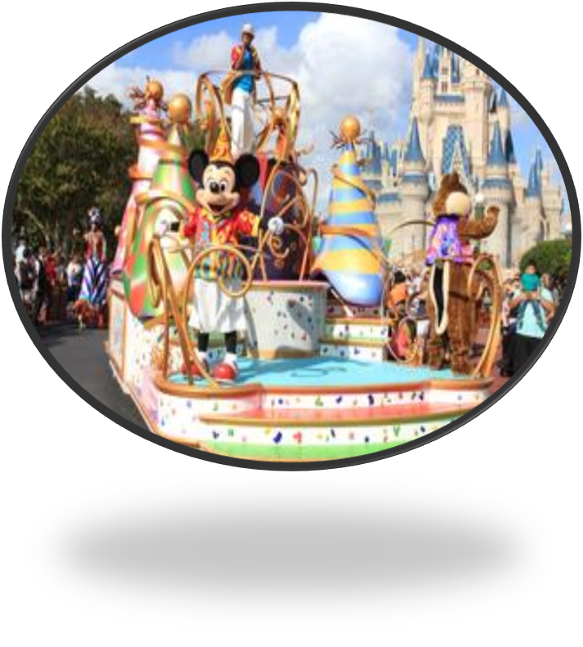
theme park
I go to the theme park.

Slide 9
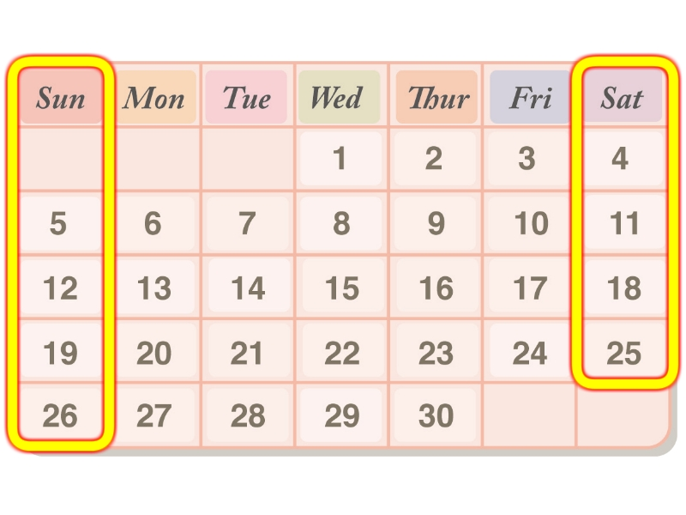
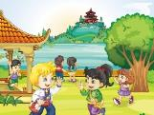
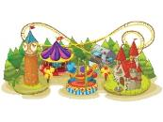
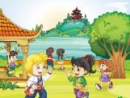

Slide 10
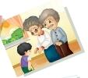

Slide 11
TV reporter

Slide 12
Tips
What day is today? It’s…
How many …do you have? I/ We have …
There are/is…
What do you usually do on weekends?
I/we usually…
Do you….?
Yes/No, I/we…
Shall we…? Ok, let’s go.

Slide 13
TV Show

Slide 14
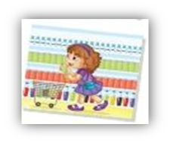
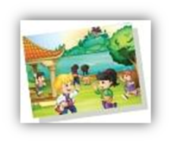
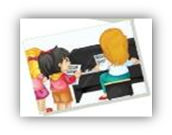
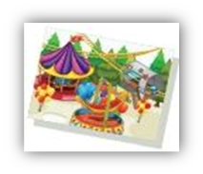
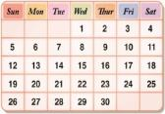
What do you usually do on weekends?
1.I usually _______________on Saturdays.
2.I usually _______________on Saturdays.
3.I usually _______________on Sundays.
4.I usually _______________on Sundays.
5.I usually go to see my grandpa and
grandma on_______.
Enjoy your weekend life!

Slide 15
What do you usually do on weekends?
1.I usually _______________on Saturdays.
2. I usually _______________on Saturdays.
3. I usually _______________on Sundays.
4. I usually _______________on Sundays.
5. I usually go to see my grandpa and
grandma ____________.
go shopping
go to the park
have music lessons
go to the theme park
on weekends
Enjoy your weekend life!

