Slide 1
冀教版八年级下
Lesson 41
A class of the world
WWW.PPT818.COM

Slide 2
Learning Aims
1.Be able to read and know about the famous places in the lesson.
2.Understand the text and learn more about countries in the lesson.
3.Learn to describe a place (a country or a city) you know best in English .

Slide 3
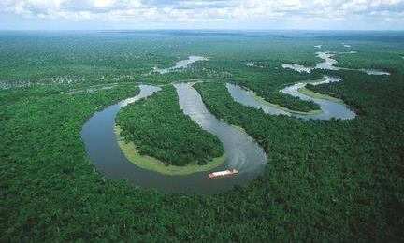
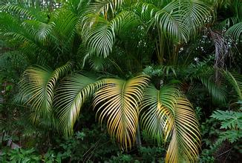
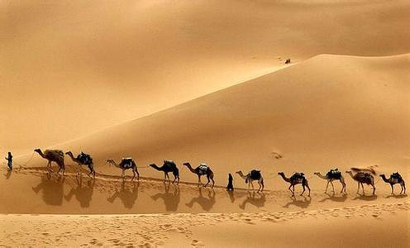
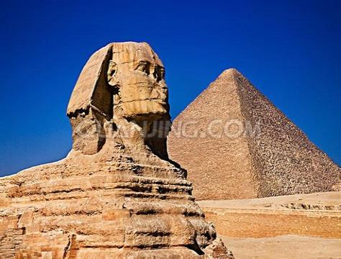
Amazon River
rainforest
Sahara Desert
Pyramid

Slide 4
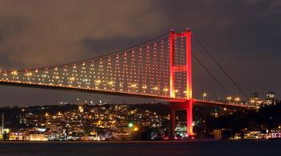
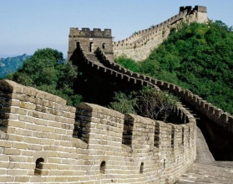
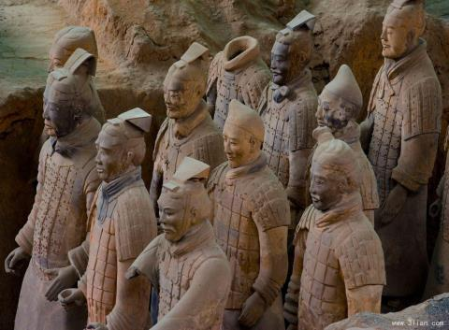
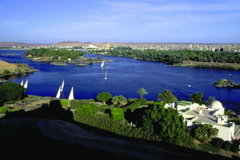
Bosphorous Bridge
The Great Wall
The Terra Cotta Warriors
The Nile

Slide 5
Fun knowledge quiz
(趣味知识问答)

Slide 6
1.What is the longest river in the world ?
The Nile
2.What is the second longest river in the world ?
Amazon River
3.Which bridge connects Europe and Asia ?
The Bosphorous Bridge
PPT模板：www.1ppt.com/moban/ PPT素材：www.1ppt.com/sucai/
PPT背景：www.1ppt.com/beijing/ PPT图表：www.1ppt.com/tubiao/
PPT下载：www.1ppt.com/xiazai/ PPT教程： www.1ppt.com/powerpoint/
资料下载：www.1ppt.com/ziliao/ 范文下载：www.1ppt.com/fanwen/
试卷下载：www.1ppt.com/shiti/ 教案下载：www.1ppt.com/jiaoan/
PPT论坛：www.1ppt.cn PPT课件：www.1ppt.com/kejian/
语文课件：www.1ppt.com/kejian/yuwen/ 数学课件：www.1ppt.com/kejian/shuxue/
英语课件：www.1ppt.com/kejian/yingyu/ 美术课件：www.1ppt.com/kejian/meishu/
科学课件：www.1ppt.com/kejian/kexue/ 物理课件：www.1ppt.com/kejian/wuli/
化学课件：www.1ppt.com/kejian/huaxue/ 生物课件：www.1ppt.com/kejian/shengwu/
地理课件：www.1ppt.com/kejian/dili/ 历史课件：www.1ppt.com/kejian/lishi/
4.What is the biggest desert in the world ?
The Sahara Desert
5.It is in ShanXi province in China , it is one of eight wonders (奇迹) in the
world ,what is it ?
The Terra Cotta Worriors

Slide 7
6.What is the capital city of Egypt ?
Cairo
7.They were built in ancient Egypt , and Egypt is famous for them , what were they ?
the Pyramids

Slide 8
Listen to the text and pay attention to the pronunciation of every placename
and underline them

Slide 9
Scan(浏览)the whole lesson and tick the correct answers :
1.Where does Ahmed come from ?
A.Brazil B.Turkey C.Egypt
2.Where is the Amazon?
A.In Brazil B.In Turkey C.In Egypt
3.What connects Europe and Asia ?
A.The Amazon B.The Bosphorous Bridge
C.The Nile
4.What can you do in the Sahara Desert ?
A.Walk in the markets B.Ride a camel
C. Take a boat tour

Slide 10
Detail -- reading

Slide 11
Read the first paragraph by yourselves aloud and tell us some features about Brazil .
1.Brazil is the largest country in South America .
2.It has a huge river called the Amazon and a rainforest with more trees .
3.The people are known for our their fun dances and colourful culture .(Translate)

Slide 12
Read paragraph 2 in pairs and fill in the blanks :
Akia came from ________ , and Turkey is her ________ _________ .Turkey is in both ________ and __________ . The Bosphorous Bridge _________ Europe and Asia .
Turkey
home country
Europe Asia
connects

Slide 13
Read paragraph 3 in groups and answer the questions:
1.What interesting places are there in Egypt ?
2.What can you see and do except Pyramids in Egypt ?
the Pyramids , the Nile , the Sahara Desert , the ancient markets in Cairo .
relax on a boat tour of the Nile , ride a camel in the Sahara Desert or walk in the ancient markets in Cairo .

Slide 14
Read paragraph 4 together and introduce our home country --- China .
Can you recite (背诵) this paragraph within 2 minutes ？
Who is the quickest ?
Who is the best ?

Slide 15
Do you have any questions about this lesson ?

Slide 16
Understand the following sentences and tell us the usage of “pride and proud ”
More students talk about their countries with pride . All of them are proud of their home countries .
即时练习：
1.Yang LiWei is the _____ of Chinese people.
2.That lady took great _____ in her sons .
3.Brian is ______ of his record .
4.Danny says ______ , “he won the first place .”
pride
pride
proud
proudly

Slide 17
Write a passage about a place (a city or a country ) you know best in groups ,and then share it with your classmates .
Task tips :
Where is it ?
How big is it ?
What’s the population ?
What is it famous for ?

Slide 18
Thanks for your attention!

