Slide 1
Unit 1 Li Ming Goes to Canada
Lesson 2 Jenny’s House
WWW.PPT818.COM

Slide 2
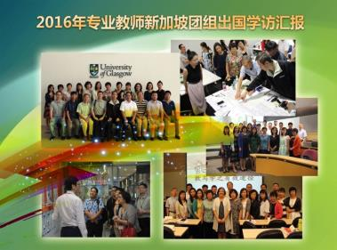
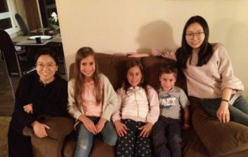
Warming up
1.Let’s watch a video.
2.Free talk

Slide 3
Presentation
the foreigners’ houses
Do you want to know the English names of those room?

Slide 4
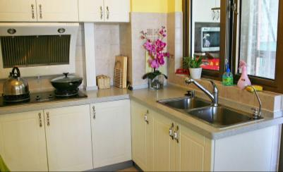
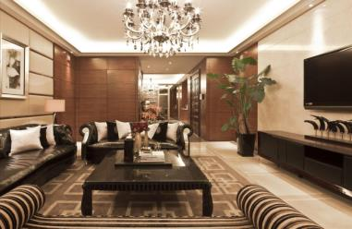
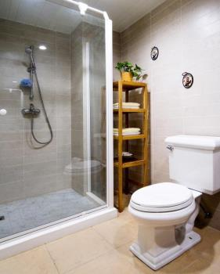
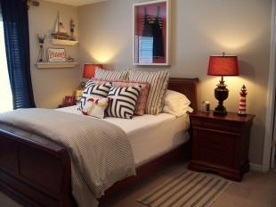
Presentation
Do you want to know the English name of those rooms?

Slide 5
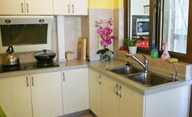
Presentation
kitchen
bedroom
study
living room
bathroom

Slide 6
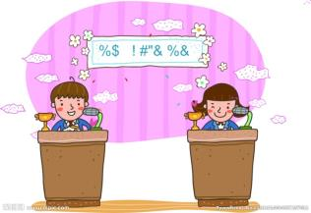
Presentation
1.一口气读单词比赛
2.单词“爆炸”游戏

Slide 7
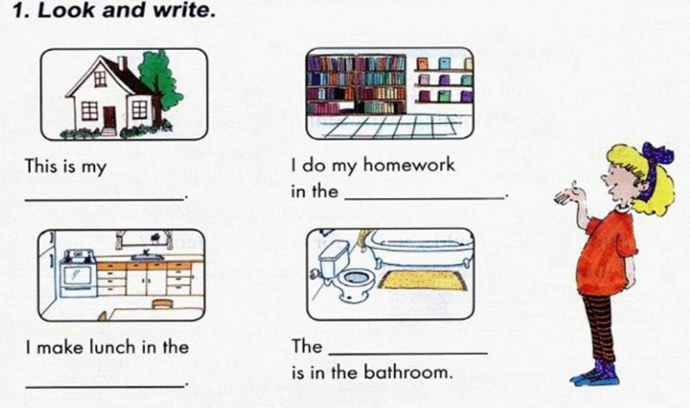
Presentation
house
study
toilet
kitchen

Slide 8
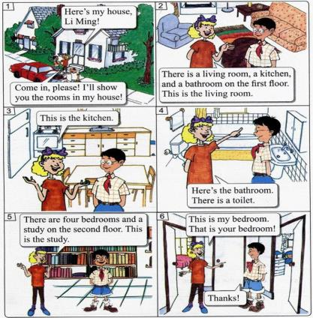
Presentation
How many floors are there in Jenny’s house?
Which rooms are there in Jenny’s house?
Two floors.
Nine rooms.

Slide 9
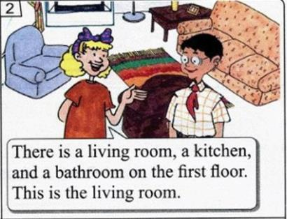
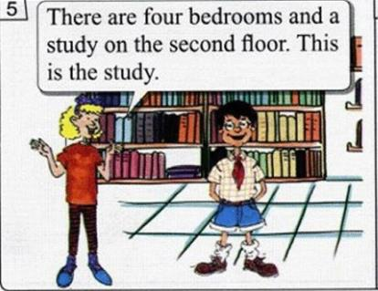
Presentation
There be句型
There is a living room in Jenny’s house.
There are four bedrooms in Jenny’s house.

Slide 10
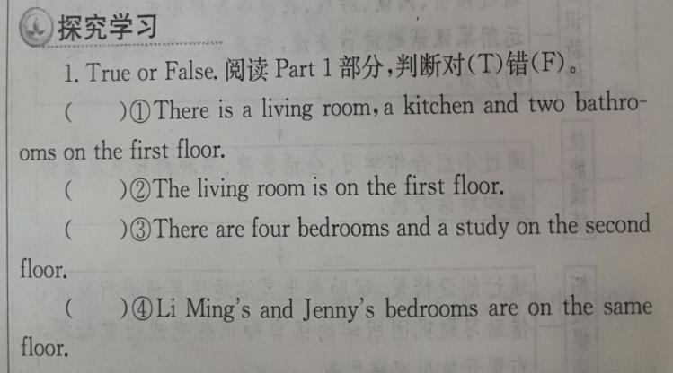
Presentation
F
T
T
T

Slide 11
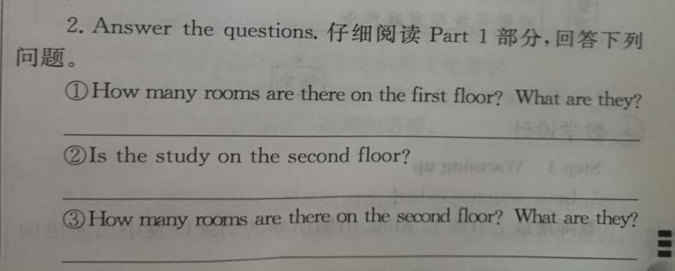
Practice
Three.
Yes, it is.
Five. They are four bedrooms and a study.
A toilet.
Yes, they are.

Slide 12
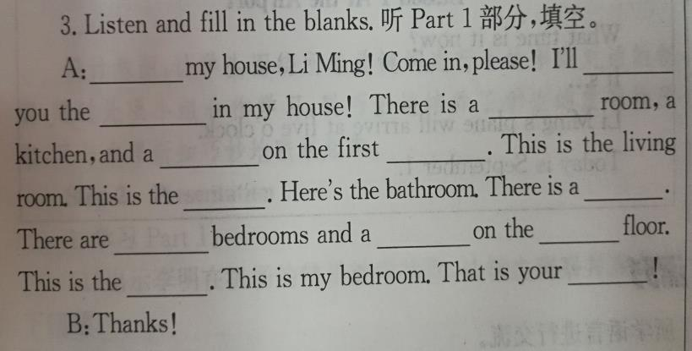
Practice
show
Here’s
living
rooms
bathroom
floor
toilet
kitchen
study
second
four
bedroom
study

Slide 13
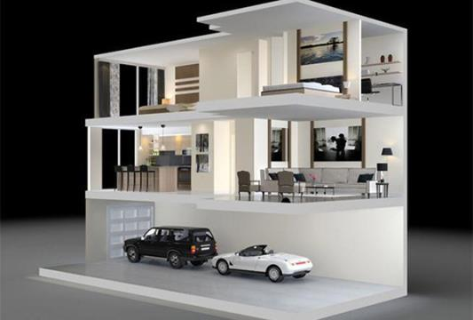
Consolidation
This is our home.
There are…rooms.
There is a…
There are…

Slide 14
Summing up
1.Words:
living room, kitchen, bathroom, toilet
bedroom, study
2.Sentences:
There is a…on the first floor.
This is…
3.
这节课我的收获是：_____________
这节课我的不足是：_____________

Slide 15
Homework
1.听录音，朗读本课的第一部分
2.完成相关习题
3.画一张你家的平面图，并对它进行描述

