Slide 1
九年级英语上 新课标 [冀教]
Unit 6 Movies and Theatre
Theatres Are Fun!
WWW.PPT818.COM

Slide 2
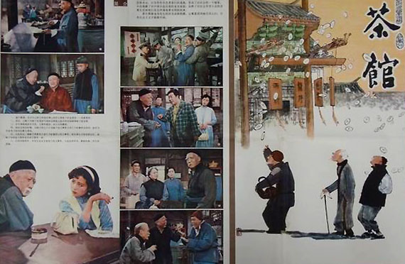

Slide 3
Think About It !
Can you name some famous playwrights? Who are they?
What kinds of plays do you like? Why?

Slide 4
New Words
handsome
teahouse
playwright
actress
tragedy

Slide 5
Read the lesson and write true(T)or false(F).
(1)William Shakespeare is a world-famous playwright.
(2)Shakespeare’s works are all comedies and historical pieces.
(3)Hamlet is a famous comedy.
(4)Teahouse was written by Lao She.
(5)Cao Yu wrote the play Thunderstorm.
(6)In Lao She Teahouse Theatre,you can drink tea while enjoying a play.
T
F
F
T
T
T

Slide 6
Match each play with its playwright.You can search the Internet for help.
Romeo and Juliet
Hamlet
Sunrise
Longxu Slum
Teahouse
Thunderstorm
Camel Xiangzi
Cao Yu
LaoShe
Shakespeare

Slide 7
Read the text and find out main phrases and sentences.
Main phrases:
·on one’s way home
·perform a play
·can’t wait to do
·in order to
·look like
·be on stage
·one day

Slide 8
Main sentences:
·Guess what?
·I played the poor but handsome fisherman,and Jenny was the fisherman’s wife.
·We learned about some good plays and famous playwrights!
·Yes,many famous works in English were written by him.
·Actually,his early plays were mainly comedies and historical pieces.

Slide 9
·They are well known around the world.
·We have some excellent playwrights and famous plays in China.
·Cao Yu’s Thunderstorm and Lao She’s Teahouse have been on stage for many years—and still are today.
·I would love to go to the teahouse one day.
·But we do have a Lao She Teahouse in Beijing.

Slide 10
☆教材解读☆
1.Guess what?
what在本句中表示“不清楚的人或事物”,请求确认或重复。
2.I saw a big poster for the new Kung Fu Dinosaur movie on my way home.
on one’s way to…意为“在某人去……的路上”,如果to后跟的是副词,则要把to省略。on my way home意为“在我回家的路上”。
3.Kung Fu Dinosaur really looks like Danny.
look like意为“看起来像”,强调外表。此处like为介词,意为“像,如……一样”,后面跟名词或动名词形式。

Slide 11
4.We performed a play in class.
perform a play中play为名词,意为“话剧,剧”,perform为及物动词,意为“表演,扮演,执行”,后接名词或代词作宾语。
5.I played the poor but handsome fisherman,and Jenny was the fisherman’s wife.
play the poor but handsome fisherman中play为动词,意为“扮演”。
6.I can’t wait to see them.
can’t wait to do sth.意为“迫不及待去做某事”。

Slide 12
7.Some research was done in order to make the play.
in order to意为“为了……”,表示目的,在用法和意义上相当于so as to结构,但是in order to可以用于句首、句中,而so as to多用于句中。两者的否定式分别为:in order not to和so as not to。
【拓展】 in order to和so as to在句中表示目的时,常可以转化为in order that或so that引导的目的状语从句。
8.We learned about some good plays and famous playwrights!
playwright为可数名词,意为“剧作家”,指主要进行剧本创作的人,而writer为可数名词,意为“作家”,指进行文学作品创作的作家。

Slide 13
9.Yes,many famous works in English were written by him.
◆many famous works意为“许多名著”,其中work为可数名词,表示“著作”。
◆be written by …意为“由……写,被……写”。
10.Actually,his early plays were mainly comedies and historical pieces.
◆mainly为副词,意为“主要地,大体上”,由形容词main加后缀-ly构成。
◆historical为形容词,意为“历史的”,在句中常作定语。而history为名词,意为“历史”,在句中作主语、宾语或表语。

Slide 14
11.They are well known around the world.
be well known around the world意为“举世闻名”,known是know的过去分词形式。
12.We have some excellent playwrights and famous plays in China.
本句是表达“某处有……”的句型之一,与there be,there lie/stand等句型作用相同。

Slide 15
13.I would love to go to the teahouse one day.
one day意为“有一天”,可用于将来时态或过去时态。
14.But we do have a Lao She Teahouse in Beijing.
do在本句中用作助动词,起强调谓语的作用。主语是单数第三人称时,用does;句子是一般过去时态时,用did。

Slide 16
Practice
Ⅰ.根据汉语提示完成句子
1.Look!The students are (表演)a new play.
2.This is a (历史的)play.Do you like it?
3.She was nervous when she stood on the (舞台).
4.What a (英俊的)boy he is!
5.We can watch (戏剧)in this theatre.
performing
historical
stage
handsome
plays

Slide 17
Ⅱ.用所给词的适当形式填空
1.This novel is (write)by Mo Yan.
2.We would love (see)that play.What about you?
3.She enjoys (watch)plays on TV.
4.They hope (visit)that old teahouse soon.
5.That writer is writing a (history)novel.
written
to see
watching
to visit
historical

Slide 18
Ⅲ.根据汉语意思完成句子
1.李明刚才迫不及待地打开了礼物。
Li Ming the gift just now.
2.为了赶上他们,我们正在努力工作。
up with them,we are working hard.
3.这部电影上映一周的时间了。
This film for a week.
4.李明和丹尼同时到了影院。
Li Ming and Danny arrived at the
cinema .
5.我喜欢读莫言写的书。
I like reading books Mo Yan.
couldn’t wait to open
In order to keep
has been on
at the same time
written by

Slide 19
Homework
1.Complete Let’s Do It!No. 3.
2.Finish off the exercises in the activity book.
3.Preview Lesson 36.

