Slide 1
Unit5 Family and Home
Lesson 26 Li Ming’s Family
WWW.PPT818.COM

Slide 2

教材原文
1 Li Ming’s family tree
This is my family tree.We live in China.I have two grandmothers and two grandfathers. ^{①}I have no brothers or sisters.My parents have one son, me!My uncle and aunt have one daughter，Li Jing.She is very young.I love my family.

Slide 3
2 Father and Mother, I love you.
I have a great dad.He is tall and strong.He has many friends.What does my father do?He is a businessman. ^{②}I can talk to him about everything. ^{③}On weekends, we play football together.
I love my mum. ^{④}I am close to her.She is a doctor and she is very kind.She is always ready to help others.
I am a student. ^{⑤}I work hard at school.I love my family.We always have fun together.
Family→Father and Mother, I love you.

Slide 4
Let’s Do It!
1 Search for family words and write them down.
brother
(答案不唯一)grandmother; sister; aunt; mother; grandfather; father; son; cousin; uncle; daughter

Slide 5
2 Read Part 1 of the lesson and answer the questions.
1.Does Li Ming’s mother have any brothers or sisters?
2.Does Li Ming’s father have any brothers or sisters?
3.How many aunts and uncles does Li Ming have?
4.How many cousins does Li Ming have?
1.No, she doesn’t have any brothers or sisters.
2.Yes. He has a brother.
3.Li Ming has one aunt and one uncle.
4.Li Ming has one cousin. She is Li Jing.

Slide 6
3 Read Part 2 of the lesson and fill in the blanks.
Li Ming’s father is ________ and ________ .He is a ________________ .Li Ming can talk to his father about everything.On ________ , they play football ________. Li Ming is ________ to his mother.She is a ________ .She is very ________. She is always ready to help ________.
tall
strong
businessman
weekends
together
close
doctor
kind
others

Slide 7
4 Work in groups.Draw and label your own family tree.Then talk about it.
Task tips:Who is the family member?What is his/her name?Is he/she young or old, tall or short? What colour is his/her hair or eyes? What does he/she do?
My Family Tree

Slide 8

01I have no brothers or sisters.我没有兄弟姐妹。(教材P68)
【析句式】 I have no brothers or sisters.

Slide 9

no的用法
本句中，no在此处充当形容词，意为“没有”，常位于可数名词单数前，相当于not a(n)。no放在不可数名词或可数名词复数前，相当于not any。
I have no pen.=I don’t have a pen. 我没有钢笔。
The old man has no teeth.=The old man doesn’t have any teeth.
那个老人没有牙齿。
＊
＊

Slide 10

or的用法
此句是个否定句，否定句中并列的两个成分用or连接。
【易混辨析】 or和and
or | 用于疑问句中, 意为“或者”；用于否定句中, 意为“和” | Is your friend tall or short? 你的朋友高还是矮？
and | 作连词，意为“和”，一般用于肯定句中 | My uncle and aunt are both teachers. 我的叔叔和婶婶都是老师。

Slide 11
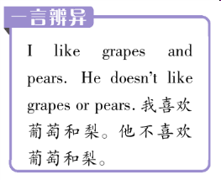
【注意】 ①连接三个或三个以上的
并列成分时，只在最后两个并列成
分之间用and或or。
I have a brother, a sister and two cousins.
我有一个弟弟、一个妹妹和两个堂兄。
②在否定句中如果所连接的两个词前都有否定词, 则用and。
Tom has no sisters and no brothers. 汤姆没有兄弟姐妹。
＊
＊

Slide 12

(2016·湖南湘西中考，3)Tina doesn’t like meat___ eggs. She’s afraid to be heavy.
A.orB.andC.but
【解析】or用于否定句中连接并列成分，表示“和，与”之意；and也表示“和，与”，用于肯定句；but意为“但是”，表转折。本句为否定句，故选A。
【答案】A

Slide 13

02I can talk to him about everything.我可以和他谈论所有的事情。(教材P68)
【析句式】 I can talk to him about everything
talk的用法
talk作不及物动词，意为“谈话；交谈”。
状语.

Slide 14

03On weekends,we play football together.(在)周末，我们一起踢足球。(教材P68)
on weekends的用法
weekend为可数名词，意为“周末”。on weekends为固定搭配，意为“在周末”。其同义表达
还有on/at the weekend。
I never work at the weekend.
=I never work on the weekend.
=I never work on weekends.
周末我从不工作。
＊

Slide 15
play的用法
play football是动词短语, 意为“踢足球”。play后跟某种球类运动时，球类名词前面不加任何冠词，即“play+球类名词”。
The boys like to play basketball. 男孩们喜欢打篮球。
【拓展】 play与西洋乐器类名词连用时，西洋乐器类名词前要加定冠词the，即“play+the+西洋乐器类名词”。
Jenny is playing the piano.
詹妮正在弹钢琴。
＊
＊

Slide 16
(2016·江苏盐城中考，1)I think playing football is a good way to learn the spirit of teamwork.
A.aB.anC.theD./
【解析】句意：我认为踢足球是学习团队精神的一个好途径。play后跟球类名词时，球类名词前不加任何冠词。故选D。
【答案】D

Slide 17
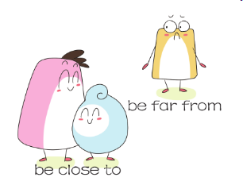
04I am close to her.我和她很亲近。(教材P68)
be close to的用法

Slide 18
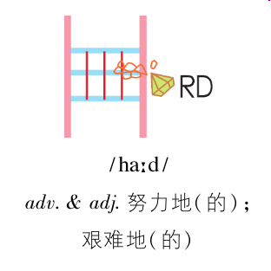
05I work hard at school.我在学校努力学习。(教材P68)
hard的用法
＊
This work is hard.这项工作是困难的。
It often rains hard in summer. 夏天经常下大雨。
＊

