Slide 1
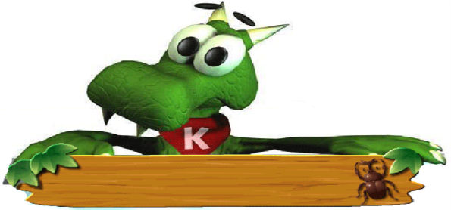
Lesson 36
Classroom Olympics
WWW.PPT818.COM

Slide 2
Words & expressions
rope
sit-up
push-up
race
result
none
twentieth
n. 绳
n. 仰卧起坐
n. 俯卧撑
n. 赛跑；速度竞赛
n. 结果；成绩
pron. 一个也没有；毫无
num. & adj. 第二十(的)

Slide 3
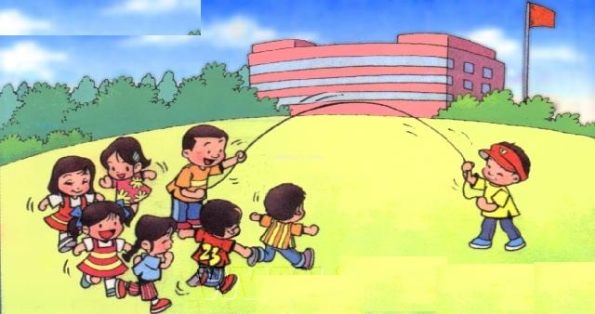
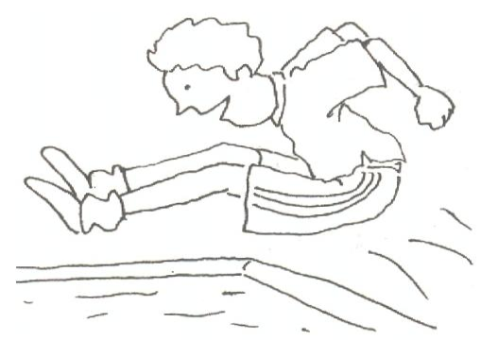
jump rope
long jump

Slide 4
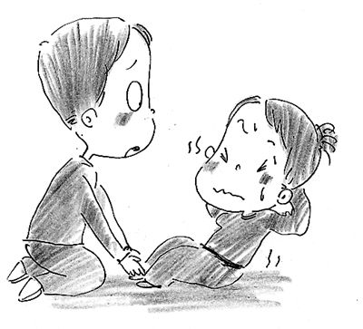
sit-ups
push-ups

Slide 5
Think about it!
1. Would you like to hold a classroom Olympics?
2. What events would your classroom Olympics have?

Slide 6
Objectives
To understand the letter.
2. To learn some useful words and expressions about classroom Olympics.

Slide 7
Words:
rope sit-up push-up race
result none twentieth
Expressions:
one by one fall off

Slide 8
Read the lesson and answer the questions.
How many events did Jenny’s
classmates invent for the classroom
Olympics? What are they?
Five. They are jump rope, long jump, sit-
ups, push-ups and “Jump over the
Dinosaur”.
2. What things did they need to prepare
for Danny’s event?
Some paper pizzas, a cardboard donut
and a toy dinosaur.

Slide 9
3. Who was the champion of the “Jump
over the Dinosaur” event?
Danny.
4. How did Brian feel? Why?
He felt sad. Because he lost.
5. What did Jenny think of the events?
She thought the events were fun.

Slide 10
Language Points

Slide 11
None of us could catch him! But I was close.
没有人能追上他!但是我很接近了。
none可以作代词、副词，意思是“(三个以
上之中)没有任何(人、物)，无一人；丝毫
没有……”。常用结构为：none of +可数
名词复数/不可数名词。
None of the students could answer this question.
没有一个学生会回答这个问题。

Slide 12
None of us have/has ever been abroad.
我们之中没有人曾到过国外。
He did none of his task.
他的工作一点都没干。
None of the money was paid to me.
一分钱也没有付给我。
None of the books is/are new.
没有一本书是新的。

Slide 13
2. He came in twentieth.
他得了第二十名。
in twentieth意思是“……第20名”，相当于
in the twentieth place.
I was in twentieth in this maths test.
我在这次数学考试中得了第二十名。

Slide 14
3. He did his best, but he kept falling off
the pizzas!
他尽了最大努力，但还是不断地从披萨上
掉下来。
keep (on) doing 继续做某事；重复做某事
He kept crying.
他一直在哭。

Slide 15
Keep going until you reach a cinema.
继续走直到你到达一个电影院。
keep sb. from doing sth.
意思是“阻止某人做某事”，其中的from不
能省略。
The bells kept me from sleeping.
钟声吵得我睡不着觉。

Slide 16
fall off 减少；跌落；下降；衰退
Beware of objects that can fall off shelves.
小心可能从架子上掉下来的物品。
If you fall off your horse, you get back on.
你从马上摔下来，你再骑上去就可以了。
Attendance at my lectures has fallen off
considerably .
听我讲课的人已大大减少了。

Slide 17
Time for Reflection
one by one
fall off
keep on doing sth.
keep sb. from doing sth
一个接一个
减少；下降
继续做某事
阻止某人做某事

Slide 18
Fill in the blanks with the words in the box.
none result rope event
A/An ________is a race or a competition.
A/An _______ is a very thick strong string.
The accident was a/an _______of bad driving.
He went to many bookstores, but _______ of them had the book he wanted.
event
rope
result
none

Slide 19
Translate the following sentences.
1. 主赛项目下午1点开始。
The main events start at 1 p.m.
2. 他们一个接一个地发现我醒了, 活过来了。
One by one, they noticed me awake and alive.
3. 不管工作有多难, 他总会坚持不懈地把它干完。
No matter how difficult the work was, he
would keep on doing it until he
accomplished it.

Slide 20
4. 很快他在赛跑中落在了后面。
Soon he fell behind in the race.
5. 就像我讲的，没有人是完美无缺的。
As I say, none of us is perfect.
6. 我不接受这个结果，它是假的。
I do not accept this result. It is false.
7. 秋天，树叶纷纷从树上掉下来。
Leaves fall off the trees in the autumn.

Slide 21
Homework
My Classroom Olympics: Write a letter to a friend telling them about your classroom Olympics. Consider the following:
1. What events were there?
2. Did you win any events?
3. What events did your friends win?
4. Did anyone set any class records?
5. Did you have fun? Why or why not?

Slide 22
Preview
Learn the words and expressions in Lesson 37.
2. Underline the sentences you don’t understand on page 98.

