Slide 1
Unit 4 Christmas
Lesson 23 It’s Christmas Morning!
WWW.PPT818.COM

Slide 2
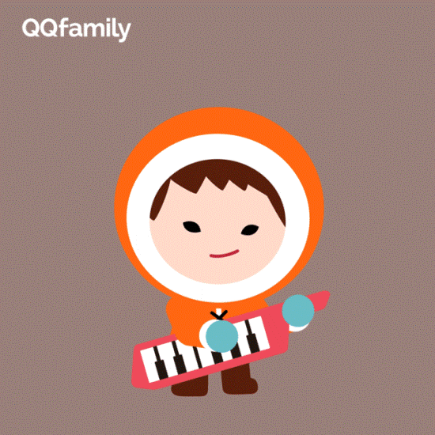
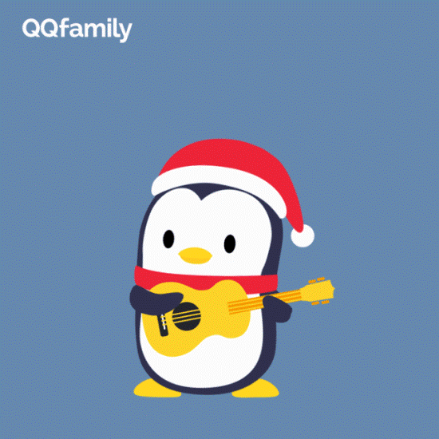
Warming up
1.Let’s sing a song
Dashing through the snow In a one-horse open sleigh o’er the fields we go laughing all the way bells on bob-tail ring making spirits bright Oh what fun it is to ride and one-horse open sleigh jingle bells, jingle bells jingle all the way oh what fun it is to ride in a one-horse open sleigh Hey jingle bells, jingle bells jingle all the way oh what fun it is to ride in a one-horse open sleigh

Slide 3
Warming up
2.Free talk
Today is December 25.
It’s Christmas morning!
Merry Christmas!

Slide 4
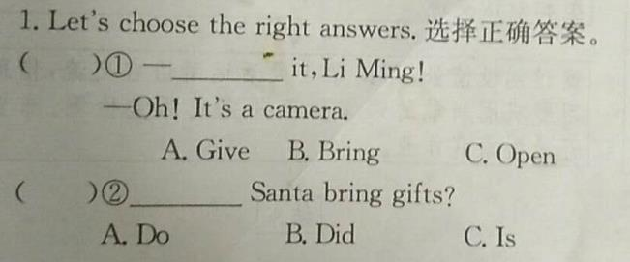
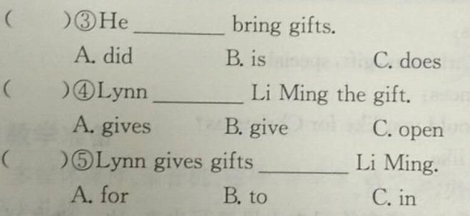
Presentation
完成习题
A
B
A
A
B

Slide 5
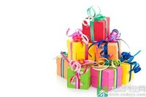
Presentation
I’m going to give you a special gift from China for your Christmas tree.
Open it!

Slide 6
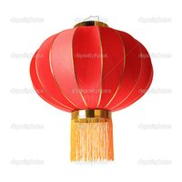
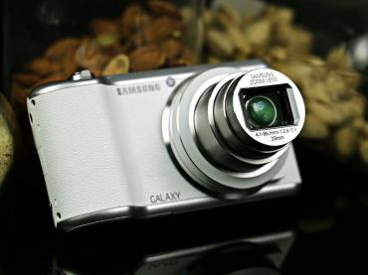
Presentation
lantern
It’s a Christmas lantern.
camera
It’s a camera.

Slide 7
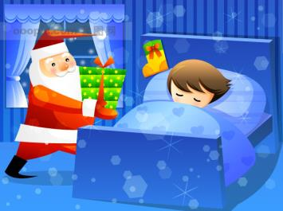
Presentation
Who brought me these gifts?
Santa did bring gifts.
bring (sb.) sth.带给某人某物

Slide 8
Presentation
花样百出：bring 在过去时中的各种用法
强调句：He did bring gifts!
一般疑问句中：Did Santa bring them?
陈述句中：She thinks Santa brought them.
难点：Did Santa bring them?

Slide 9
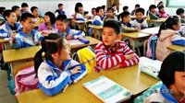
Presentation
复习巩固give: give sb. sth. = give sth. to sb.
例如：Lynn gives Li Ming gifts.=Lynn gives gifts to Li Ming.

Slide 10
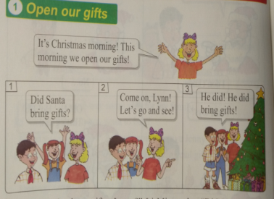
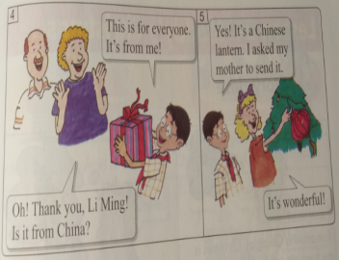
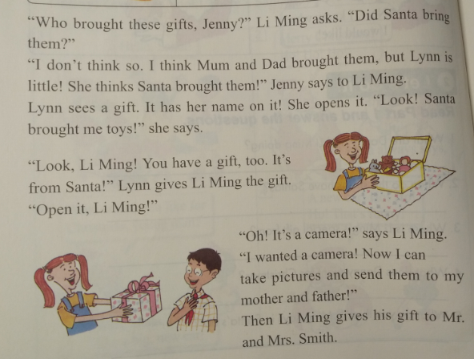
Presentation
Open our gifts

Slide 11
Presentation
Read Part 1. Then tick or cross.
①People open gifts on Christmas morning. ( )
②Jenny thinks her mum and dad brought the gifts. ( )
③Lynn thinks the gifts are from Santa. ( )
④Li Ming gets a camera for Christmas. ( )
⑤Li Ming’s gift is for Mr. and Mrs. Smith. ( )
⑥Santa wrote the names on the gifts. ( )
√
√
√
√
√
×

Slide 12
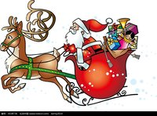
Practice
Let’s listen, say and share.
说出你听到的句子或单词，并尽可能地做出相应的讲解，与同学分享
1_______________________
2_______________________
3_______________________
4_______________________

Slide 13
Consolidation
Listen and repeat.

Slide 14
Summing up
1.Words:
bring, give, open, little, camera, lantern
2. Sentences:
Did Santa bring gifts?
He did bring gifts.
Open it.
bring(sb.) sth.
give sb. sth. = give sth. to sb.
3.
这节课我的收获是：_____________
这节课我的不足是：_____________

Slide 15
Homework
1.听录音，朗读本课的第一部分
2.完成相关习题
3.利用课余时间采访调查家人、朋友们圣诞节想要什么礼物，下节课在班里做报告，与大家分享，大家评出“最佳小记者”。

