Slide 1
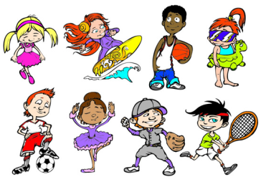
Unit4 What Do You Do on Saturday?
陕旅版
四年级下册
第二课时
WWW.PPT818.COM

Slide 2
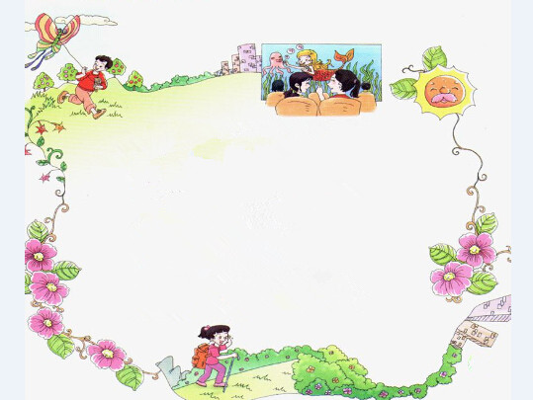
>>Warm-up
Let’s chant
Pair work
What do you do, what do you do,
What do you do on Saturdays?
I fly, fly my kite.
What do you do, what do you do,
What do you do on Sundays?
I see, see, see films.
What do you do on the weekend?
I climb, climb, climb mountains.

Slide 3
>>Review
Play a game
play
football
fly a kite
do exercise
see a film
What’s missing?
do some
washing
climb the
mountain
do his
homework

Slide 4
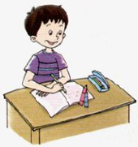
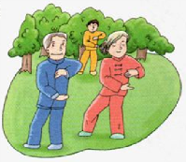
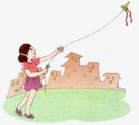
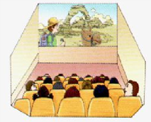
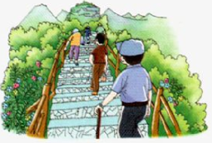
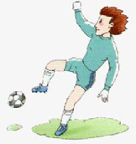
>>Review
I say you do
do his homework
do exercise
fly a kite
see a film
climb the mountain
play football

Slide 5
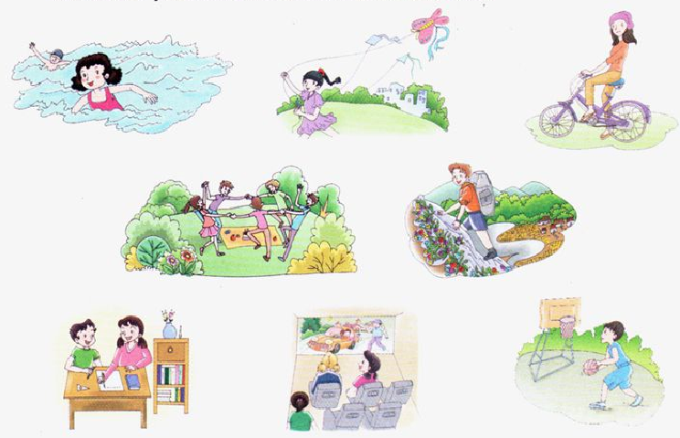
>>Lead-in
Think and circle
What do you often do on the weekend?

Slide 6
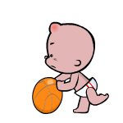
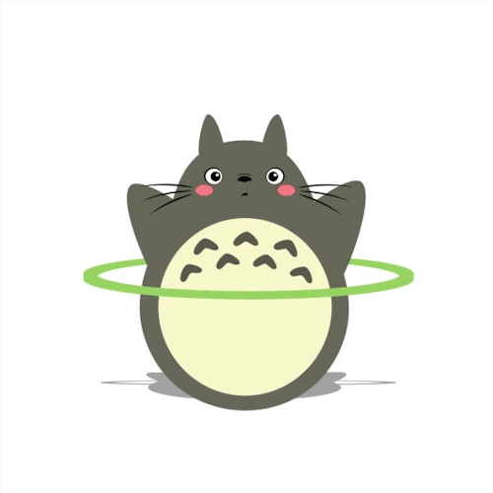
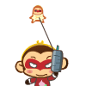
>>Presentation
Ask and answer
What … doing?
be + doing表示现在进行时
… doing …
I’m playing basketball.
I’m doing sports.
I’m flying a kite.

Slide 7
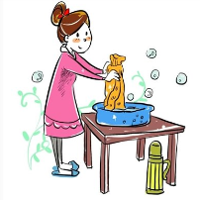
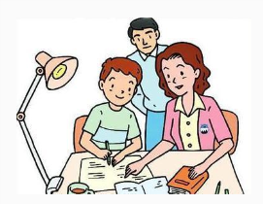
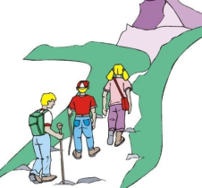
>>Presentation
Ask and answer
What do you/does your … do on Saturday?
often用于一般现在时，表示经常性、习惯性的动作或行为。
I/He/She/They often +动词短语.
She often does some washing.
I often do my homework.
They often climb the mountain.

Slide 8
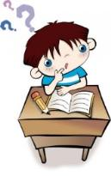
>>Presentation
Listen, then ask and answer
Who is in the picture?
Su Nan and his grandpa.
What is Grandpa doing?
He is doing exercise.
What does Su Nan often do on Saturday?
He often plays football.
What does Su Nan’s father do on weekend?
He often climbs the mountain.

Slide 9
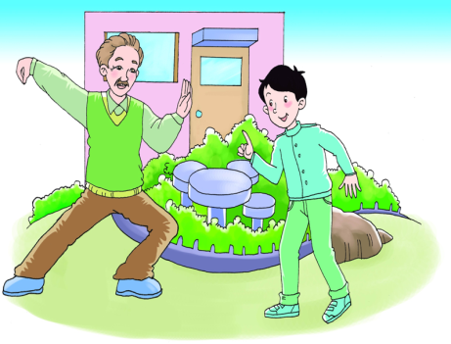
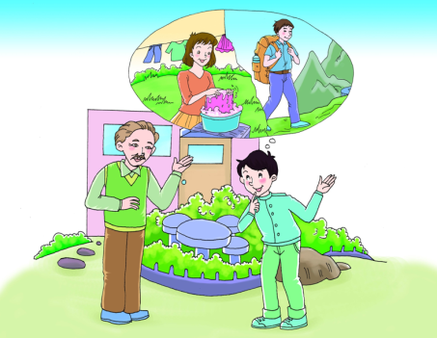
>>Presentation
Look and imagine

Slide 10
I am doing exercise.
What do you do on Saturday?
>>Presentation
Good morning,Grandpa!
What are you doing?
I do some exercise, too.
I often play football.

Slide 11
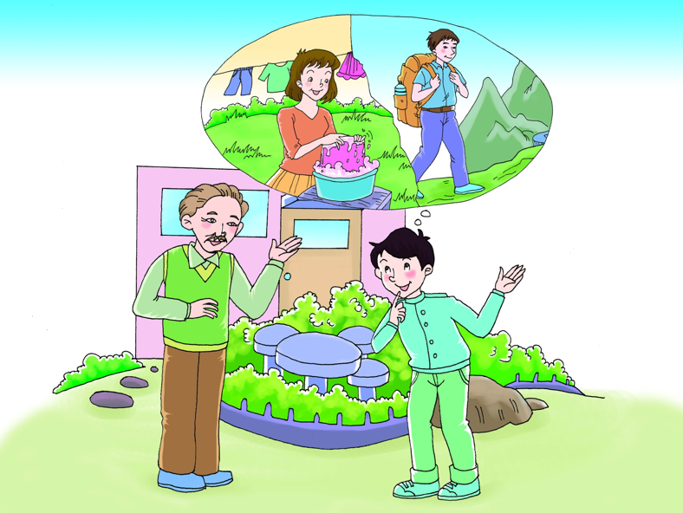
What does your father
do on the weekend?
He often climbs
the mountains.
She often does
some washing.
What about your mother?

Slide 12
>>Presentation
Let’s talk
Read and imitate
Su Nan: Good morning, Grandpa!
What are you doing?
Grandpa: I am doing exercise.
What do you do on Saturday?
Su Nan: I do some exercise, too.
I often play football.
Grandpa: What does your father do on the weekend?
Su Nan: He often climbs the mountains.
Grandpa: What about your mother?
Su Nan: She often does some washing.

Slide 13
>>Practice
Group work（小组活动）
小组内分角色并表演故事，可以用自己的语言来表演。
act
（表演）
recite(背诵)
read(读)

Slide 14
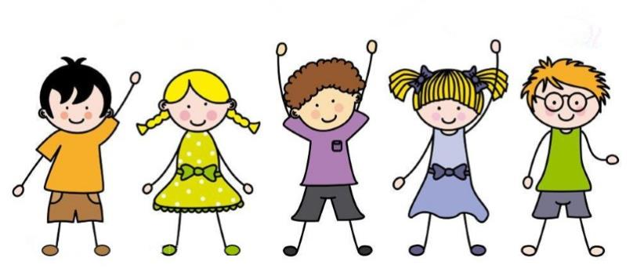
>>Practice
What do you do on the weekend?
滚雪球
What does he/she do on the weekend?
I often …
He often …She
often …I often …
…
…
He often …
I often …

Slide 15
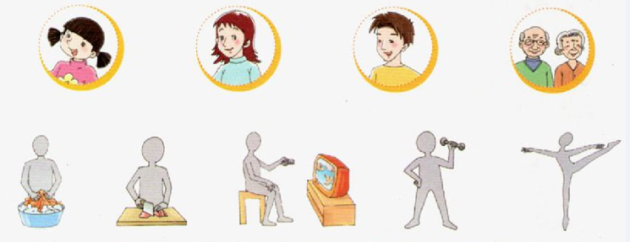
>>Practice
Read and match
Hi, I’m Wu Chen! I often dance on Sundays. My mother does some cooking. And my father does some washing. What do my grandpa and grandma do? They often watch TV and exercise. How happy we are!

Slide 16
>>Summary
本课所学的重点句型：
-What do you/does your … do on Saturday?
-I/He/She often +动词短语.
例如：
-What do you do on Saturday, Jim?
-I often play basketball.

Slide 17
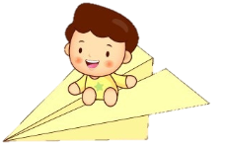
>>Homework
1.听课文录音并跟读，按照正确的语音、语调朗读并表演课文对话。 2.同桌之间分组表演Let’s talk，并在此基础上进行对话创编。
3.预习 Unit4 B Let’s learn more。
close

