Slide 1
Unit8 What are you doing?
Model4 Activities
WWW.PPT818.COM

Slide 2
words
have a look
fish
fly
dance

Slide 3
Let’s guess!

Slide 4
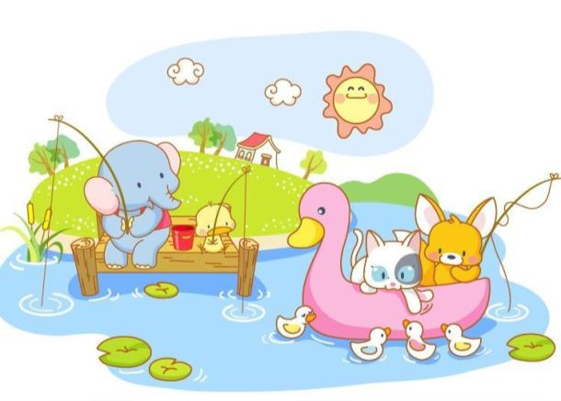
fishing in the park
phrases
fish
正在公园里钓鱼

Slide 5
flying a kite in the playground
fly
正在操场放风筝

Slide 6
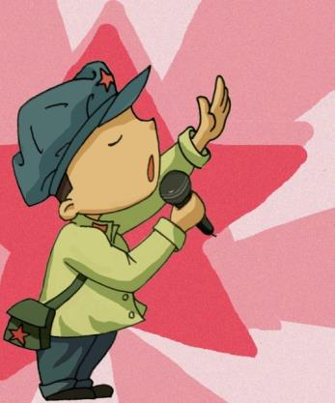
singing and dancing in the living room
dance
正在客厅里唱歌跳舞

Slide 7
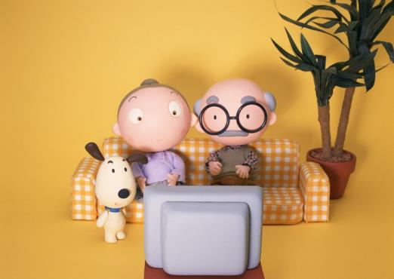
watching cartoons in the living room
正在客厅里看卡通片

Slide 8
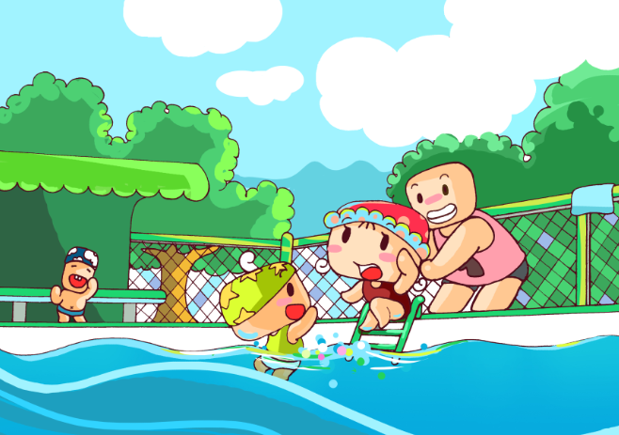
swimming in the pool
正在游泳池里游泳

Slide 9
Listen and talk!
Listen to the tape!

Slide 10
Let’s talk!
What are you doing?
——I am 。
fishing in the park
flying a kite in the playground
singing and dancing in the living room
watching cartoons in the living room
swimming in the pool

Slide 11
Homework
Remember the new words：have a look, fish, fly and dance after class.
Practise: What are you doing?
——I am…
with your partner.

