Slide 1
Module 2 Experiences
Unit 2 They have seen the Pyramids.
WWW.PPT818.COM

Slide 2
Learning objectives
1.Read a passage about the experiences of the Robinsons, and understand the information of travelling.
2.Use some words and sentences to describe your travel experiences.
3.Try to use the structure“I have visited/seen/travelled/learnt…”.

Slide 3
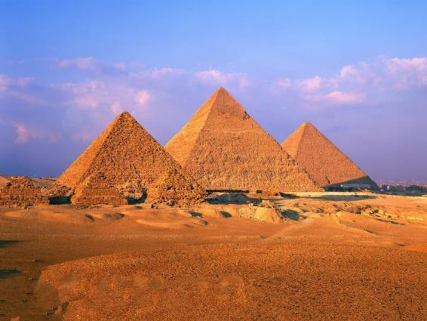
the Pyramids
Egypt

Slide 4
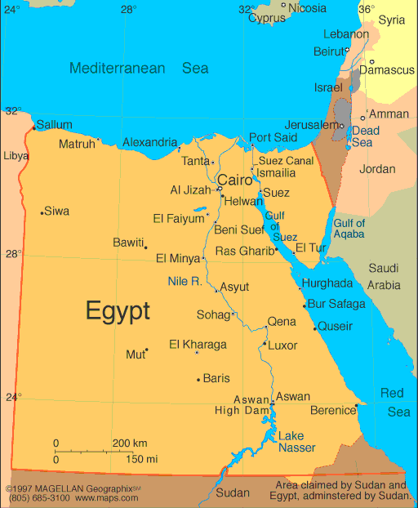
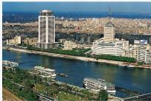
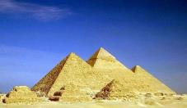
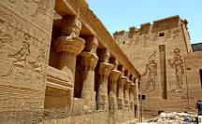
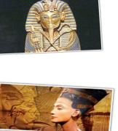
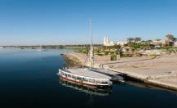
Tips:当我们在阅读旅行文章时，可以使用地图哦！
Pyramids
/ˈkairəʊ/
Pyramids
palaces and towers
Nile River
ancient kings and queens
Notes:
4

Slide 5
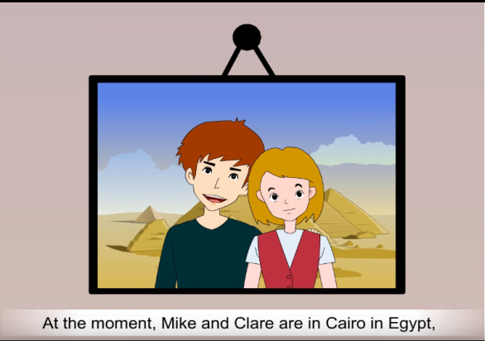
Prediction
Guess?

Slide 6
Watch a video and check your answer.
Why are they in Egypt?

Slide 7
Listen to the tape and check your answer.
Why are they in Egypt?
Because the company has many offices in many countries, and it has sent their father to work in Egypt.
They moved to Egypt with their parents.

Slide 8
Read
What's the passage mainly about?
It's mainly about the Robinsons' experiences.

Slide 9
Read
How many parts of the passage?
Part 1: Paragraph 1--2
Part 2: Paragraph 3--4
Part 3: Paragraph 5
The introduction of the Robinsons and why they move to many countries.
Their experiences.
The feelings of coming back to the US.

Slide 10
Read part 1(Para.1-2) and fill in the blanks.
Retell part 1
 | Age | Where are they from? | What countries have they visited? | Why? | How long have they stayed in a country?
Mike
Clare
Germany,
France,
China and
Egypt.
The company
has sent their
father to work
in many countries
and they moved
with him.
15
America
For about
two years.
14

Slide 11
Discuss 讨论
Read part 2(Para.2-4)
Ask and answer some questions with your deskmate.
Further thinking深度思考:
1.What do they think of seeing the world?
2.What have they learnt when they are travelling?
It is very interesting.
How do they feel about learning Arabic?
Try your best to learn English!
Maybe it is fun.
They have learnt many languages.

Slide 12
Read part 3(Para.5) Answer the questions.
1.Why are the Robinsons moving again?
2.Are they looking forward to going home?Why?
Because the company has sent Peter to work back in the US.
Further thinking深度思考:
They have friends all over the world, but why do they miss the friends in the US?
Yes, they are.Because they miss their friends in the US.
East or west, home is the best.

Slide 13
Interview
During the holiday, you have travelled to many places. A reporter from the school radio wants to interview you to share your experiences.
Talk about your travel experiences
1.When did you go?
2.Why did you go there?
3.How did you go there?
4.What have you seen or done?
5.Feelings
6.......

Slide 14
Homework
1.完成学案上本课重点单词和短语、经典必背的句子。
2.继续完成自己的旅行日志。

