Slide 1
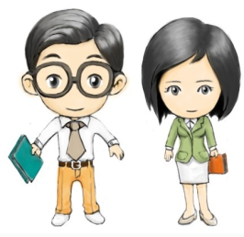
Unit5 What Is He like?
陕旅版六年级下册
第二课时
WWW.PPT818.COM

Slide 2
>>Review
Magic fingers
kind
clever
friendly
outgoing
shy
serious
hard-working

Slide 3
>>Warm-up
Look, read and choose
a
b
c
1. She is tall with glasses.
She is from Australia.
c
______
2. She is short with short hair.
She is wearing a skirt.
______
a
3. She is tall. She has long hair.
She is wearing a dress.
______
b

Slide 4
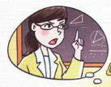
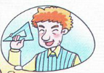
>>Presentation
Look, read and choose
What’s Ms. May like?
What do you think of her?
What’s Mr. Black like?
What do you think of him?
She is serious.
He is kind.
Ms. May
Mr. Black

Slide 5
>>Presentation
Listen, then ask and answer
What does Mr. Black do?
He is a Math teacher.
What does Ms. May do?
She is a Math teacher.
What’s Kevin’s favourite subject? Why?
His favourite subject is Math. Because he
likes his Math teacher.
What does Kevin’s think of their Math classes?
He thinks his Math classes is interesting.

Slide 6
>>Presentation
Let’s talk
Sister: What’s your favourite subject, Kevin?
Kevin: My favourite subject is Math.
Sister: Why do you like it?
Kevin: Because I like my Math teacher.
Sister: Who is your Math teacher?
Kevin: Mr. Black.
Sister: What is he like?

Slide 7
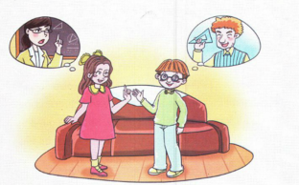
>>Presentation
Let’s talk
Kevin: He is kind to us. He always tries to make
Math easy to understand. We find Math
classes interesting. Who’s your Math teacher?
Sister: My Math teacher is Ms. May.
Kevin: What do you think of her?
Sister: She is a littler serious.
But she teaches very well.

Slide 8
>>Practice
Read it by yourselves for one minute.
自读对话一分钟。
一分钟倒计时
60
10
50
Tips:
当你自己朗读时，遇到不会读或不明白意思的单词或句子，可以把它圈起来，请教同学或老师！
20
40
30
开始

Slide 9
>>Practice
Role play
角色扮演，小组先进行练习，然后展示，其他同学评价。
 | 小组合作，声音洪亮，有感情地正确朗读课文。 |  | C
 | 小组合作默契，声音洪亮，脱离课本，口语表达较准确流利，感情与肢体语言较丰富。 |  | B
 | 小组合作默契，声音洪亮，能结合已有知识或生活，对内容有创新，口语表达准确流利，感情与肢体语言丰富。 |  | A
Good
Great
Excellent

Slide 10
>>Practice
Ask and answer
A: What is Kevin like?
B: He is shy.
A: What do you think of Li Shan?
B: She is clever.
shy
clever
outgoing
friendly

Slide 11
>>Practice
Complete the conversations
A: What ____ your uncle ____?
B: He is a police officer.
A: What ____ he ____?
B: He is hard-working and friendly.
A
D
B
C
A. does
B. is
C. like
D. do

Slide 12
>>Practice
Complete the conversations
B
2. A: Do you ____ Chinese?
B: Yes, I ____. It’s my favourite ____.
A: ____ do you like it?
B: Because I like my Chinese teacher.
C
A
D
A. subject
B. like
C. do
D. Why

Slide 13
>>Summary
本课所学的重点句型？
-What is he like?
-He is …
-What do you think of …?
-… is …

Slide 14
>>Summary
本课所学的重点句型
e.g. -What is he like?
-He is kind to us.
-What do you think of her?
-She is a little serious.

Slide 15
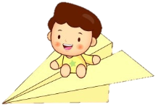
>>Homework
1.听课文录音并跟读，按照正确的语音、语调朗读并表演课文对话。 2.Pair work:2人一组，分角色表演课文，并在此基础上进行对话创编。
3.预习B Let’s learn more。
close

