Slide 1
Unit2 She looks cute.
人教精通版五年级上册
WWW.PPT818.COM

Slide 2
>>Warm-up
Let’s sing

Slide 3
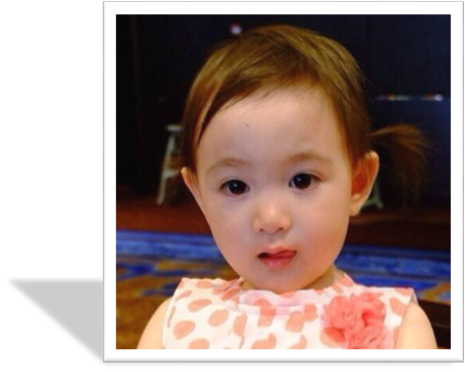
>>Presentation
Look and say
What’s her name?
Her name is Olivia.

Slide 4
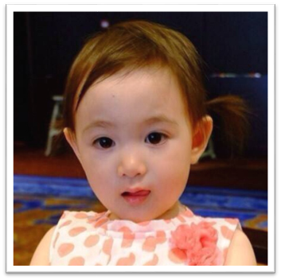
>>Presentation
Look and say
big eyes
She has .
small nose
small mouth
She is pretty and quiet.

Slide 5
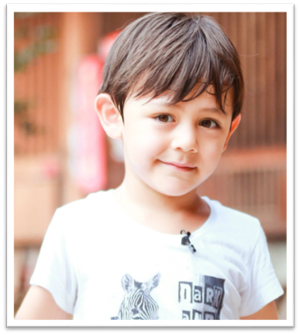
>>Presentation
Look and say
What’s his name?
His name is Liu Nuoyi.

Slide 6
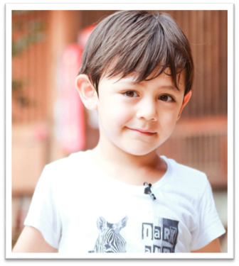
>>Presentation
Look and say
big eyes
short hair
He has .
small nose
He is clever.

Slide 7
>>Presentation
Look and say
This is our new friend.
What’s her name?
Her name is Zhou Pei.

Slide 8
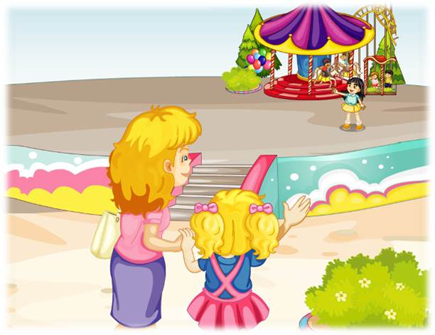
>>Presentation
Look and say
Look! Who’s that girl?
Who are they?
Zhou Pei
Kate’s mum
Kate

Slide 9
>>Presentation
Look and say
What are Kate and her mum talking about?
Can you guess?

Slide 10
>>Presentation
Read and answer
1. What does Zhou Pei look like?
She has big eyes and long hair.
2. What does Kate think of Zhou
Pei?
She’s pretty and clever.

Slide 11
>>Presentation
Just talk
Listen and imitate
Mum: Who’s that girl, Kate?
Kate: She is my new friend.
Mum: What’s her name?
Kate: Her name is Zhou Pei.
Mum: Oh, she has big eyes and long hair.
Kate: And she’s pretty and clever.

Slide 12
>>Practice
Show time
小组合作，练习对话并表演，其他同学评价。
Pronunciation (语音) |  | Fluency (流利) | Cooperation (合作)
OK!
Great!
Super!

Slide 13
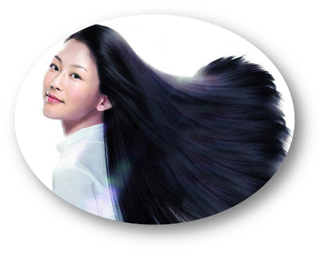
>>Practice
Look and say
He has ________.
short hair
She has _______.
long hair

Slide 14
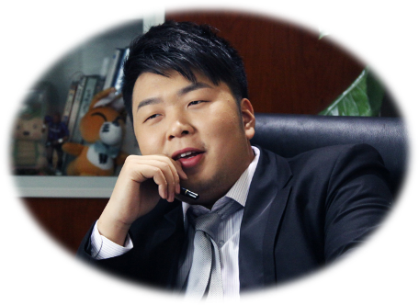
>>Practice
Look and say
She has _______.
He has _________.
big eyes
small eyes

Slide 15
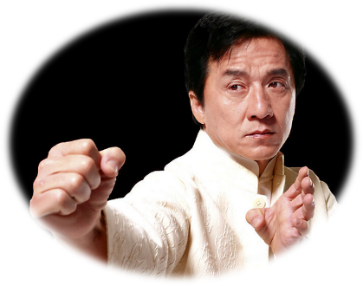
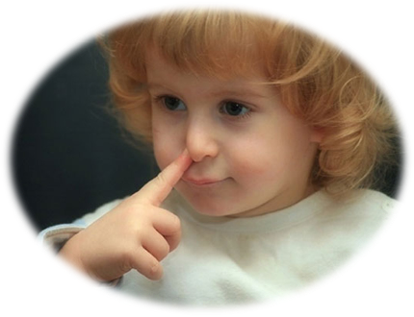
>>Practice
Look and say
big nose
He has a _______.
He has a _________.
small nose

Slide 16
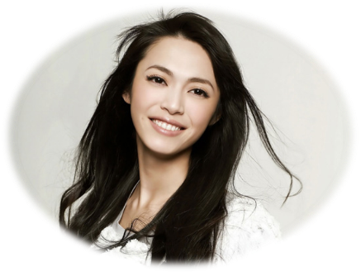
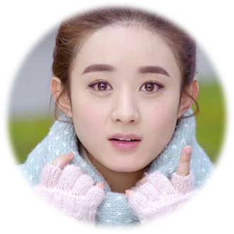
>>Practice
Look and say
big mouth
small mouth
She has a ________.
She has a __________.

Slide 17
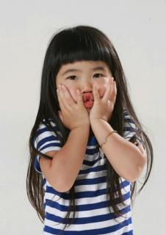
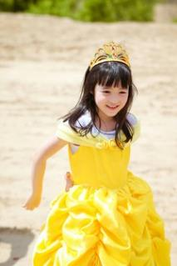
>>Practice
Game
Guess, guess, guess
She has big eyes.
She’s tall and thin.
She’s pretty.
What’s her name?
Poppy
Her name is _____.

Slide 18
>>Practice
Game
Guess, guess, guess
She has long hair and small eyes.
She’s short and fat.
She’s clever.
What’s her name?
Her name is _____.
Grace

Slide 19
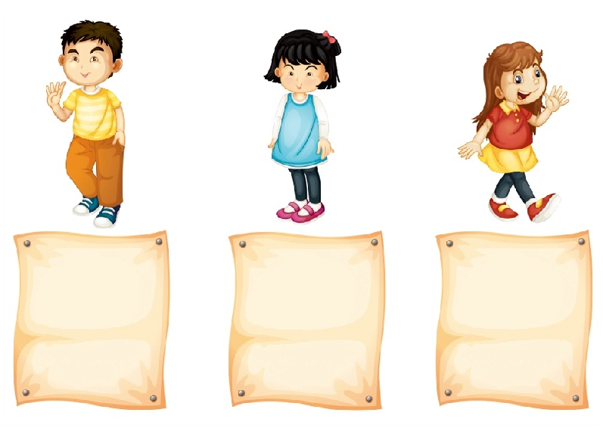
>>Practice
Look and say
Carl
short hair
small eyes
a small nose
a small mouth
clever
Cathy
black hair
small eyes
a small nose
a small mouth
quiet
Carla
long hair
big eyes
a big nose
a big mouth
pretty

Slide 20
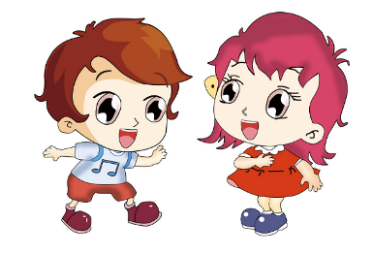
>>Practice
Pair work
两人一组，模仿本课对话，相互描述一下自己的好朋友吧！
I have a friend.
His name is …
He has … He is …
I have a friend, too.
Her name is …
She has … she is …

Slide 21
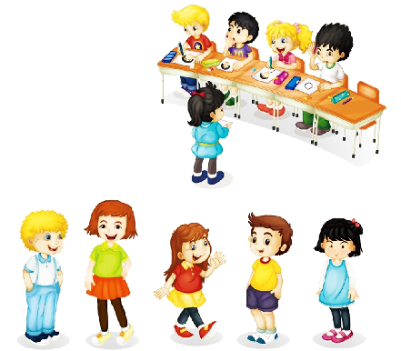
>>Practice
Let’s find
Draw your friend, then tell your classmates. Can they find him or her?
She has short hair.
She has big eyes and a small nose.
She’s very tall and thin. What’s her name? Guess!
Yes, her name is _______.
Bob
Linda
Carla
Tim
Cathy

Slide 22
>>Practice
Let’s chant

Slide 23
>>Summary
如何描述他人的外貌和性格呢？
She/He has … (eyes/nose/hair…)
She/He is… (pretty/quiet/clever…)
例句
She has big eyes and long hair.
She is pretty and clever.

Slide 24
>>Homework
1.观看课文动画，按照正确的语音、语调朗读课文对话。 2.运用本课所学句型“She / He has … She / He is…”向父母介绍一下自己的朋友。
3.预习 Lesson 9。

