Slide 1
Unit 5 Shopping
Can I help you?
WWW.PPT818.COM

Slide 2
toy
s

Slide 3
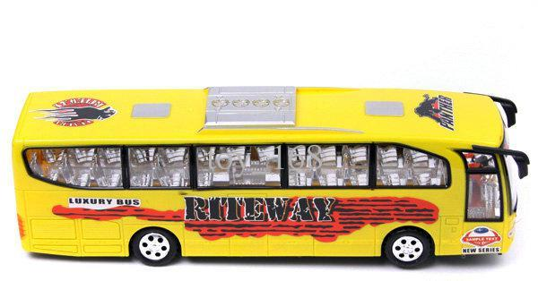
bus
toy

Slide 4
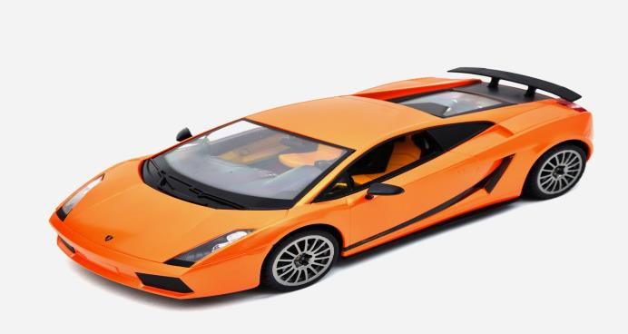
car
toy

Slide 5
fast

Slide 6
Watch and answer:
What does Li Ming want?
A: A book.
B: A toy

Slide 7
Read the second paragraph and answer:
(阅读第二段文本，回答):
What does the shop assistant say?
(售货员说了什么？)

Slide 8
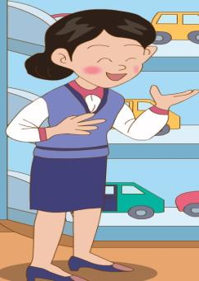
Can I help you?
I’d like a toy ,please

Slide 9
Watch again and answer:
Does Li Ming want a toy bus? Why?

Slide 10
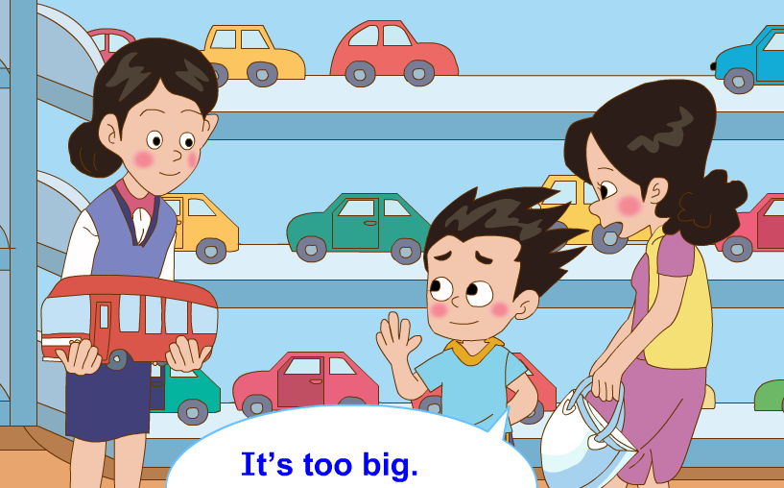
Does Li Ming want a toy bus? Why?
No,he doesn’t.

Slide 11
How about this toy bus?

Slide 12
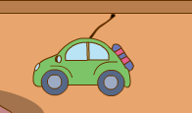
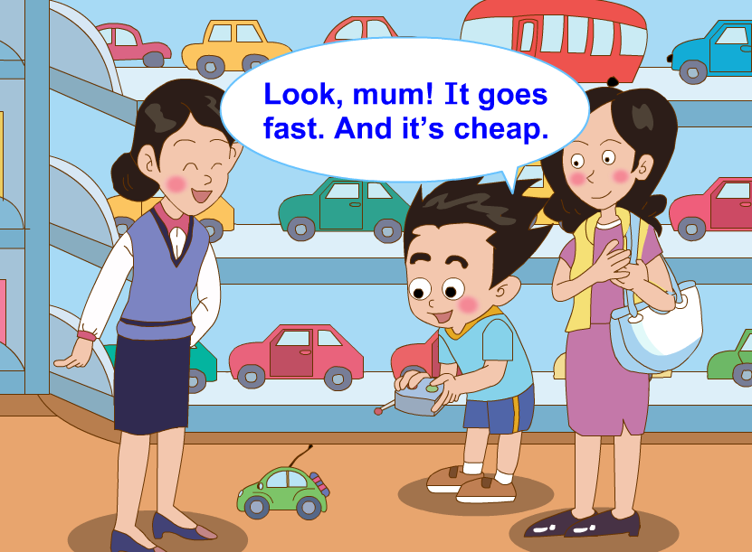
Does Li Ming want a toy car? Why?
Yes,he does.

Slide 13
Li Ming likes the toy car.
What does mum say?
All right！We’ll take it.

Slide 14
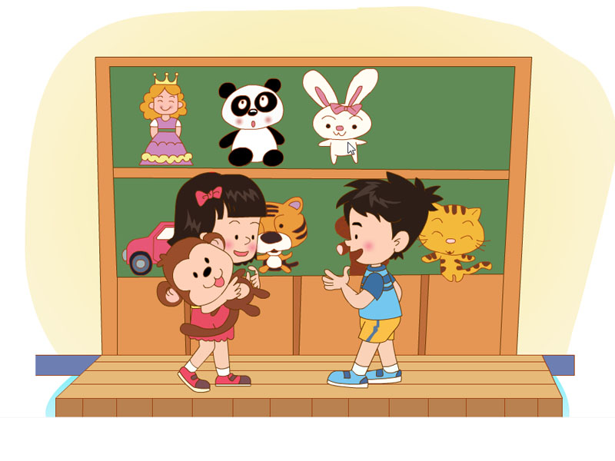
Let's practice
Can I help you?
I’d like a toy, please.
How about this monkey?
Oh, it’s lovely. I’ll take it.

Slide 15
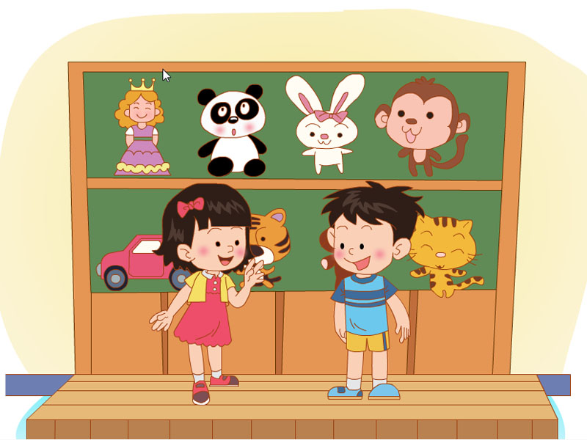
Let's practice

Slide 16
Fill in the blanks(填空) :
Can I help you
A: ——————————?
take
B: I’d like a_____,please.
toy
A:How about this toy______?
car
B:It’s too big.
bus
A:How about this toy______?It’s small and it’s______.
All right
cheap
B:____ ______. We’ll ______ it.

Slide 17
Thank you for listening.
Goodbye

