Slide 1
Unit 6
I’m watching TV.
Section B 第2课时
WWW.PPT818.COM

Slide 2
Words game
n. 竞赛
v. & n. 学习；研究
n. 州
美国；美利坚合众国
adj.美国的 n.美国人
adj.任何的；任一的
pron.任何；任一
race
study
state
the United States
American
any

Slide 3
adj. 另外的；其他的
pron. 另外的人(或物)
adj. 幼小的；年轻的
n. 儿童(pl. children)
v. 怀念；思念；错过
v. 希望
adj. 可口的；美味的
adv. 还；仍然
other
young
child
miss
wish
delicious
still

Slide 4
Lead-in
Dragon Boat Festival

Slide 5
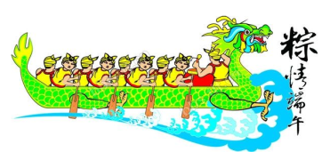
making zongzi
eating zongzi
boat race

Slide 6
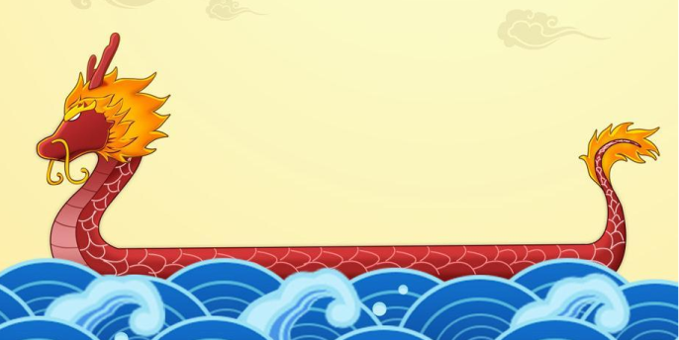
Let’s enjoy a video.
Dragon Boat Festival

Slide 7
Look at the clocks and ask your partner about the time in different places.
2a
A: What time is it in Beijing?
B: It’s eight o’clock in the morning.

Slide 8
A: What time is it in _______?
B: It’s _______ o’clock in the morning.

Slide 9
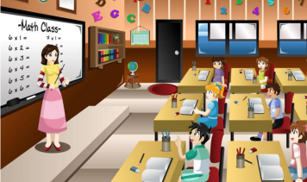
It’s ___________ a.m.
in Beijing, the students ______________.
eight o’clock
are having class

Slide 10
It’s ___________ a.m.
in Sydney, the girl ______________.
ten o’clock
is watching TV

Slide 11
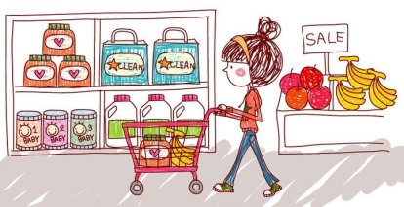
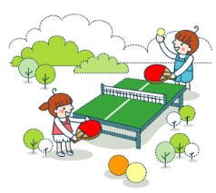

Slide 12
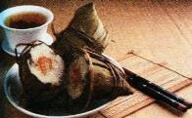
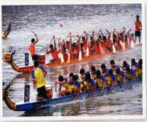
Look at the picture and answer the questions.
What special day is it?
It’s the Dragon Boat Festival.
2.What are Chinese people doing on this day?
Chinese people are making zongzi and watching the boat races on TV.
3.What do people eat on this day?
Zongzi.

Slide 13
2b
Read the TV report and answer the questions.
1.Why are Zhu Hui’s family watching boat races and
making zongzi? ______________________________________________
2.Does Zhu Hui like his host family? What does he think
about his home in China?
______________________________________________
Because today is the Dragon Boat Festival.
Yes, he does. He misses his home in China very much.

Slide 14
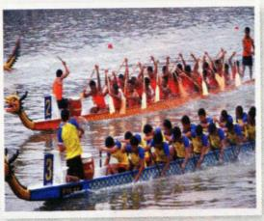
Today’s story is about Zhu Hui, a student from Shenzhen.
He’s now studying in the United States. He’s living with an American family in New York. Today is the Dragon Boat Festival. It’s 9:00 a.m. and Zhu Hui’s family are at home.
His mom and aunt are making zongzi.
His dad and uncle are watching the
boat races on TV.

Slide 15
Is Zhu Hui also watching the races and
eating zongzi? Well, it’s 9:00 p.m. in New
York, and it’s the night before the festival.
But there isn’t a Dragon Boat Festival in the US, so it’s like any other night for Zhu Hui and his host family. The mother is reading a story to her young children. The father is watching a soccer game on TV. And what’s Zhu Hui doing? He’s talking on the phone to his cousin in Shenzhen. Zhu Hui misses his family and wishes to have his mom’s delicious zongzi . Zhu Hui likes New York and his host family a lot, but there’s still “no place like home”.

Slide 16
Read the TV report and fill in the chart.
 | Members |  | Activities
Zhu Hui’s family in China | It’s 9:00 a.m. Today is the Dragon Boat Festival.
 | mom and aunt
 | dad and uncle
 | his cousin
are making zongzi
are watching the boat races on TV
is talking on the phone

Slide 17
Zhu Hui’s host family in New York | It’s 9:00 p.m. It is the night before the festival in New York. It is like any other night.
 | the mother
 | the father
 | Zhu Hui
is reading a story to her young children
is watching a soccer game on TV
is talking on the phone to his cousin

Slide 18
Match the verbs in column A with the words in column B.
2c
A
living
reading
making
talking
studying
watching
B
food
in the US
a race
with a family
on the phone
a story

Slide 19
Then use the phrases to write sentences
according to the TV report.
2c
1. Zhu Hui is living with an American family in New York.
2. Zhu Hui is talking on the phone with his cousin in
Shenzhen.
3. The mother is reading a story to her young children.
4. Zhu Hui’s father and his uncle are watching a race on
TV.

Slide 20
Language points
1. Dragon Boat Festival意为“端午节”。
端午节为每年农历五月初五，是中国的传统节日，同时也是国家法定节假日之一。

Slide 21
常用的有关我国传统节日的英语表达：
Lantern Festival 元宵节
Qingming Festival 清明节
Dragon Boat Festival 端午节
Mid-Autumn Festival 中秋节
Double Ninth Festival 重阳节

Slide 22
2. So it's like any other night for Zhu Hui and his host
family.所以对朱辉和他的寄宿家庭来说今晚和任何
一个平常的晚上是一样的。
any other意为“其他任何一个；任何其他的……”,是指在同一范围内除了某人或某物以外的其他人或事物，其后接单数名词。
例：我比班上其他任何一个男孩都要高。
I'm taller than any other boy in the class.

Slide 23
3. Zhu Hui misses his family and wishes to have
his mom's delicious zongzi. 朱辉思念他的家人
并希望吃上他妈妈 (做)的可口的粽子。
(1) miss动词，意为“怀念；思念”。
例：我非常想念我的外婆。
I miss my grandma very much.
(2) miss动词，意为“错过”。
例：不要错过火车。
Don't miss the train.

Slide 24
wish此处用作及物动词，意为“祝愿；希望”。跟从句时多指难以实现的愿望。
常见搭配：wish sb. sth.祝愿某人……
wish sb. to do sth.想要某人做某事。
例：我希望有一天将飞到月球上去。
I wish I will fly to the moon one day.
例：苏珊希望举办一次聚会。
Susan wishes to have a party.

Slide 25
【辨析】wish与hope
wish
hope
wish sb. sth.祝愿某人某事
动词
wish (sb.) to do sth.希望(某人)做某事
wish +that 从句,表示难以实现的愿望
名词
常用复数
hope to do sth.希望做某事
动词
hope +that 从句，表示可以实现的愿望

Slide 26
4. But there’s still “no place like home”. 但是
“千好万好还是不如自己的家好”。
still副词，意为“仍然，还”，表示动作仍然在继续，多用于肯定句或疑问句。
例：你还在做作业吗？
Are you still doing your homework?

Slide 27
【辨析】still，yet与already
still
yet
already
可用于各种句式，表示某事正在进行中， 意为“还；仍然”，一般只位于句中。
常用于否定句和疑问句句末，谈论预期发生的事。
常用于肯定句，与完成时和进行时连用；用于否定句和疑问句时，表示“惊讶;怀疑”。

Slide 28
Exercise
Jane _____ reading a book.
A. is B. am C. are D. be
Tom and Tim ____ playing basketball.
A. is B.am C. are D.be
3. --What are you doing?
-- I _____ watching TV.
A. is B. am C. are D. being
A
C
B

Slide 29
4. Listen, Kate ______.
A. sings B. singing C. is sing D. is singing
5. Are you _____ your homework?
A. do B. to do C. doing D. does
6. Tom _____ eating dinner.
A. don’t B. doesn’t C. isn’t D. not
D
C
C

Slide 30
句型转换
1. I am watering the flowers. (否定句)
2. She’s opening the box now. (一般疑问句)
I am not watering the flowers.
Is she opening the box now?

Slide 31
3. The boys are playing cards.(划线提问)
4. He is doing his homework.(复数句)
What are the boys doing?
They are doing their homework.

