Slide 1
九年级英语上 新课标 [冀教]
Unit 3 Safety
How Safe Is Your Home?
WWW.PPT818.COM

Slide 2
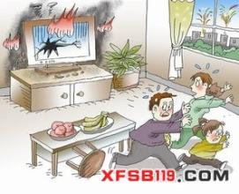

Slide 3
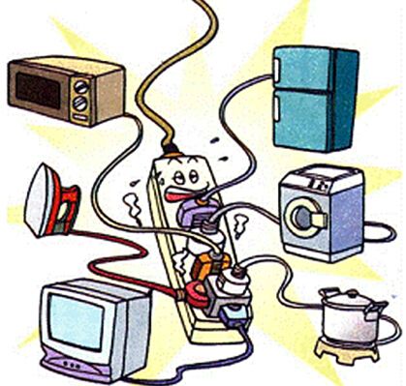
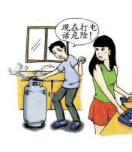

Slide 4
Words and
Expressions
prevent
certain
themselves
baking
soda
salt
scissors
v. 阻止；预防
adj. 某些；某个
pron. 他(她、它) 们自己
n. 烘焙
n. 苏打
n. 食盐
n. 剪刀

Slide 5
Words and
Expressions
knife
poison
heat
burn
bathtub
slip
n. 刀
n. 毒药；毒物
n. 高温；热；炉灶
v. 加热
v. 烧伤；烫伤；燃烧
n. 浴缸；浴盆
v. 滑倒

Slide 6
Read the text and answer the following
questions.
(1)Why are the kitchen and the bathroom the two most dangerous rooms in the house?
(2)What are the safety tips to prevent accidents in the kitchen?
Because most accidents happen in the kitchen
and the bathroom.
Don’t stand on chairs.Don’t use water to put out kitchen fires.Be careful with scissors and knives.Don’t keep poisons in the kitchen.
Notes:
6

Slide 7
(3)What are the safety tips to prevent accidents in the bathroom?
(4)Why shouldn’t parents leave young children alone in the bathtub?
Never use electricity in the shower or bathtub.
Be sure to keep the bathroom floor dry.
Because children sometimes drown in bathtubs.

Slide 8
Read the lesson and complete the table.
Safety tips for preventing accidents in the kitchen |  | Safety tips for preventing accidents in the bathroom
Dos | Don’ts | Dos | Don’ts
Be careful with knives./ Use baking soda or salt to put out kitchen fire./ Be careful with fire and heat when you cook.
Don’t stand on chairs./ Don’t use water to put out kitchen fires./ Don’t keep poisons in the kitchen.
Be sure to keep the bathroom floor dry after you have a shower or bath.
Never use electricity
in the shower or bathtub.

Slide 9
Read the text and find out main phrases and sentences.
Main phrases:
·put out
·baking soda
·hurt oneself
·fall off
·be careful with

Slide 10
Main sentences:
·Can people prevent certain accidents?
·So be careful!
·Don’t use water to put out kitchen fires.
·It’s easy to slip and fall on a wet floor.
·Be sure to keep the bathroom floor dry after you have a shower or bath.
·Never leave small children alone in a bathtub.

Slide 11
☆教材解读☆
1.Can people prevent certain accidents?
prevent为及物动词,意为“阻止,预防”,常用结构prevent sb. from doing sth.意为“阻止某人做某事”,与stop sb. from doing sth.用法相同。
2.So be careful!
careful为形容词,意为“小心的,仔细的”,其副词形式为carefully,意为“小心地,仔细地”;名词形式为carefulness,意为“小心,仔细,认真”。

Slide 12
3.Many people hurt themselves by falling off chairs.
◆hurt oneself意为“伤着自己”。hurt themselves表示“伤到他们自己”,其中themselves是反身代词。
◆fall off意为“掉下来”,强调“从什么地方掉下来”,相当于drop/fall down from,后面接名词作宾语。

Slide 13
4.Don’t use water to put out kitchen fires.
◆这是一个否定形式的祈使句。以动词原形开头的祈使句变为否定形式时,多在动词原形前加don’t。
◆use sth. to do sth.意为“用某物做……”,to do不定式表目的。
◆put out意为“扑灭,熄灭”,是由“动词+副词”构成的动词短语,后接代词作宾语时,代词要放在put与out中间。
◆和fire相关的短语:catch fire(着火),make a fire(生火),discover a fire(发现火情),light/start a fire(点火),put out the fire(灭火),set fire to sth.=set sth. on fire(放火烧……),be on fire(失火,在着火)。

Slide 14
5.Use baking soda or salt instead.
instead为副词,意为“代替,反而,却”,instead of也表示“代替”。
【辨析】 instead,instead of
instead常位于句末,译作“而是”,instead of常位于句中,译作“而不是”。
6.Be careful with scissors and knives!
be careful with意为“小心,谨慎……”。

Slide 15
7.You don’t want to burn yourself.
burn在本句中为动词,意为“燃烧,烧毁,烧坏,烧伤”,其过去式、过去分词有两种形式,即burnt,burnt或burned,burned。
8.It’s easy to slip and fall on a wet floor.
不定式作主语时,往往用it作形式主语,而将不定式放在后面。这句话中的主语是to slip and fall on a wet floor,It是形式主语,is是系动词,easy是表语。

Slide 16
9.Be sure to keep the bathroom floor dry after you have a shower or bath.
◆be sure to do sth.意为“务必/切记去做某事”,常用于祈使句中,表示说话人向对方提出要求。
【拓展】 be sure about/of意为“对……有把握,一定会”。
◆“keep+sth./sb.+形容词”意为“使……处于某种状态”,形容词作宾语补足语。
【拓展】 keep doing sth.一直做某事;keep sb. doing sth.让某人一直做某事。

Slide 17
10.Never leave small children alone in a bathtub.
leave sb./sth. alone.意为“让某人/某物独自留下”。
【辨析】 alone,lonely
(1)alone作副词,用于陈述客观事实,强调独自一人,没有别的同伴;作形容词,在句中作表语或后置定语,强调别无其他,处境安全孤立。
(2)lonely作形容词,意为“孤独的,寂寞的”,具有感情色彩,在句中作表语或前置定语,修饰某地时,意为“荒凉的,偏僻的”。

Slide 18
Make posters
Today we talked a lot about how to keep safe at home. Then what should we do to stay safe at school or on the way home or to school? Give tips on your posters. Choose one topic to do!

Slide 19
2
Practice
I.Fill in the blanks with the correct forms of the words from the lesson. The first letter is given.
1. Tom won’t drive to Beijing. He’ll take a bus i______ .
2. We should eat less s____ to prevent heart disease.
3. Take the k_____ away. The little boy may cut himself.
4. A hot coal fell out the fire and b___________ the shoes.
5. Grandma likes to sit in the sun. She enjoys the h____ of the sun.
nstead
alt
nife
urned/ burnt
eat

Slide 20
II.Read the passage and fill in the blanks with
the words in the box.
Scalding Cuts Falls Burns
Be Careful!
Here are some of the most common accidents that happen at home:
Scalding — Hot water or drinks can scald you badly. Be careful when you smell your coffee and want to drink it right away!
________ — Every year, quite a lot of children fall and hurt themselves. They fall off furniture or down the stairs. Climbing trees, high walls or fences can be dangerous, too.
________ — Many people are badly burnt or even die in house fires. A cigarette can easily start a fire. People can be burnt by a hot iron or matches.
________ — Glass causes the most serious cuts. So do knives and scissors.
These things should be kept away from children.
Falls
Burns
Cuts

Slide 21
Ⅲ.句型转换
1.He did the work all by himself.(同义句转换)
He did the work .
2.You shouldn’t keep the floor wet before you use electricity.(同义句转换)
You should the floor before you use electricity.
3.Use water to put out kitchen fires.(改为否定句)
water to put out kitchen fires.
4.Many accidents happen because people are careless.(改为一般疑问句)
many accidents because people are careless?
alone
keep dry
Don’t use
Do happen

Slide 22
5.You mustn’t leave small children alone in a bathtub.(改为祈使句)
small children alone in a bathtub.
6.My friend John visited the museum last Sunday.(用倒装句作答)
(我也参观了)。
7.Children should keep away from these dangerous things.
(改为被动句)
These dangerous things away from children.
Don’t leave
So did I
should be kept

Slide 23
Homework
1.Finish off the remaining exercises in the activity book.
2.Give suggestions about how to keep a safe home.Write them down in your exercise book.Try using these expressions:
Never…when you…
You should always…
3.Read the next reading in the student’s book.

