Slide 1
How was your school trip?
Section A 第1课时
WWW.PPT818.COM

Slide 2
动词 | 名词 | 副词&形容词 | 短语
milk 挤奶 | cow 奶牛 | quite相当 | milk a cow给奶牛挤奶
feed 喂养 | horse马 | anything 任何事 | ride a horse骑马
grow种植; | farmer农民 | excellent 极好的 | feed chickens 喂鸡
pick 采;摘 | farm 农场; | luckily 幸运地 | quite a lot (of…)许多
worry担心 | countryside乡村 |  | in the countryside 在乡下
 | yesterday 昨天
 | flower 花
 | sun 太阳

Slide 3
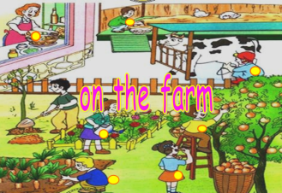
We went to the countryside yesterday.
/'kʌntrisaɪd/ n.乡村;农村
/'jestə(r)di/ adv.昨天
There was a farm in the countryside.
/fɑ:(r)m/ n.农场; v.务农;种田
My grandfather likes farming on the farm.
in the countryside 在乡下;在农村

Slide 4
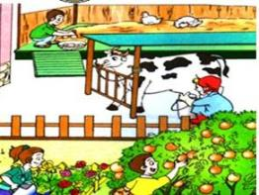
There were quite a lot of chickens on the farm. Jim fed the chickens.
/kwaɪt/adv.相当;完全
feed /fi:d/ v. (fed /fed/ )喂养;饲养
quite a lot (of…)许多
feed chickens 喂鸡
What did we do on the farm?
milked a cow
milk a cow给奶牛挤奶
milk /mɪlk/v.挤奶
/kaʊ/ n.奶牛
picked apples
pick /pɪk/ v.采;摘
rode a horse
ride a horse骑马
/hɔ:(r)s/ n.马

Slide 5
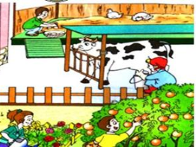
There were quite a lot of chickens on the farm. Jim fed the chickens.
/kwaɪt/adv.相当;完全
feed /fi:d/ v. (fed /fed/ )喂养;饲养
quite a lot (of…)许多
feed chickens 喂鸡
What did we do on the farm?
grew flowers
grow/grəʊ/v.(grew /gru:/)种植;生长;发育
/'flaʊə(r)/ n.花
helped the farmer
/'fɑ:(r)mə(r)/ n.农民;农场主

Slide 6
anything /'enɪθɪŋ/ pron.(常用于否定句或疑问句) 任何东西;任何事物
Is there anything interesting? No, there isn’t anything interesting.
excellent /'eksələnt/ adj.极好的;优秀的
worry/'wʌri/ v.&n.担心;担忧
luckily /'lʌkɪli/ adv.幸运地;好运地
sun /sʌn/ n.太阳
She is an excellent student.
Don’t worry, he is very well.
Luckily, he passed the exam.
Look at the sun, it’s a sunny day.

Slide 7
根据句意和单词提示填空
1. The boy m______ the cow yesterday.
2. There are a lot of ________(farm)working in the field.
3. He is a smart boy. The homework doesn’t w _________ him at all.
4. L________, it was not very hot and we didn’t feel very tired.
5. We had a trip in the c___________.
ilked
farmers
orry
uckily
ountryside

Slide 8
单项选择
1. She ________a horse with her friends last Saturday afternoon.
A. ride B. rode C. rides D. riding
2. Was there ___________ in yesterday’s newspaper?
A. something new B. new something
C. anything new D. new anything
B
C

Slide 9
词
名词：cow 奶牛horse马 …
短语
ride a horse骑马…
feed chickens 喂鸡…
副词等：anything 任何事物
动词：milk 挤奶 feed喂养…

