Slide 1
Unit 4 Christmas
JJ 六年级上册
Lesson 22 Christmas Gifts
WWW.PPT818.COM

Slide 2
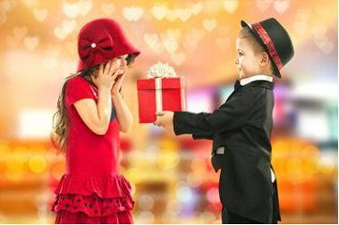
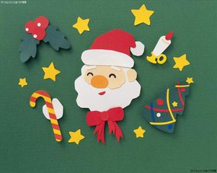
What would you like for Christmas?

Slide 3
1. In the shop
Danny and Li Ming are shopping for Christmas gifts in a shop.
At Christmas, shops often have Santas. Santas are fun!
Danny: I want to buy some gifts for my family.
Li Ming: What do you want to buy?
Danny: I don’t know. Are you going to give Jenny’s family a gift?
Li Ming: Yes! I am going to give them a special gift from China for
their Christmas tree.
Danny: Great! Oh, look! There’s Santa! Come on!
Danny: Hello, Santa!
Santa: Merry Christmas! Ho! Ho! Ho!

Slide 4
1. In the shop
Danny: Santa always says, “Ho! Ho! Ho”
Santa: What would you like for Christmas, young man?
Danny: Well, Santa, I would like a big, new car!
Santa: A new car! Ho! Ho! Ho! That’ s funny!
Santa: What would you like for Christmas?
Li Ming: I don’t know.
Santa: Oh! Ho! Ho! Ho! Would you like a new sweater?
Li Ming: No...
Santa: Some toys?
Li Ming: No... I know what I would like!
Santa: Oh! Ho! Ho! Ho! That’s great!

Slide 5
讲解
知识点 1
What do you want to buy?
你想要买什么？
用法及答语：
这是由 what 引导的特殊疑问句，是询问对方想要买什么的句型，回答是：I want to buy＋某物．
例句：
—What do you want to buy? 你想要买什么？
—I want to buy a coat. 我想要买一件外套。
典例
I want to buy a shirt for my father.(就画线部分提问)
you want to buy for your father?
What do

Slide 6
讲解
知识点 2
Would you like a new sweater?
你想要一件新的毛衣吗？
用法及答语：
Would you like...?用来礼貌地询问对方的意愿或委婉地提出请求、建议。
(1)后面跟名词或代词，表示“想要某物”。
例句：—Would you like some bread?
你想要些面包吗？
—Yes, please. /No, thanks.
好的, 太感谢了。/不，谢谢。

Slide 7
讲解
(2)后面跟“to＋动词原形”，表示“想要（某人）做某事”。
例句：—Would you like Jenny to wash the dirty dishes?
想要詹妮洗这些脏盘子吗？
—Yes.是的。/No. I want to wash them.
不。我想要洗它们。

Slide 8
讲解
易错点
提示
like与would like意思不一样，不能混淆。like意为“喜欢”，would like是“想要”，相当于want，但是 would like比want更礼貌。

Slide 9
2. Let’s do it!
Read Part 1 and answer the questions.
1. What are Danny and Li Ming doing?
_______________________________________________________
2. When do the shops have Santas?
————————————————————————————
3. Where is Li Ming’s special gift from?
_______________________________________________________
4. What does Danny want for Christmas?
_______________________________________________________
5. What do you think Li Ming says in Santa’ s ear?
________________________________________________________
Danny and Li Ming are shopping for Christmas gifts in a shop.
At Christmas.
From China.
Danny would like a big, new car.
I don’t know.

Slide 10
习题
一、按要求完成下列句子。
I want to buy some fruit．(就画线部分提问 )
you want to buy?
What do
询问某人想要买什么用What do/does sb. want to buy？本
句主语为you，故用What do，注意句首单词首字母大写。
点拨：
二、判断下列句子与图片是（T）否（F）相符。
（ ）The man is too funny.
F

Slide 11
习题
三、单项选择。
—Would you like shopping with me?
—Yes, I’d like to.
A. to go B. to going C. goes
四、句子接龙游戏。
两位学生为一组，一问一答，练习“Would you like ...?”句型。然后角色互换。如：
S1：Would you like some eggs?
S2：No, thanks. Would you like some bananas?
A

Slide 12
本节课我们学习了以下知识，请同学们一定加强巩固，以便能和同学们进行灵活交流哦！
重点词汇：funny
重点短语：funny story, have fun
重点句式： What do you want to buy?
What would you like...?

Slide 13
Thank you!

