Slide 1
Unit 4 Christmas
Lesson 19 Christmas Is Coming!
WWW.PPT818.COM

Slide 2
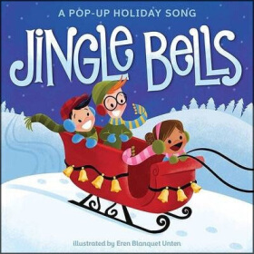
Warming up
1.Listen and try to sing the song.
Dashing through the snow In a one-horse open sleigh o’er the fields we go laughing all the way bells on bob-tail ring making spirits bright Oh what fun it is to ride and one-horse open sleigh jingle bells, jingle bells jingle all the way oh what fun it is to ride in a one-horse open sleigh Hey jingle bells, jingle bells jingle all the way oh what fun it is to ride in a one-horse open sleigh

Slide 3
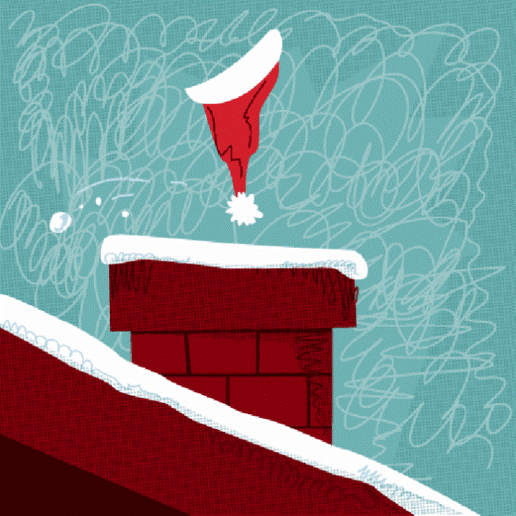
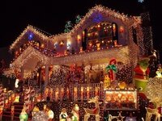
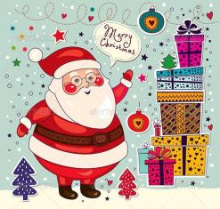
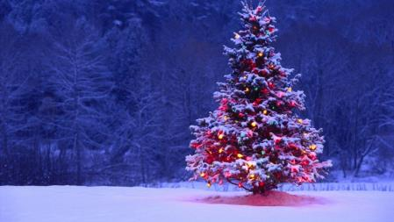
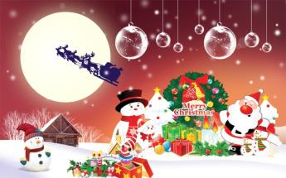
Warming up
2.Free talk
How are you ?
Do you know Christmas?
How do you like it?

Slide 4
Warming up
“出彩中国人”片头

Slide 5
Presentation
1.预习出彩
小组预习
Christmas Western holiday work
go to school merry man bring
gift have fun Santa light
例如：bring=b+ring（圆环）
Santa=San+ta（用拼音来记）
light（可以从right引出）

Slide 6
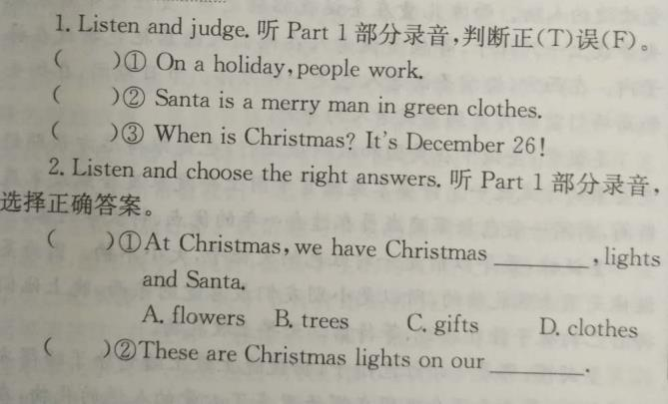
Presentation
2.听力出彩
听录音，完成习题。
F
F
F
B
B

Slide 7
Presentation
3.表演出彩
A: Christmas is coming. Do you love it?
B: Yes, I do.
A: Do you know Santa?
B: Yes. I love him very much. He brings us many gifts.
A: What do people prepare for Christmas?
B: We prepare trees and gifts…

Slide 8
Presentation
①What’s Christmas?
②When’s Christmas?
③Who’s Santa?
④Do people give gifts to their family on Christmas?
⑤Do people work on Christmas?
⑥What colour are Santa’s clothes?
A. Yes , they do.
B. No, they don’t.
C. It’s December 25.
D. A merry man in red
clothes.
E. Red.
F. It’s a Western holiday.

Slide 9
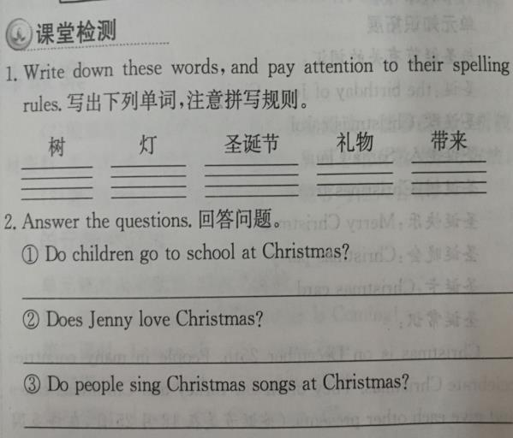
Practice
4.练习出彩
tree
light
Christmas
gift
bring
No, they don’t.
Yes, she does.
Yes, they do.

Slide 10
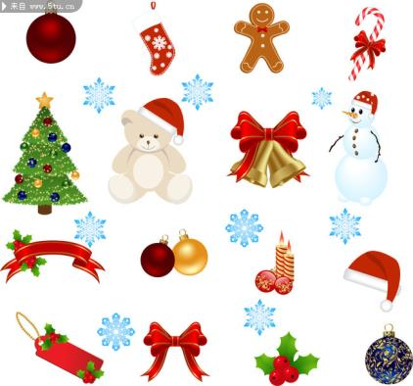
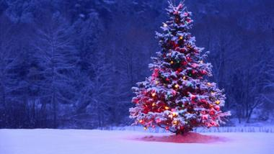
Consolidation
What do people prepare for Christmas?

Slide 11
Summing up
1.Words:
Santa, Christmas, light, gift, bring
2. Sentences:
Western holiday, Christmas trees, bring…for…, have fun
At Christmas, we have Christmas trees, lights and Santa.
They bring gifts for us.
We give our family and friends gifts, too.
3.
这节课我的收获是：_____________
这节课我的不足是：_____________

Slide 12
Homework
1.听录音，朗读本课的第一部分
2.完成相关习题

