Slide 1
Unit 3 Family
She's a Doctor
WWW.PPT818.COM

Slide 2
teacher
She’s a teacher.

Slide 3
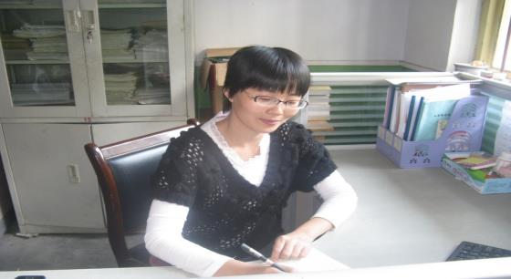
I’m a teacher, too.

Slide 4
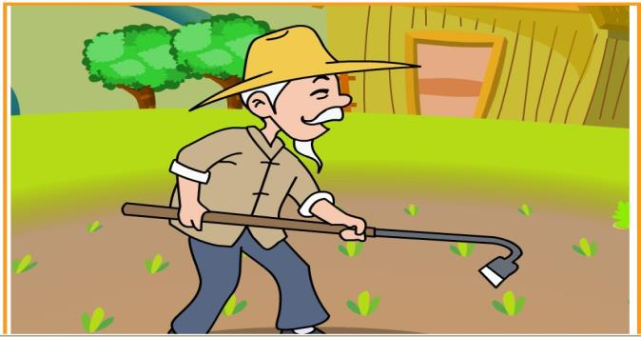
He’s a farmer.

Slide 5
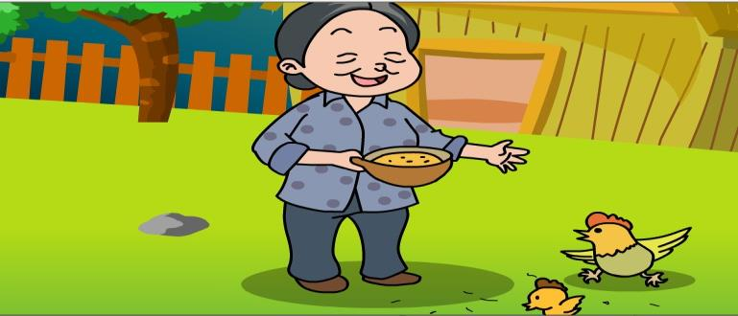
She’s a farmer, too.

Slide 6
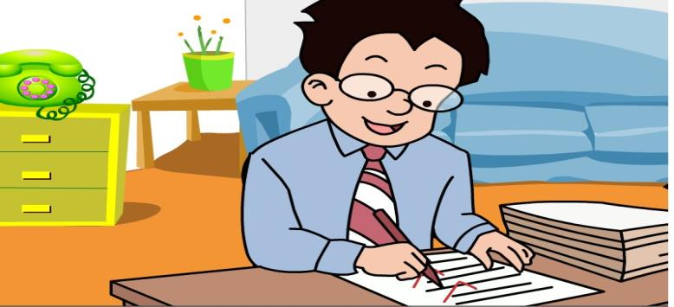
He’s a teacher.

Slide 7
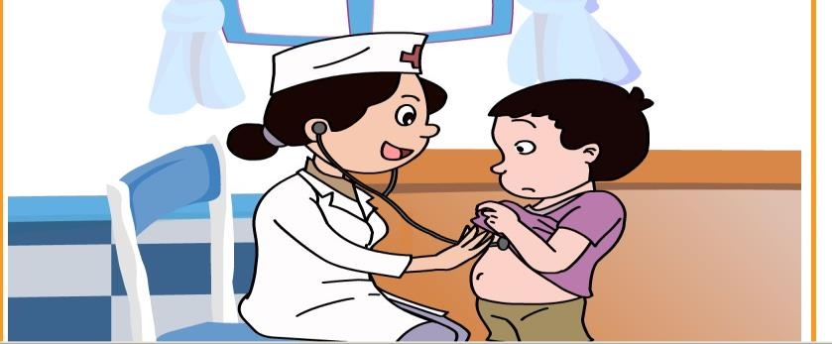
She’s a doctor.

Slide 8
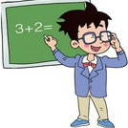
幸运大转盘

Slide 9
幸运大转盘

Slide 10
幸运大转盘

Slide 11
幸运大转盘

Slide 12
幸运大转盘

Slide 13
Act.

Slide 14
Homework
1.模仿跟读。
2.完成配套练习。

Slide 15
Thank you.

