Slide 1
Module 4 Healthy food
Unit 3 Language in use
WWW.PPT818.COM

Slide 2
Language practice
We’ve got lots of apples.
We haven’t got any meat.
She hasn’t got any coffee.
Have we got any chocolate?
Yes, we have.
Let’s get some chicken.
We haven’t got any oranges.

Slide 3
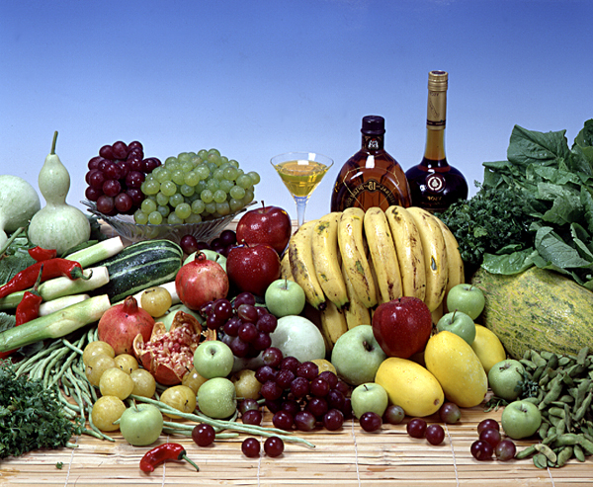
Talk about the picture.

Slide 4
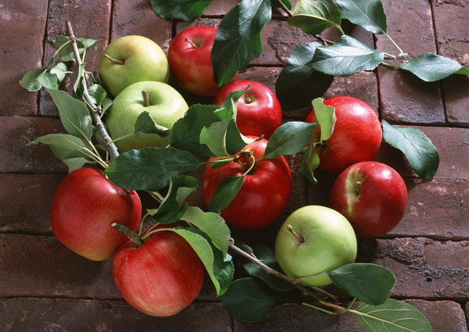
apple

Slide 5
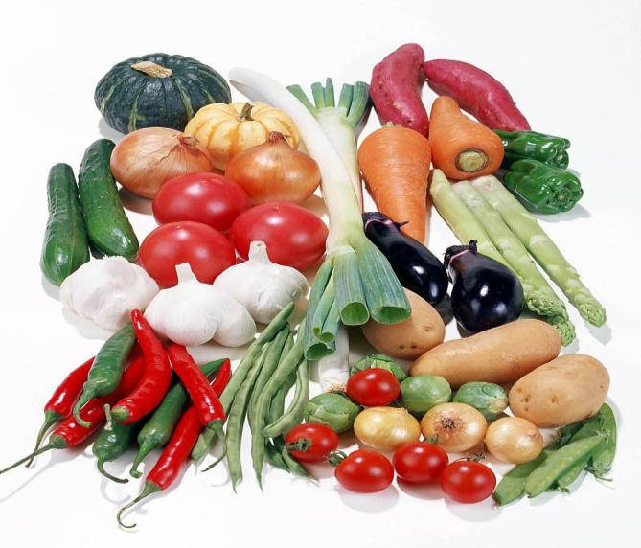
vegetables

Slide 6
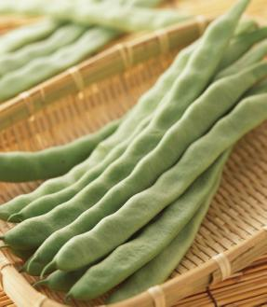
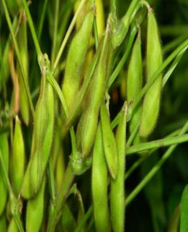
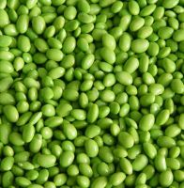
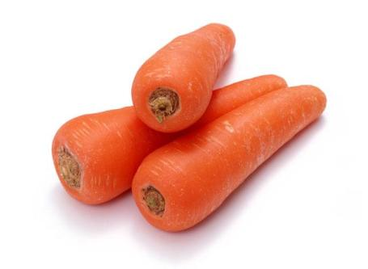
carrot
bean

Slide 7
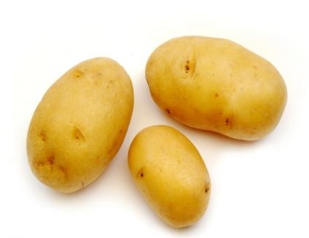
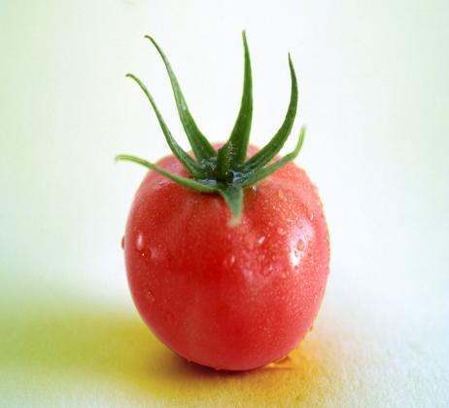
tomato
potato

Slide 8
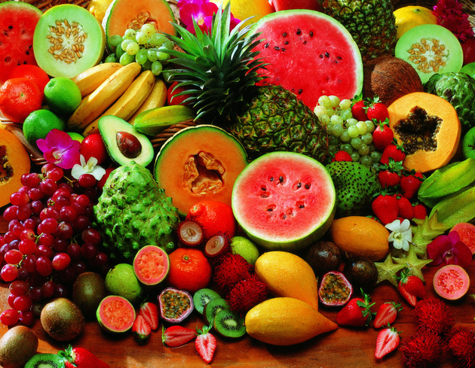
Fruit

Slide 9
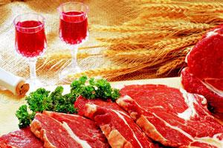
Meat

Slide 10
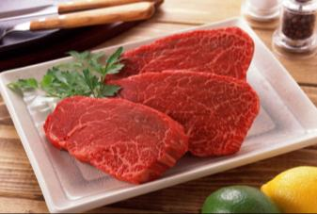
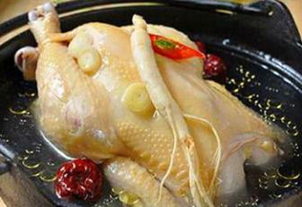
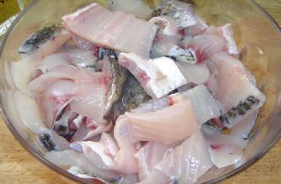
beef
chicken
fish

Slide 11
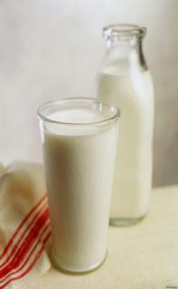
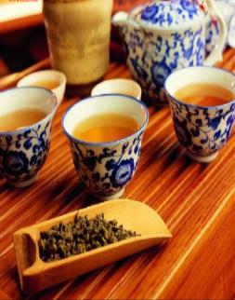
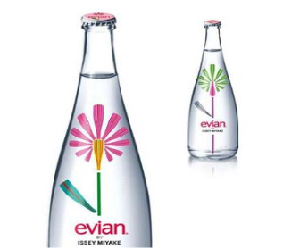
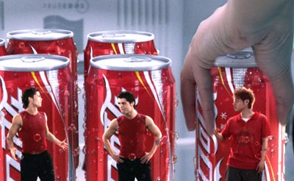
coffee
milk
tea
water
cola
Drinks

Slide 12
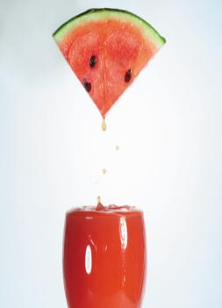
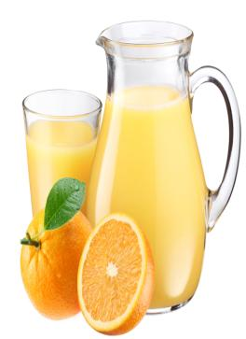
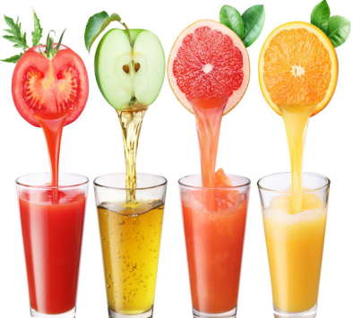
juice

Slide 13
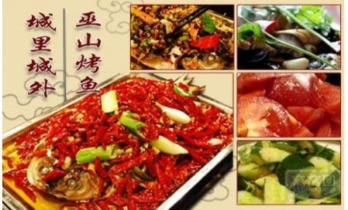
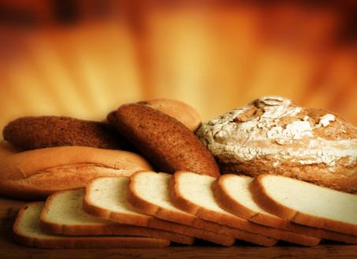
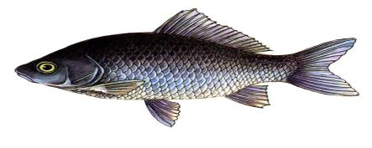
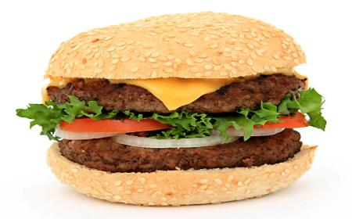
bread
hamburger
fish

Slide 14
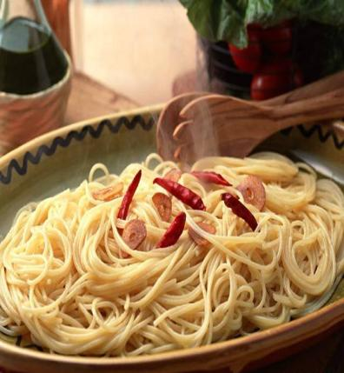
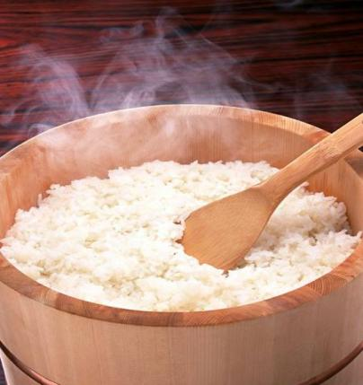
rice
noodles

Slide 15
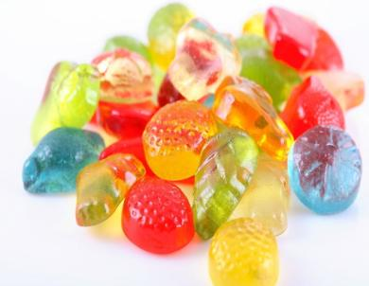
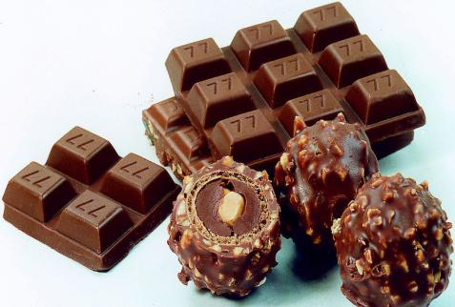
candy
chocolate

Slide 16
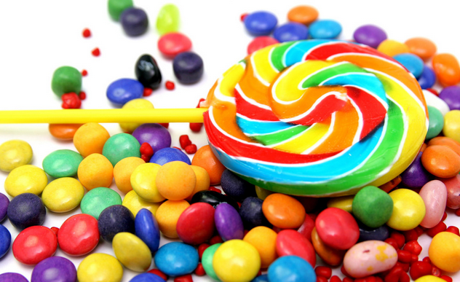
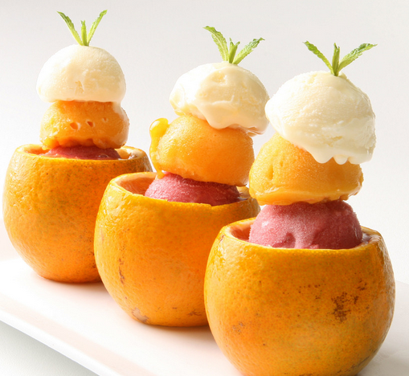
ice cream
sugar

Slide 17
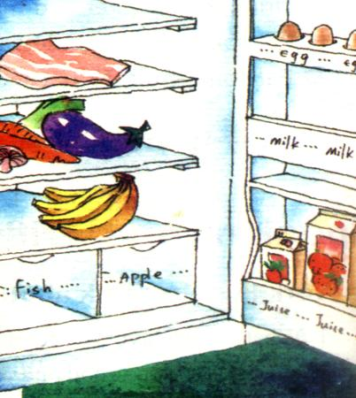
Talk about the things in the fridge.
— Have we got any
meat in the fridge?
— Yes, we have.
— Have we got any…?
—Yes, we have. /
No, we haven’t.

Slide 18
Now write about the food in
the fridge.
We’ve got some meat.
We haven’t got any fish.
1. ________________ vegetables.
2. _________________ orange.
3. _________________ apples.
We have got some
We haven’t got any
We haven’t got any

Slide 19
4. _________________ eggs.
5. _________________ bananas.
6. _________________ orange juice.
7. _________________ milk.
We have got some
We have got some
We have got some
We haven’t got any

Slide 20
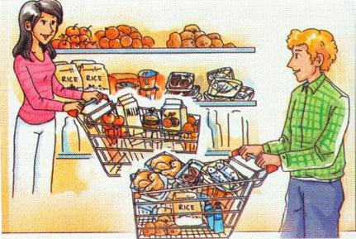
Look at the picture and talk
about it.
apple | hamburger | orange | potato | tomato
apples | hamburgers | oranges | potatoes | tomatoes
fish meat rice milk juice chicken water

Slide 21
He has got some a(n)…
He hasn’t got any…
She has got some a(n)…
She hasn’t got any…
The have got some a(n)…
They haven’t got any…

Slide 22
名词的复数
A. 构成方法及读音规则
一般情况加 –s：
e.g. map-maps boy-boys girl-girls
pen-pens bag-bags car-cars
清辅音后读
浊辅音和元音后读

Slide 23
2) 以s, sh, ch, x等结尾加 –es
e.g. bus-buses watch-watches
box-boxes brush-brushes

Slide 24
3) 以辅音字母+y结尾, 变 y 为 I 再加 es,
e.g. baby---babies city-cities
country-countries
但以y结尾的专有名词，或元音字母+y 结尾的名词变复数时，直接加s变复数。
e.g. monkey---monkeys
holiday---holidays

Slide 25
4) 以o结尾的名词，变复数时：
加s, (无生命)
e.g. photo— photos piano—pianos
radio—radios zoo—zoos
b. 加es, (有生命)
e.g. potato— potatoes
tomato—tomatoes

Slide 26
5)以 f 或 fe 结尾的名词变复数时：改 f, fe 加 -ves，
e.g. half—halves knife—knives
leaf—leaves wolf—wolves
wife—wives life—lives

Slide 27
B. 名词复数的不规则变化
1) child — children foot — feet
tooth — teeth mouse — mice
woman—women man—-men

Slide 28
注意:
由一个词加 man 或 woman构成的合成词, 其复数形式也是 -men 和-women, 如an Englishman, two Englishmen。但German不是合成词, 故复数形式为Germans；Bowman是姓，其复数是the Bowmans。

Slide 29
2) 单复同形
e.g. deer, sheep, fish, Chinese, Japanese,
li, jin, yuan, two li, three mu, four jin
但除人民币的元、角、分外, 美元、英镑、法郎等都有复数形式。
e.g. a dollar two dollars
a meter two meters

Slide 30
3) 集体名词, 以单数形式出现, 但实为
复数。
people, police 等本身就是复数，
不能说 a people, a police, 但可以
说a person, a policeman.

Slide 31
4)以s结尾，仍为单数的名词
maths, politics, physics等学科名词，
一般是不可数名词，为单数。
b. news 为不可数名词。

Slide 32
c. the United States, the United Nations
应视为单数。
e.g. The United Nations was organized in
1945.
联合国是1945年组建起来的。
d. 以复数形式出现的书名，剧名，报
纸，杂志名，也可视为单数。

Slide 33
5) 表示由两部分构成的东西
e.g. glasses （眼镜）trousers, clothes 等，若表达具体数目，要借助数量词 pair（对，双）; suit（套）; a pair of glasses; two pairs of trousers等。

Slide 34
6) 另外还有一些名词，其复数形式有时
可表示特别意思
e.g. goods 货物 waters 水域
fishes（各种）鱼

Slide 35
C. 不可数名词：不可数名词主要分物质
名词和抽象名词。
1) 物质名词指表示无法分为个体的实
物的词。
e.g. snow(雪), rain(雨), water(水), coffee(咖啡), meat (肉), milk(牛奶), rice(米饭), bread(面包), beef (牛肉), chicken(鸡肉), juice (果汁), Coke (可乐), ice cream (冰激凌) 等

Slide 36
2) 抽象名词是指表示动作、状态、
品质、感情等抽象概念的词。
e.g. work(工作), study(学习)
love(爱), friendship (友谊)等。

Slide 37
A.写出下列名词的复数形式:
1. apple – 2. orange –
3. potato – 4. carrot –
5. banana – 6. egg –
7. hamburger –
8. noodle – 9. onion –
10. vegetable –
11. tomato –
12. melon –
apples
oranges
potatoes
carrots
bananas
eggs
hamburgers
noodles
onions
vegetables
tomatoes
melons

Slide 38
B. 不可数名词有：
1. water 水 2. meat 肉 3. food 食物
4. fruit 水果 5. beef 牛肉 6. chicken 鸡肉 7. juice 果汁 8. ice cream 冰激凌
9. tea 茶 10. rice 米饭 11. bread 面包 12. milk 牛奶 13. coke 可乐

Slide 39
14. chocolate 巧克力 15. fish 鱼肉
16. cheese 奶酪 17. sugar 糖
18. candy 糖果 19. soup 汤
C.可数名词的特殊变化：
1. child—children 孩子
2. tooth—teeth 牙齿

Slide 40
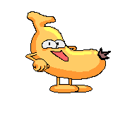
Complete the word map.
chicken
beef
tomatoes
fish
carrots
potatoes
meat
vegetables
water
milk
juice
oranges
healthy food
healthy
drink
fruit
apples
food
drink
bananas
favourite
food
favourite
drink
carrots
beef
juice
milk

Slide 41
Complete the sentences with the correct form of the words from the box.
1. _________ to buy some fruit.
2. It’s _________ to eat healthy food.
3. Eat well and ____ healthy.
4. Orange juice is ________. Let’s buy some.
5. I am a ___ tired.
bit delicious important remember stay
Remember
important
stay
delicious
bit

Slide 42
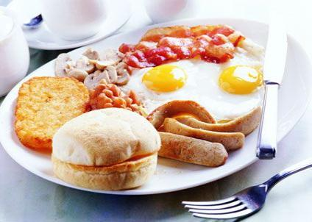
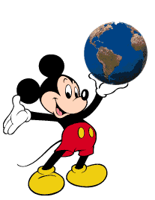
Around the world
A Western breakfast
In the West, for breakfast, people usually eat bread and eggs and drink coffee or tea,
milk and fruit juice.

Slide 43
Module task: Making a poster about
a healthy breakfast.
Work in groups of four or five. Make a
poster about a healthy breakfast.
1. Make a list of questions about a healthy
breakfast.
2. Talk to students from another group about a healthy breakfast.

Slide 44
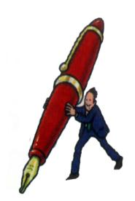
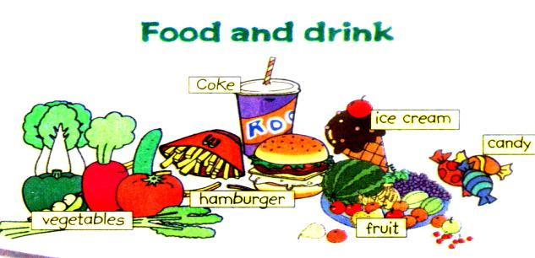
3. Make a poster about your healthy
breakfast.
Present your poster to the class.
Choose the best poster.

Slide 45
Exercises
Fill in the blanks with some and any.
1. Have you got ____ fruit?
Yes, we have.
2. Have we got ___ meat?
No, we haven’t.
3. We’ve got _____ oranges and _____ apples.
4. We have got _____ melons.
5. We haven’t got ____ tomatoes.
any
any
some
some
some
any

Slide 46
Complete the sentences.
1. 我们有一些猪肉吗？ 没有。
_____ we ____________?
No, __________.
2. 你们有一些土豆吗？ 有。
____ you ___________?
Yes, _______.
3. 我们的冰箱里没有胡萝卜。
We ____________________ in the fridge.
Have got any pork
we haven’t
Have got any pork
we have
haven’t got any carrots

Slide 47
4. 鱼和蔬菜是健康的食品，但汉堡包不
是。
Fish and vegetables _______________,
____________________ healthy food.
5. 吃些水果，不要吃糖果和冰激淋。
___ some fruit, ___ candy __ ice cream.
are healthy food
but hamburgers aren’t
Eat not or

Slide 48
根据短文内容及首字母提示，在空格处填入正确的词，使短文意思完整。
My name is Tom. I’m from A______. I’m fourteen y____ old. I’m in China with my p_______ now. I like China. I like C_____ food, too. I eat rice and v_________ everyday. They are h______ food.
merica
ears
arents
hinese
egetables
ealthy

Slide 49
My favorite vegetables are carrots and t________. I like drinking tea. My father and mother also like d_______ tea, too. I don’t like Coke. Coke is
u_______ drink. I also eat noodles, fish and meat. I don’t like candy. Candy isn’t healthy food. I like fruit. Apples are my favorite f___.
omatoes
rinking
nhealthy
ruit

Slide 50
Make a poster about a healthy lunch.

