Slide 1
Module1 My classmates
Unit 1 Nice to meet you.
WWW.PPT818.COM

Slide 2
学习目标
一、掌握以下单词：Chinese, from, where, America, not, England等。
二、能运用 be动词的一般现在时的陈述句和一般疑问句形式。
三、能听懂别人的自我介绍。
四、能运用所学be动词的基本句型，进行包括姓
名、年龄、家乡等在内的简单的自我介绍。

Slide 3
Review
Task1: 快速说出相应的答语
What’s the weather like in spring?
What’s your favourite sport?
What’s your name，please？
Can you spell “desk”?
How do you spell “pencil”?
What day is it today?
Good morning！

Slide 4
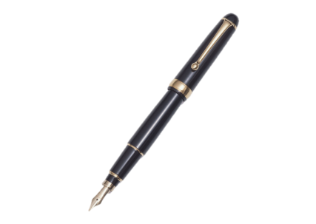
Task2: Ask and answer
What’s this in English?
It’s a/an…

Slide 5
Task2: Ask and answer
What color is it?

Slide 6
Listen and check (√) the number of speakers.
Presentation
Listening and vocabulary
1
a) 1 b) 2 c) 3

Slide 7
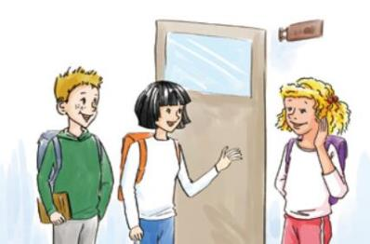
Listen again and check (√) the words you hear.
2
class friend
hello name
teacher too
√
√
√
√
√

Slide 8
3
Task1: 听第一遍对话，回答问题。
1. How many people speak in the conversation?
Five.
2. Who are they?
Ms Li, Lingling, Daming, Tony and Betty.
3. Are they in the same class?
Yes, they are.

Slide 9
Task2: Check (√) the true sentences.
1.Ms Li is from Wuhan.
2.Lingling is twelve years old.
3.Daming is thirteen years old.
4.Tony is not in Class 4.
5.Betty is from America.

Slide 10
Task2: Listen again and complete the table.
Name | Age | Job | City | Country
Ms Li | /
Lingling
Daming
Tony | / |  | /
Betty | / |  | /
teacher
Wuhan
China
thirteen
student
Beijing
China
twelve
student
Beijing
China
student
England
student
America

Slide 11
Task4: Retell the dialogue.
My name is Wang Lingling. I’m _____ Beijing. I’m ______ years old. I’m _______. Ms Li is my ______. She ______ Wuhan. Daming is my ______. He is ______ years old. Tony is from ________. Betty is from America, and she is _________.
from
thirteen
Chinese
teacher
is from
friend
twelve
England
American

Slide 12
How to introduce yourself?
如何做自我介绍？

Slide 13
自我介绍句型：
My name is … .
I’m from … .
I’m …years old.
I’m a/an...

Slide 14
Practice
4
Work in pairs. Choose the correct answer.
1 —Is Daming from Beijing?
—Yes, he is. / No, he isn’t.
2 —Is Lingling from Beijing?
—Yes, she is. / No, she isn’t.
3 —Is Tony from America?
—Yes, he is. / No, he isn’t.
4 —Is Betty English?
—Yes, she is. / No, she isn’t.
5 —Are you from China?
—Yes, I am. / No, I’m not.

Slide 15
5
Complete the passage with the correct form of the words from the box.
America Chinese England grade student
Betty, Tony, Daming and Lingling are (1) ________ in Class 4 (2) ______ 7. Betty is from (3) _______ and Tony is from _______. Daming and Lingling are _______.
students
Grade
America
England
Chinese

Slide 16
Role-play
1. Role play the conversation in groups;
2. Role play the conversation in front of the class.
Let’s see which group does the best.

Slide 17
Listening and vocabulary
6
Listen and repeat.
/ i: / Chinese meet teacher
/ i / Betty Tony
/ I / English is
/ e / friend twelve
/ æ / thanks

Slide 18
Work in pairs. Ask and answer.
A: What’s your name?
B: My name is …
A: Are you English?
B: No, I’m …
A: How old are you?
B: I’m … years old. I’m in Class…
A: Nice to meet you.
B: Nice to meet you too.

Slide 19
Summary
Chinese, China, American, America, England
year, Ms, grade
核心词汇
he, our,
Unit1
from, about
My name is…/I’m…
核心句型
What about you?
Where are you from?
—Is Tony from America?
—Yes, he is./No, he isn’t.

