Slide 1
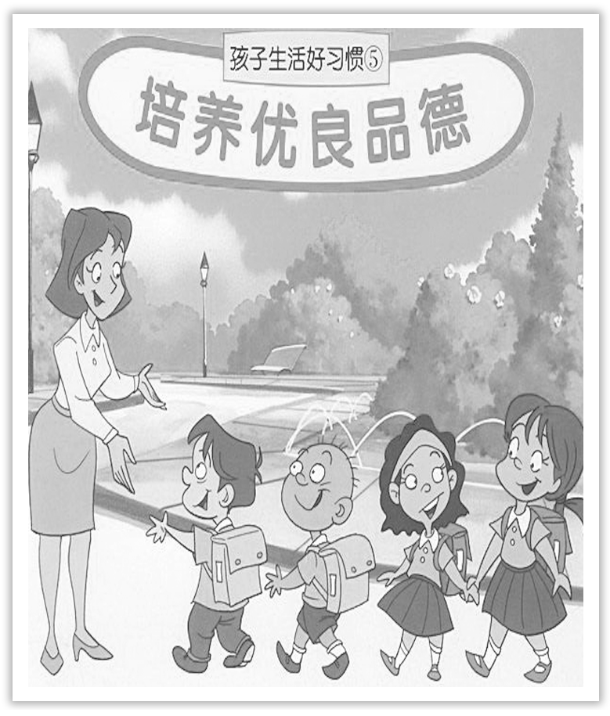
Unit 2 Morals and Virtues
Section Ⅶ Reading for Writing——故事评论
WWW.PPT818.COM

Slide 2
本单元的写作项目是阅读一篇关于道德品质的故事，写一篇有关道德品质故事的评论。

Slide 3
Ⅰ.Pre-writing
(Ⅰ)Learning a fable before writing
THE STONE IN THE ROAD
Once upon a time there was a king who often thought，“Nothing good can come to a nation whose people only complain and expect others to solve their problems.” One day，he had an idea.
Early one morning，the king disguised himself and went to a local village.He placed a large stone in the middle of the main street and hid gold coins under the stone.Then he hid behind a huge maple tree and watched.

Slide 4
The first person down the street was a milkman with his cart.He crashed into the stone，spilling the milk everywhere.“What fool put this stone here？” he shouted.He picked himself up and angrily went away.
After a while，a group of women came along，each balancing a pot of water on her head.One woman tripped over the stone and her water pot went crashing to the ground.She picked herself up and limped away in tears.Neither she nor her friends thought about moving the stone out of the road.
The king watched all day as many people complained about the stone but he found nobody making an attempt to move it.The king was in despair.“Is there no one in this village who feels any responsibility to keep their neighbours from harm？”

Slide 5
Just then，the king saw a young girl coming along.She was the daughter of a local farmer.She had been working all day and was very tired.But when she saw the stone，she said to herself，“This stone is a danger to anyone who comes down the street after dark.I’ll move it out of the way.”
The girl pushed the stone with all her might.After a great deal of effort，she finally succeeded in moving it to the side of the street.Imagine her surprise when she saw the gold coins where the stone had been！

Slide 6
Just then，the king stepped out from behind the tree.“Oh sir，” the girl said，“does this gold belong to you? If not，we surely must find the owner，for he will certainly miss it.”
The king said，“My dear，the gold is mine.I put it in the road and moved the stone over it.Now the gold is yours，because you are the only person who has learnt the lesson I wanted to teach my people.”

Slide 7
文章要点
Person：milkman
Experience：crashed into the stone
Emotion：angry
Response：went away
Person：woman with water
Experience：tripped over the stone
Emotion：in tears
Response：limped away
Person：other villagers

Slide 8
Experience：just complained about the stone
The king’s emotion：in despair
Person：young girl
Emotion：worried
Response：move the stone out of the way
Experience：saw the gold coins
Emotion：surprised
Person：king and girl
Experience：the king gave the gold to the girl
Purpose：teach villagers a lesson

Slide 9
(Ⅱ)Preparation—Answer the following questions before writing.
1.What is the title of the story?
2.What kind of story is it?
3.What is the main idea of the story?
4.What is the author’s purpose?
5.Were the details of the story clear?
6.Do you think the story achieved its purpose?
7.What did you like about the story?
8.What did you not like about the story?
9.Would you recommend this story to others?

Slide 10
Ⅱ.While-writing
Step 1 List the outline for writing a review of the fable.
Paragraph 1： | ________________________________
Paragraph 2： | ________________________________
Paragraph 3： | ________________________________
Basic information about the story
Your analysis of the story
Your opinion about the story

Slide 11
Step 2 List the words，phrases and sentences
1.Words and phrases
①____________ v.加标题；给……取名
②____________ n.目的
③____________遇到，碰到
④____________采取行动
⑤____________处理
title
purpose
meet with
take action
deal with

Slide 12
⑥________________在我们的日常生活中
⑦____________向某人学习
⑧________________关心他人
⑨________________自私的村民
⑩______________________有意义和有用的
in our daily life
learn from
care for others
selfish villagers
meaningful and helpful

Slide 13
2.Sentences
①故事讲的是一个国王想要给村民们一个教训，他把金子藏在了大街上的石头下。(who，by doing)
________________________________________________________________________
________________________________________________________________________
②这个故事的目的是告诉我们，当遇到问题时，我们不应该抱怨和期待别人来解决它们。(when doing，to do...)
________________________________________________________________________
________________________________________________________________________
It is about a king who wanted to teach villagers a lesson by hiding gold under the stone in the street.
The story’s purpose is to tell us that when meeting with problems we should not complain and expect others to solve them.

Slide 14
③事实上，我们应该做的是立即采取行动来处理我们日常生活中的问题。(主语从句，to do...)
________________________________________________________________________
________________________________________________________________________
④更重要的是，我们应该学习故事中无私的女孩总是关心别人，而不是学习其他自私的村民。(doing，rather than)
________________________________________________________________________
________________________________________________________________________
In fact，what we should do is to take action at once to deal with our problems in our daily life.
More importantly，we should learn from the selfless girl always caring for others in the story rather than other selfish villagers.

Slide 15
Step 3 Draft the passage by using the following words.
in fact，more importantly，rather than，and，remember
The fable titled“The stone in the road” is a moral story.It is about a king who wanted to teach villagers a lesson by hiding gold under the stone in the street.
The story’s purpose is to tell us that when meeting with problems we should not complain and expect others to solve them.In fact，what we should do is to take action at once to deal with our problems in our daily life.More importantly，we should learn from the selfless girl always caring for others in the story rather than other selfish villagers.

Slide 16
I like the story very much and I think it is very meaningful and helpful to us.Remember：one good turn deserves another.I will recommend this story to as many people as I can.

Slide 17
Ⅲ.Post-writing—polishing the passage
Exchange your passage with your partner and pay attention to the following points.
□1.Does the writer give a short description of the story?
□2.Does the description include the most important details of the story?
□3.Does the writer give his opinion about the characters or their actions?
□4.Is the review well-organised?
□5.Does the writer use the-ing form as the adverbial in the review?
□6.Are there any grammar，spelling，or punctuation errors？

Slide 18
亮点表达
1.The fable tells us that one good turn deserves another.
这则寓言告诉我们，善有善报。
2.Whenever I have the ability to help others，I should always lend a hand.
每当我能帮助别人的时候，我应该总是伸出援助之手。
3.After reading it，I understand that we teenagers should find and make good use of our advantages，stopping complaining the shortcomings all the time.
读了这个故事之后 ，我明白了我们青少年应该发现和利用我们的优势，不要总是抱怨自己的缺点。

Slide 19
4.So we should stay positive and value what we have instead of complaining too much.
所以我们应该保持积极的态度，珍惜我们所拥有的，而不是抱怨太多。
5.This story indicates that those not blindly listening to other’s criticism or praise are more likely to obtain what they are pursuing.
这个故事表明，那些不盲目听别人批评或赞扬的人更有可能获得他们所追求的东西。
6.So whatever you encounter，accept it willingly and use it to the fullest.
所以无论你遇到什么，欣然接受并充分利用它。

Slide 20
7.As a matter of fact，the fable mirrors that different attitudes may bring about different results.
事实上，这个寓言反映了不同的态度可能会带来不同的结果。
8.As an old saying goes，union means power.
俗话说，团结就是力量。

Slide 21
写作技巧
1.引述材料
有的放矢地引用原文或摘录关键词、句，或概述要点。不管采用哪种方式引述，“引”都要简练、准确，有针对性。
2.分析材料
要对读的内容进行一番评析。可以由现象到本质，由个别到一般地作一番挖掘；对寓意深的材料更要作深度分析。

Slide 22
3.联系实际
要紧密联系实际，既可以从大处着眼，也可以从小处入手。
4.总结全文
总结既可以回应前文，也可以提出希望，发出号召。

