Slide 1
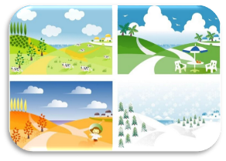
Unit6 There are four seasons in a year.
人教精通版六年级上册
WWW.PPT818.COM

Slide 2
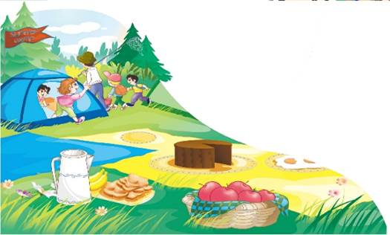
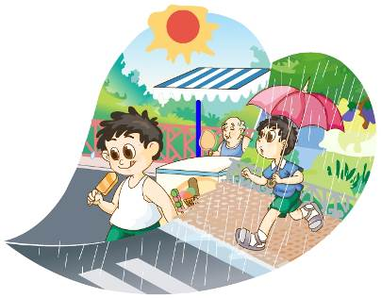
>>Review
Think and say
When does summer begin?
How’s the weather in summer?
What do students do on summer holidays?

Slide 3
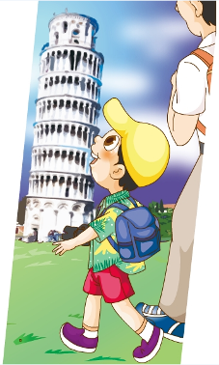
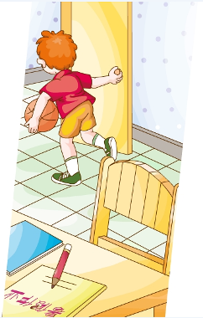
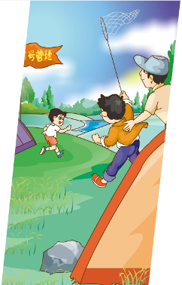
>>Review
Look and match
go to a summer camp
have summer
holidays
go on a trip

Slide 4
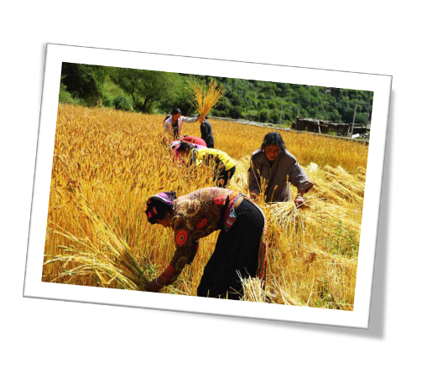
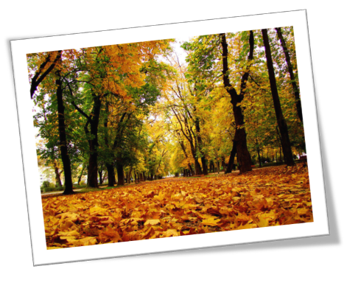
>>Lead-in
Look and say
Which season is this?
autumn
(fall)

Slide 5
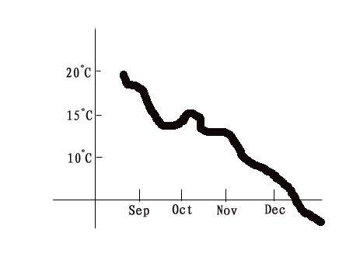
>>Presentation
Look and say
What’s the weather like in autumn?
The weather gets colder and colder.

Slide 6
>>Presentation
Look and say
 | 白天
 | 日出 | 日落 | 白天总计 (小时)
Sep.22nd | 05:58 | 18:09 | 12.51
Oct. 27th | 06:32 | 17:18 | 10.86
Nov. 15th | 06:54 | 16:58 | 10.04
Dec. 3rd | 07:13 | 16:49 | 9.36
The days get ________________.
shorter and shorter

Slide 7
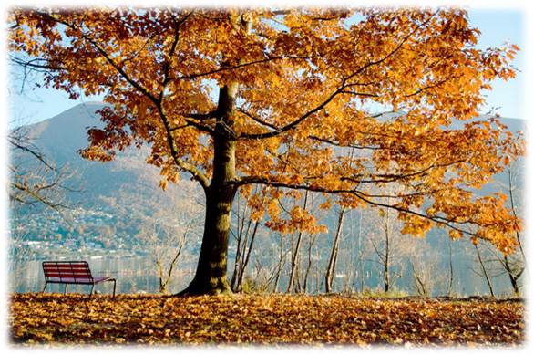
>>Presentation
Look and say
The leaves on the trees are __________________.
yellow and brown

Slide 8
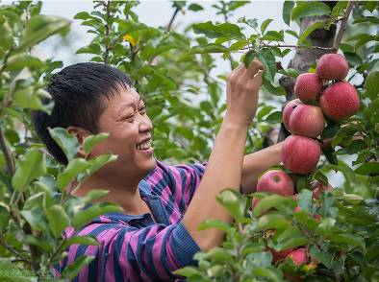
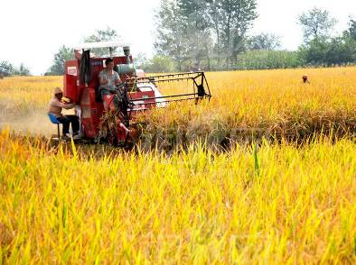
>>Presentation
Look and say
The farmers are busy harvesting.
pick apples
cut rice

Slide 9
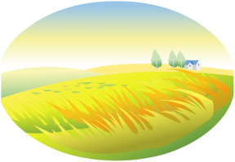
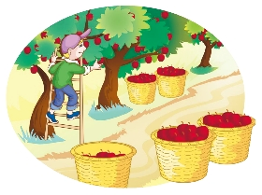
>>Presentation
Just read and talk
Listen and find the answers:
Q1: When does autumn begin?
Q2: Is autumn the golden season?
It begins around September.
Yes, it is.

Slide 10
>>Presentation
Read and say
Autumn
Time
begin around September
Weather
get colder and colder
Days
get shorter and shorter
Leaves on the trees
yellow and brown
Farmers
busy harvesting

Slide 11
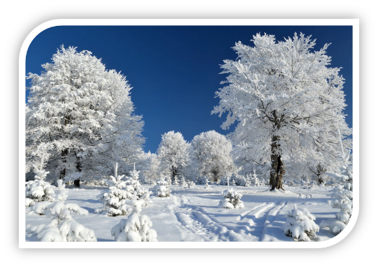
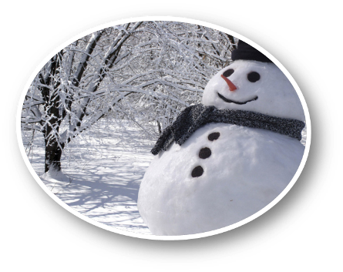
>>Presentation
Look and say
winter
Winter is the _____ season.
white

Slide 12
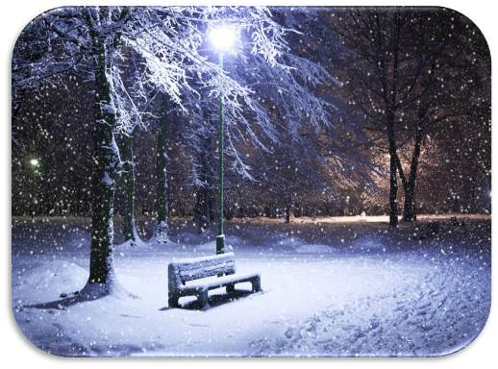
>>Presentation
Look and say
The weather is ___ and it often _____.
cold
snows

Slide 13
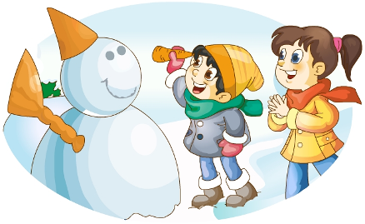
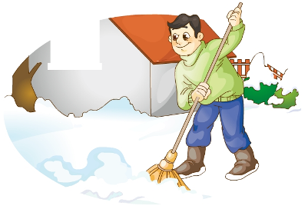
>>Presentation
Look and say
What do people often do in winter?
make a snowman
sweep the snow

Slide 14
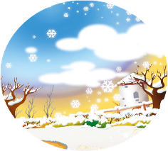
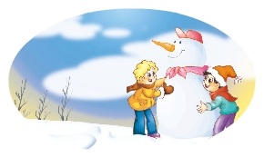
>>Presentation
Just read and talk
Listen and find the answers:
Q3: When does winter begin?
Q4: What do children do in winter?
It begins around December.
They make snowmen.

Slide 15
>>Practice
Just read and talk
Listen and imitate
Autumn is the third season of the year. It begins around September. The weather gets colder and colder. The days get shorter and shorter.
Autumn is the golden season. The leaves on the trees are yellow and brown. The farmers are busy harvesting. Look! This farmer is picking apples.

Slide 16
>>Practice
Just read and talk
Listen and imitate
Winter is the fourth and the last season of the year. It begins around December. The weather is cold and it often snows.
Winter is the white season. When it snows, everything is white. It looks beautiful! Children make snowmen. What beautiful snow!

Slide 17
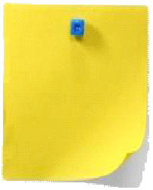
>>Practice
Let’s read
Read together.
(齐读)
Read in pictures.
（分图读）
Read in groups.
(分组读）

Slide 18
>>Practice
Let’s sing

Slide 19
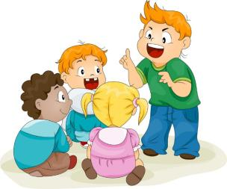
>>Practice
Group work
What’s your favorite season?
What do you often do in that season?

Slide 20
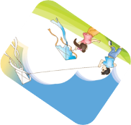
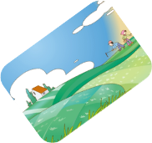
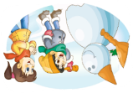
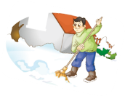
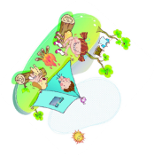
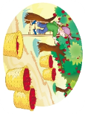
>>Practice
Let’s play!

Slide 21
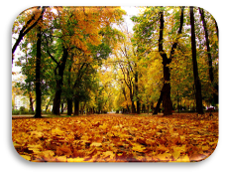
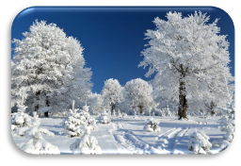
>>Summary
本课学习主要学习的季节和该季节的相关活动是什么？
autumn
winter
pick apples
make a snowman
cut rice
sweep the snow

Slide 22
>>Homework
1.跟读课文动画或录音，按照正确的语音、语调朗读课文。 2.写一写你最爱的季节是什么，并写出该季节的天气特点以及人物活动等。
3.做一做本单元的相关练习。

