Slide 1
Unit 3 Winter in Canada
Lesson 14 Snow! It’s Winter!
WWW.PPT818.COM

Slide 2
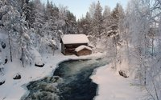
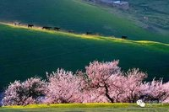
Warming up
1. Free talk
Which season do you like best?
Why?

Slide 3
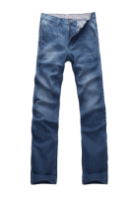
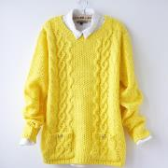
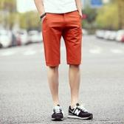
Warming up
2.Let’s play 季节服装搭配

Slide 4
Presentation
1.Sing a song.
How’s the Weather - 儿童歌曲
How’s the weather?
It’s sunny.
How’s the weather?
It’s sunny.
How’s the weather?
It’s sunny.
It’s sunny today.
How’s the weather?
It’s rainy.
How’s the weather?
It’s rainy.
How’s the weather?
It’s rainy.
It’s rainy today.
How’s the weather?
It’s snowy.
How’s the weather?
It’s snowy.
How’s the weather?
It’s snowy.
It’s snowy today.
warm, hot, cold, sunny, snowy

Slide 5
Presentation
2. Ask and answer.
What day is it today?
Today is…
What’s the date today?
It’s December…
How’s the weather today?
It’s cold and snowy.
What should we do?
We should put on…

Slide 6
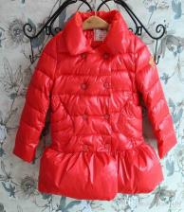
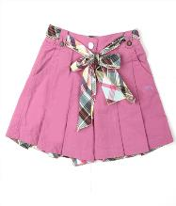
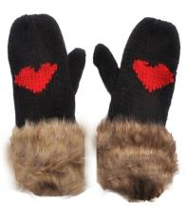
Presentation
3. Guess and revise the words about clothes.
scarf
hat
coat
skirt
gloves

Slide 7
Presentation
4.Play the tape and ask them to follow it.
5.Group work.
What day is it today?
What’s the date today?
How’s the weather today?
What should we do?

Slide 8
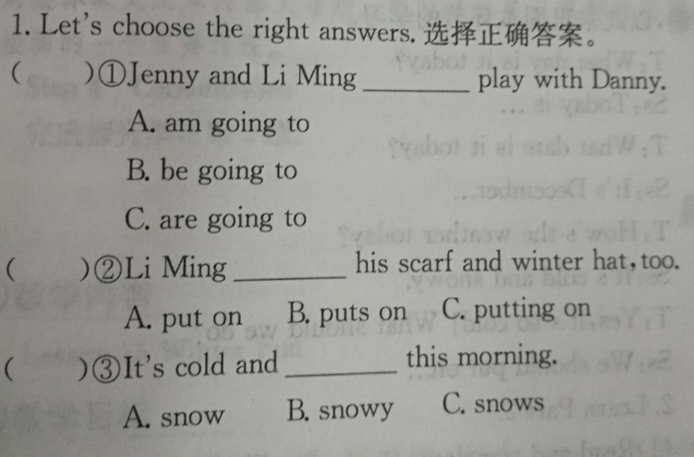
Presentation
C
B
B

Slide 9
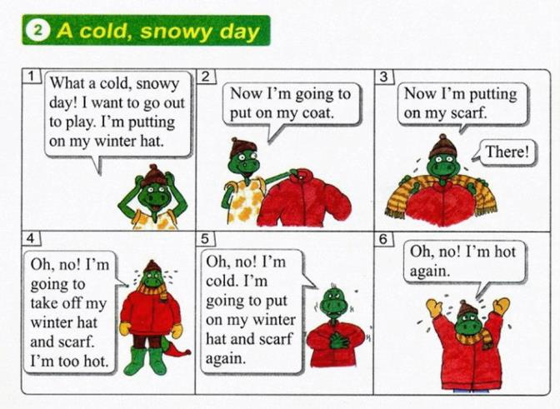
Presentation
A cold, snowy day

Slide 10
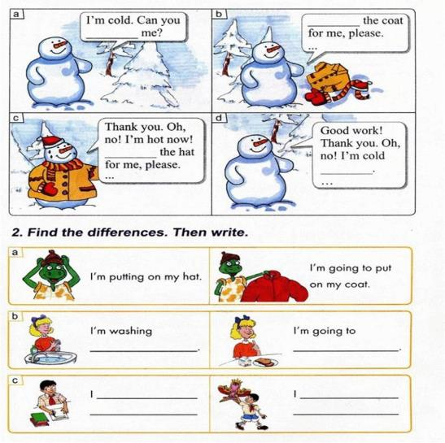
Presentation
Let’s do it!

Slide 11
Practice
阅读课文内容，完成习题
1.What day is it today?
_________________________________
2.What are Jenny and Li Ming going to do?
__________________________________
3.How’s the weather today? ___________________________________
4.What does Jenny put on?
____________________________________
5.What does Li Ming put on?
_____________________________________
Today is Saturday, December 9.
They are going out to play with Danny.
It is cold and snowy.
Jenny puts on her winter coats.
Li Ming puts on his scarf and winter hat.

Slide 12
Consolidation
Let’s listen , say and share.
说出你听到的句子或单词，并尽可能地做出相应的讲解，与同学分享。
1_______________________
2_______________________
3_______________________
4_______________________

Slide 13
Summing up
1.Words:
put on, take off
2. Sentences:
Put on your winter clothes!
I’m doing…
I’m going to do…
3.
这节课我的收获是：_____________
这节课我的不足是：_____________

Slide 14
Homework
1.听录音，朗读本课的第一部分
2.完成相关习题

