Slide 1

Unit 14
I remember meeting all of you in Grade 7.
Section B
WWW.PPT818.COM

Slide 2

Section B
课前自主预习
单 词 闯 关 | 1.经理；经营者 n. ________ →(同根词)经营；管理 v．________ 2．祝贺 v. _________→(派生词)祝贺 n. _________ 3．感谢的；感激的 adj. ________→(同根词) 感谢；感激 v．________
manager
manage
congratulate
congratulation
thankful
thank

Slide 3
Section B
单 词 闯 关 | 4．任务；工作 n. ________ 5．有责任心的 adj. __________ 6．单独的；分离的 adj. 分开；分离 v. ________
task
responsible
separate

Slide 4
Section B
短 语 互 译 | 1.信任；信赖 ____________ 2．首先 ____________ 3．渴望；渴求 ____________ 4．在……前面 ____________ 5．对……有责任；负责任 ____________
believe in
first of all
be thirsty for
ahead of
be responsible for

Slide 5
Section B
短 语 互 译 | 6．分离；隔开 ____________ 7．向……学习 ____________ 8．在将来 ____________ 9．长大；成长 ____________ 10.犯错误 ____________
separate from
learn from
in the future
grow up
make mistakes

Slide 6
Section B
短 语 互 译 | 11．be thankful to sb. _____________ 12．along with ________________ 13．be proud of ____________ 14．give up ____________ 15．wait for ____________ 16．set out ____________ 17．deal with ____________
对某人心存感激
连同；除……以外还
为……感到自豪
放弃
等待
出发；启程
处理，对付

Slide 7
Section B
句 型 在 线 | 1.但是除困难以外，还会有很多令人兴奋的事情等着你们。 But ________ ________ difficulties, there will also be many exciting things waiting for you.
along with

Slide 8
Section B
句 型 在 线 | 2.虽然现在你们不得不走上不同的道路，但是 我希望在几年后，你们会回来参观我们学校。 ________ you have to go your separate ways now, I hope that in a few years' time, you'll come back to visit our school.
Although

Slide 9
Section B
课 文 初 探 | 阅读2b，补全句子。每空一词。 1．First of all, the writer would like to _________ all the students who are here today. 2．Some of the students were a little difficult to ________ ________.
congratulate
deal with

Slide 10
Section B
课 文 初 探 | 3．The writer hopes the students will remember ________ ________ ________ in their lives who helped and supported them. 4．The writer thinks the key is to learn from their mistakes and ________ ________ ________. 5．The writer hopes the students will come back to ________ ________ ________ in a few years' time.
the important people
never give up
visit their school

Slide 11

Section B
课堂互动探究
词汇点睛
1 first of all 首先
[观察] First of all, I'd like to congratulate all the students who are here today. 首先，我要祝贺今天所有在这儿的学生。

Slide 12
Section B
[拓展] all的相关短语：
all in all 总而言之 ____________总共；总计
____________毕竟；终究 ____________遍及；到处
above all最重要的是；尤其是 ____________ 一直；总是
in all
after all
all over
all the time

Slide 13
Section B
活学活用
1．We will spend the coming
week together. So ________， let's know each other's names.
A．in the end
B．all the time
C．first of all
D．as a result
C

Slide 14
Section B
【解析】in the end意为“最后，终于”；all the time意为“一直，总是”；first of all意为“首先，第一”；as a result意为“因此，结果”。题干中提到了“我们会一起度过即将到来的这一周”，由此可推断，首先，让我们先知道一下对方的名字，故答案为C。

Slide 15
Section B
2 congratulate v. 祝贺
[观察] You won the competition. I congratulate you.
你赢了比赛，祝贺你。
She congratulated him on the birth of his son. 她祝贺他喜得贵子。

Slide 16
Section B
[探究] congratulate作动词，意为“祝贺”，通常作及物动词。____________________表示“祝贺某人某事；为某事向某人祝贺”。
congratulate sb. on sth.
[拓展]派生词： congratulation n. 祝贺；恭喜(通常用复数形式)

Slide 17
Section B
活学活用
2．—Our school art festival has been a big success.
—________
A．Congratulations!
B．No problems.
C．Good idea!
D．Thank you.
A

Slide 18
Section B
3 thirsty adj. 渴望的；口渴的
[观察] You were all so full of energy and thirsty for knowledge.
你们都精力充沛，渴求知识。
I'm thirsty. Could you please give me some water?
我口渴了。你能给我一些水吗？

Slide 19
Section B
[探究] thirsty作形容词，意为“口渴的”。它还有“渴望的”之意，此时表示抽象意义。be thirsty for 意为“渴望；渴求”。

Slide 20
Section B
活学活用
3. As a teacher, I love being with my students. You can't imagine how much they ________ knowledge!
A．are thirsty for
B．are famous for
C．are good for
D．are bad for
A

Slide 21
Section B
4 thankful adj. 感谢；感激
[观察] Never fail to be thankful to the people around you.
永远不要忘了对周围的人心存感激。
[探究] thankful作形容词，其动词形式是thank。________________ 意为“对某人心存感激”。
be thankful to sb.

Slide 22
Section B
[拓展]

Slide 23
Section B
活学活用
4．(1)用括号中所给单词的适当形式填空
2017·临沂Mrs. Dean was ________(thank) to the policemen who had helped her kids arrive safely.
(2)根据汉语意思完成句子
我对我的英语老师心存感激。
I ________ ________ ________ my English teacher.
thankful
am thankful to

Slide 24
Section B
5 responsible adj. 有责任心的
[观察] Choose wisely and be responsible for your decisions and actions. 明智地选择，并为自己的决定和行为负责。
[探究] responsible作形容词，意为“有责任心的”。be responsible for意为“对……有责任；负责任”。

Slide 25
Section B
活学活用
5.你应该对你自己的决定负责。
You should ________ ________ ________ your own decision.
be responsible for

Slide 26
Section B
6 separate adj. 单独的；分离的 v. 分开；分离
[观察] They have their separate bedrooms.
他们都有自己单独的卧室。
The fat will separate from the mixture.
脂肪会从混合物中分离出来。

Slide 27
Section B
[探究] separate作形容词，意为“单独的；分离的”，通常位于名词之前作________；separate还可以作动词，意为“分开；分离”，通常和介词________搭配。
定语
from
[辨析] divide和separate
两者都有“分开”之意，________通常指把整体分为若干部分，通常和介词into搭配；________通常指把原来连在一起或靠近的东西分隔开来，通常和from搭配。
divide
separate

Slide 28
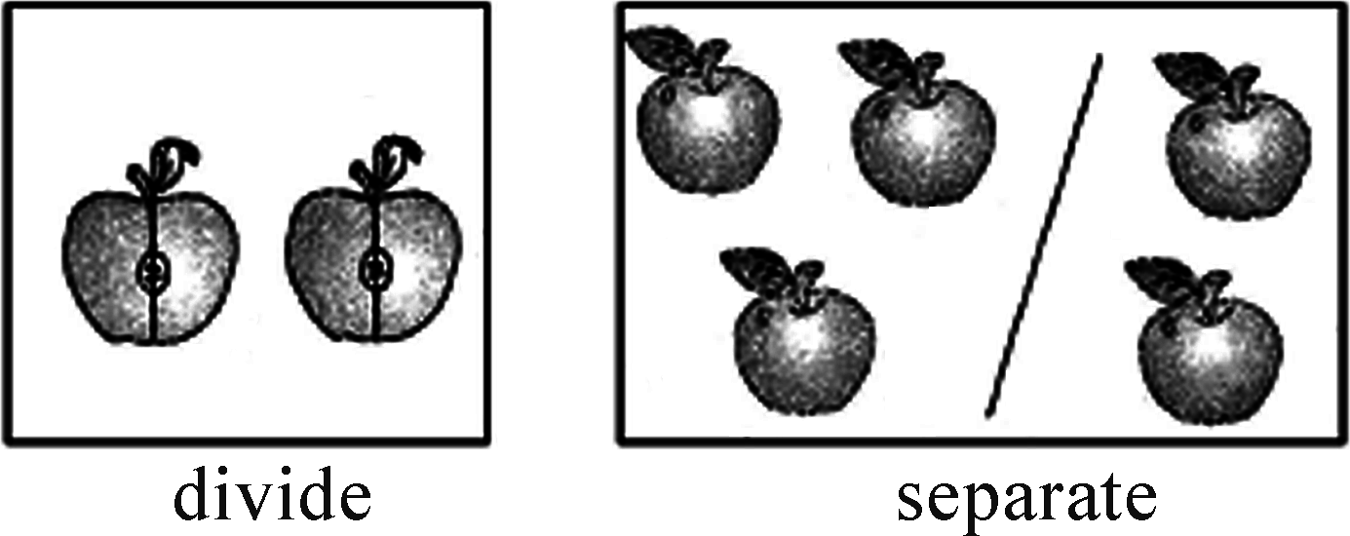
Section B
The apple is divided into two halves.
那个苹果被分成了两半。
She separated the two apples from the others.
她把那两个苹果和其他苹果分开了。

Slide 29
Section B
活学活用
6．(1)根据汉语意思完成句子
①这位病人应该和其他病人隔开。
This patient should be ________ ________ the other patients.
②世界被分成七大洲。
The world is ________ ________ seven continents.
separated from
divided into

Slide 30
Section B
(2)单项选择
2018·宜昌 —A research suggests that walking helps people live longer.
—I quite agree, but it ________ on when and how they walk.
A．remains B．separates
C．returns D．depends
D

Slide 31
Section B
7 set out 出发；启程
[观察] As you set out on your new journey, you shouldn't forget where you came from.
在新的旅行启程之际，你不应忘了你来自何处。

Slide 32
Section B
[探究] set out是固定搭配，意为“出发；启程”，和set off同义。
[辨析] set out还表示“着手，开始”； ____________表示“着手做某事”。如：
They set out to perform the operation.
他们开始动手术。
set out to do sth.

Slide 33
Section B
活学活用
7．(1)根据汉语意思完成句子
他明天动身去北京。
He will ________ ________ on his journey to Beijing tomorrow.
set out

Slide 34
Section B
(2)单项选择
2018·滨州 People now in many big cities have to ________ early to avoid the heavy traffic in the morning.
A．set out B．put out
C．take out D．give out
A

Slide 35
Section B
句型透视
1 But along with difficulties, there will also be many exciting things waiting for you.
但是除困难以外，还会有很多令人兴奋的事情等着你们。
[探究] ________是固定搭配，意为“连同；除……以外还”。如：
Take the letters along with the newspapers.
把信连同报纸一起带去。
along with

Slide 36
Section B
[注意]当主语后跟along with…结构时，谓语动词的单复数要和along with________(之前/之后)的主语的数保持一致。如：
The classroom along with its desks and chairs was rented.
这间教室连同桌椅都是租的。
之前

Slide 37
Section B
活学活用
1．Mary, along with her parents ________ Hainan for a week and they will come back soon.
A．have been to
B．has been in
C．have been in
D．has been to
B

Slide 38
Section B
2 Although you have to go your separate ways now, I hope that in a few years' time, you'll come back to visit our school.
虽然现在你们不得不走上不同的道路，但是我希望在几年后，你们会回来参观我们学校。

Slide 39
Section B
[探究] although意为“尽管，虽然”，引导________状语从句。although和though, even though同义，它们不能和________同时使用，但可以和________， yet搭配使用。如：
Although it rained heavily, they still kept working in the field.
尽管雨下得很大，但他们仍然在田地里继续工作。
让步
but
still

Slide 40
Section B
活学活用
2.(1)2017·成都Many people still try to climb Qomolangma every year ________ it is very dangerous.
A．when B．if C．though
(2)2018·海南________ the girl is only six years old, she knows more than 300 ancient Chinese poems.
A．If B．Unless C．Although
C
C

Slide 41
Section B
课文回顾
thirsty for knowledge
to deal with
helped and supported
be thankful to
learn from your mistakes
decisions and actions

