Slide 1
Module 3
Unit 2 Lesson 2
2
What’s your name?
WWW.PPT818.COM
Notes:
1
1

Slide 2
New words
what 什么
your 你的
what’s/what is 是什么
name 名字
my 我的

Slide 3
what's = what is
重点句型：
What's your name?
你叫什么名字？
I'm … / My name is …
我叫……

Slide 4
Your name, please?
相当于
What’s your name, please?
回答：
My name is…/ I’m…
或者直接说自己的姓名。

Slide 5
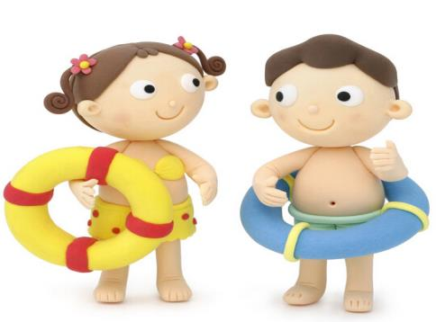
My name is Jack.
Hello, what’s your name?

Slide 6
Hello, what’s your
name?
My name is Crystal.

Slide 7
My name is Li Ming.
Hello, What’s your name?

Slide 8
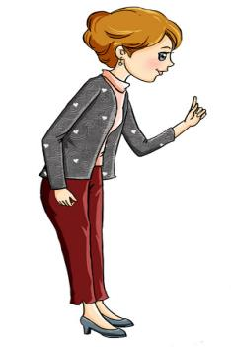
What’s your name?
My name is Sara.

Slide 9
What’s your name?
My name is Susan.
Nice to meet you,
too.
Nice to meet you.

Slide 10
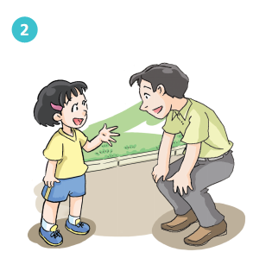
My name is Wei.
What’s your name?
Nice to meet you, too.
Nice to meet you.

Slide 11
What’s your name?
My name is Susan.
Nice to meet you,
too.
Nice to meet you.

Slide 12
My name is Yang Juan.
Hello, What’s your name?
Nice to meet you,
too.
Nice to meet you.

Slide 13
Homework
1 Copy the words and sentences.
what name your my
What’s your name?
My name is…
2 Make a mini dialogue.

Slide 14
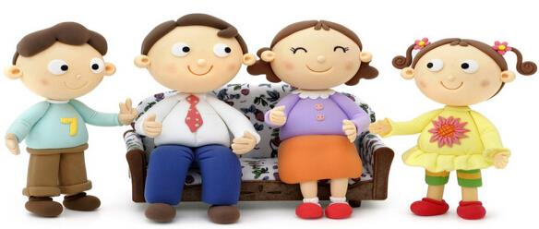
Thank you!

