Slide 1
Unit 14
I remember meeting all of you in Grade 7.
Section B 第2课时
R·九年级下册
WWW.PPT818.COM

Slide 2
Lead-in

Slide 3
Now, let’s enjoy a graduation song.

Slide 4
What is the most important thing you
have learned in junior high school ?
Discuss the question with a partner.
2a

Slide 5
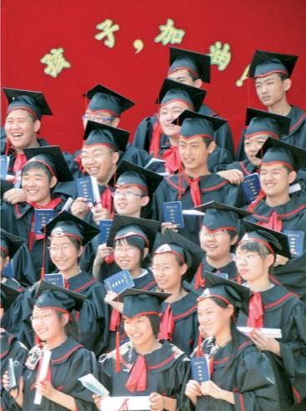
2b
Read the passage and answer the questions.
1. What kind of text is this? Is it
a story, a speech or a notice?
2. Who do you think wrote it?
3. Who is it for?

Slide 6
What kind of text is this? Is it a story, a
speech or a notice?
2. Who do you think wrote it?
3. Who is it for?
It is a speech.
The principal of the school is probably the person who wrote it.
It is for the graduating students of the school.

Slide 7
称呼语：
________________________________________________
问候语：
________________________________________________
结尾：
________________________________________________
Ladies and gentlemen,
Thank you for coming today to attend the graduation ceremony at No. 1 Junior High School.
Good luck and hope to see you again sometime soon.

Slide 8
Read the second paragraph and answer the question.
Why should we be thankful to the people around us?
They have done a lot for us and they mean a lot to us.

Slide 9
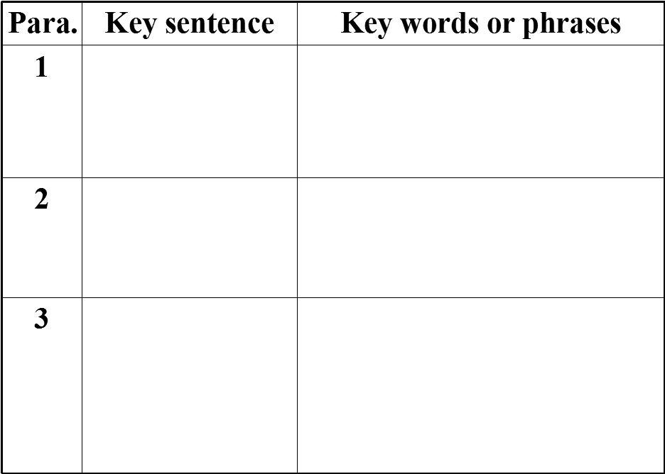
You’ve all grown up so much and I’m so proud of you.
graduation ceremony, congratulate, talented, full of hope, grow up, proud of
Never fail to be thankful to the people around you.
remember the important people who helped and supported you
difficult tasks, make mistakes, learn from mistakes, never give up, make your own choices, be responsible for your decisions
The end of junior high school is the beginning of a new life.

Slide 10
Ladies and gentlemen,
Thank you for coming today to attend the graduation ceremony at No. 3 Junior High School. First of all, I’d like to congratulate all the students who are here today. I remember meeting all of you when you were just starting Grade 7 at this school. You were all so full of energy and thirsty for knowledge. And yes, some of you were a little difficult to deal with! But today I see a room full of talented young adults who are full of hope for the future. You’ve all grown up so much and I’m so proud of you.
首先；第一
be proud of
= take pride in
为……感到自豪/骄傲
充满激情，渴望知识

Slide 11
你们没有孤军奋战
Although you’ve all worked very hard over the last three years, none of you did it alone. I hope you’ll remember the important people in your lives who helped and supported you — your parents, your teachers and your friends. Please consider what they’ve done for you and what they mean to you. Never fail to be thankful to the people around you.
永远要感谢陪伴在你身边的人

Slide 12
Lastly, the end of junior high school is the beginning of a new life. I don’t need to tell you that life in senior high school will be harder and that you have many difficult tasks ahead of you. You’ll make mistakes along the way, but the key is to learn from your mistakes and never give up. But along with difficulties, there will also be many exciting things waiting for you. Behind each door you open are chances to learn new things, and you have the ability to make your own choices.
……的关键
倒装句，原句顺序为：Chances to learn new things are behind each door you open，起强调作用，强调主语chances。

Slide 13
Choose wisely and be responsible for your decisions and actions. Although you have to go your separate ways now, I hope that in a few years’ time, you’ll come back to visit our school. As you set out on your new journey, you shouldn’t forget where you came from. The future is yours.
Good luck and hope to see you again sometime soon!

Slide 14
Read the passage and match the main idea for each paragraph.
Para. 1
Para. 2
Para. 3
Tell students something they should
or shouldn’t do in the future.
Tell students to be thankful to those
who have helped them.
Congratulate all the students and
compare the past with the present.

Slide 15
2c
Read the passage again and answer the questions.
1. What were the students like in Grade 7?
2. How have the students changed?
They were all so full of energy and thirsty for knowledge.
They become talented young adults who are full of hope for the future.

Slide 16
3. Who should the students thank and why?
4. What will senior high be like?
Their parents, their teachers and their friends. Because they helped and supported them.
It will be harder and that you have many
difficult tasks ahead of you.

Slide 17
5. How should the students deal with the future?
6. What advice would you give to students who are
just starting junior high school?
They should learn from their mistakes and never give up, choose wisely and be responsible for your decisions and actions, and never forget where they come from.
They should work hard and enjoy every day of their junior high school.

Slide 18
Fill in the blanks with the correct forms of the words in the box.
2d
参加
attend
be thirsty for
none
set out
be proud of
渴望
没人
启程
为……骄傲

Slide 19
attend be thirsty for none
set out be proud of
1. It is time to say goodbye, but ______ of us want to leave.
2. It is always hard to separate from those whom you
have spent so much time with for the past three
years. However, we are still excited to _______on a
new journey when we enter senior high school.
none
set out

Slide 20
attend be thirsty for none
set out be proud of
3. The teacher can see in our eyes that we ____________ knowledge. She tells us that knowledge will give us wings to fly.
4. We will ___________ the junior high graduation
ceremony tomorrow. It is a very special time for us.
are thirsty
for
attend

Slide 21
attend be thirsty for none
set out be proud of
5. Our teachers and parents will ____________
us because we have grown up and can be
responsible for ourselves.
be proud of

Slide 22
Underline the sentences you like in the
passage. Tell your partner what they
mean and why you like them.
2e

Slide 23
Language points
1. Thank you for coming today to attend the
graduation ceremony at No. 3 Junior High School.
例：谢谢你邀请我们参加你的生日聚会
Thanks for inviting us to your birthday party.
Thank you / Thanks for 意为“因……而感谢（你/你们）”，后面接名词、代词或动词 - ing形式。

Slide 24
辨析 thanks for 与 thanks to

Slide 25
2. You were all so full of energy and thirsty for
knowledge.
be thirsty for意为“渴望；渴求”
be thirsty for doing sth. 渴望做某事；
be thirsty for sth. 渴望得到某物。
例：青年人应该渴望知识。
Young man should be thirsty for knowledge.

Slide 26
3. some of you were a little difficult to deal with!
deal with为固定短语，意为“处理；对付”
例：他已经学会了应对各种困难。
He has learned to deal with all kinds of difficulties.

Slide 27
4. none of you could have succeeded by yourselves.
例：学生中没有人以前见过我。
None of the students has / have seen me before.
none of 意为“没有一个；都不”，作主语时，若后跟不可数名词，谓语动词要用单数形式；若后跟可数名词的复数，谓语动词用单、复数形式均可。

Slide 28
拓展:
no one常用来指人，不与of连用，作主语时谓语动词要用单数形式。
例：没有人喜欢没礼貌的人。
No one likes a person with bad manners.

Slide 29
5.You’ll make mistakes along the way
make mistakes为固定短语，意为“犯错”，相当于make a mistake。mistake后可接介词in，表示在某方面犯错误。
例：我在拼写上犯了几处错误。
I made a few mistakes in spelling.

Slide 30
mistake还可以作动词，意为“弄错；误解；误会”，可用于短语mistake…for…，意为“把…错当成…”。
例：她妈妈总把她错当成她的妹妹。
Her mother always mistakes her for her
younger sister.

Slide 31
6. Choose wisely and be responsible for your
decisions and actions.
responsible为形容词，意为“负责任的；承担责任的”，后面经常接介词for或to，在句中作表语。
be responsible for … “对……有责任；负责任”。

Slide 32
take responsibility for sth.意为“对某事负责任”。
例：要明智地做出选择并对你们的决定和行为负责。
Choose wisely and take responsibility for your
decisions and actions.

Slide 33
7. As you set out on your new journey, you shouldn’t
forget where you came from.
set out on sth.为固定的结构，意为“开始进行新的或重要的事情”。
set out to do sth.打算或着手做某事。

Slide 34
Exercise
1. The poor children are __________(渴望) knowledge.
2. He will _____________ (感激) you.
3. There will be difficulties _________ (在...前面) you.
4. At last, he _____________ (分离) his parents.
thirsty for
be thankful to
ahead of
separate from

Slide 35
5. ______, the content of any article should be relevant
to the reader.
A. First of all B. After all
C. As a result D. For example
6. — Mum, I've got the first prize in the photo competition.
— ________!
A. Good luck B. Not at all
C. Good idea D. Congratulations
A
D

