Slide 1
Unit 3 Family
This is my family.
WWW.PPT818.COM

Slide 2
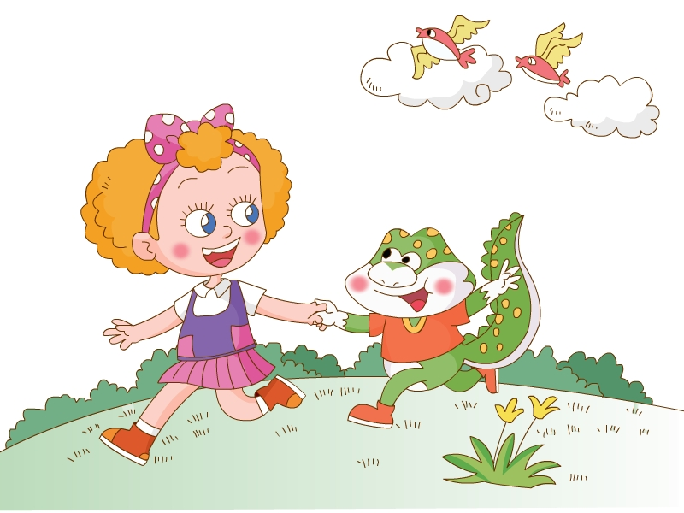
Let's chant.

Slide 3
Watch the rideo.
Q:What’s meaning of the word family? (family 什么意思？)
family
This is Jenny.

Slide 4
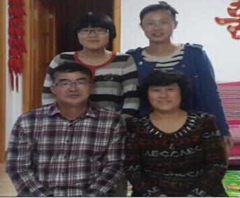
family
家
This is my family.

Slide 5
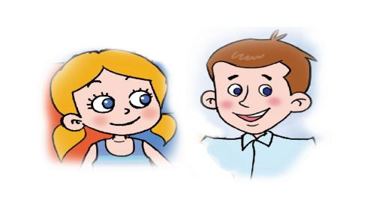
Listen,point and circle.
Q:Who are they?
(他们都是谁？)
mother
father
sister
brother

Slide 6
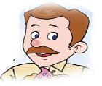
Match and say.
This is my mother.
This is my father.
This is my sister.
This is my brother.

Slide 7
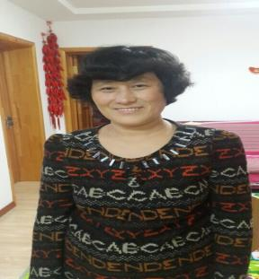
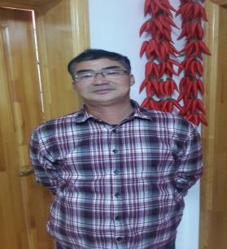
This is my mother.
This is my father.

Slide 8
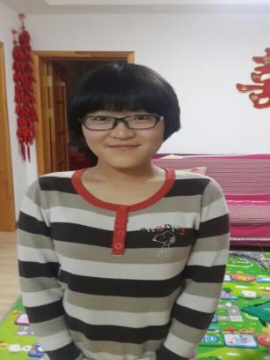
This is my sister.
(姐姐，妹妹)

Slide 9
This is my brother.
(哥哥，弟弟)

Slide 10
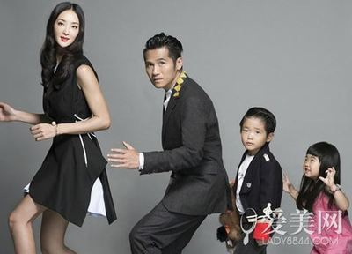
mother
father
Joy
Grace
This is Joy’s family.

Slide 11
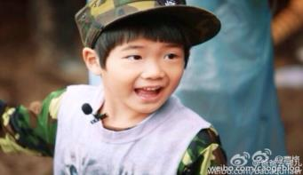
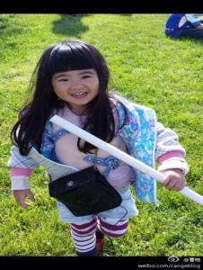
This is my sister.
Joe
Grace
This is my brother.

Slide 12
Father,mother, sister. This is my brother. Father,mother,brother. This is my sister. I love my family. We’re happy together.
Let's chant.

Slide 13
Listen,point and imitate.
（听音，指读，模仿。）
Practice in pairs.
（同桌练习。）
Role play.
（扮演Jenny,给课文配音。）

Slide 14
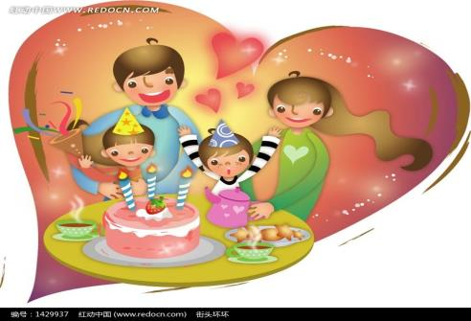
Group work.
今天明明过生日，邀请玲玲来家中参加他的生日聚会······
（见面后，他们会说些什么呢？）
Hello.
This is Lingling.
She’s my friend.
Nice to meet you.
This is my family.
Happy birthday to you.

Slide 15
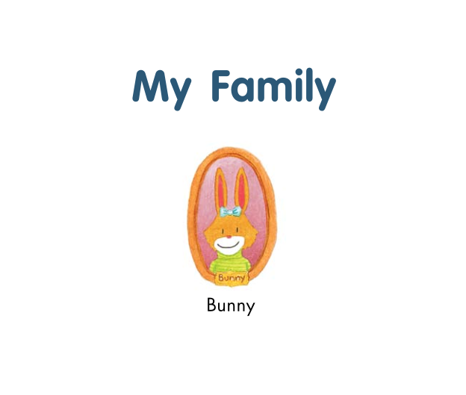
Story
(小故事)

Slide 16
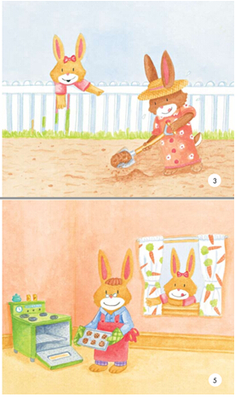
This is my mother.
She likes to dig.
(挖土)
This is my father.
He likes to bake.
（烘烤食物）

Slide 17
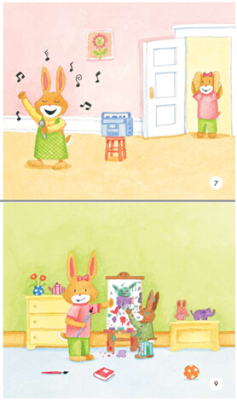
This is my sister.
She likes to sing.
This is my brother.
He likes to draw.
(绘画)

Slide 18
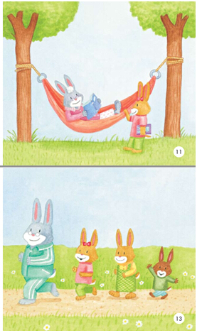
This is my grandma.
She likes to read.
This is my grandpa.
He likes to run.

Slide 19
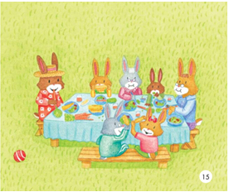
This is my family.
My family likes to eat.

Slide 20
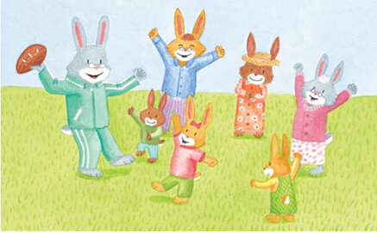
And my family loves to play.

Slide 21
True or false?
（判断对错，对的画“√”，错的画“×”）
√
1.My mother likes to dig. （ ）
2.My father likes to bake. （ ）
3.My sister likes to read. （ ）
4.My brother likes to run. （ ）
√
×
×

Slide 22
family
家

Slide 23
应该跟父母说点什么呢？
Father and mother I love you.

Slide 24
Summary
What have you learnt today?(今天你学到了什么？)
family
This is my mother.
father
sister
brother

Slide 25
Homework
1.Listen and read the text 3 times.(必做)
2.Say ‘I love you’to your father and mother. （必做）
3.Introduce your family to your friends.（选作）

