Slide 1
Unit 4 Li Ming Comes Home
Lesson 19 Buying Gifts
WWW.PPT818.COM

Slide 2
Warm-up
Greetings
Hello, boys and girls.
Hi, Miss … Nice to meet you!
Nice to meet you, too!

Slide 3
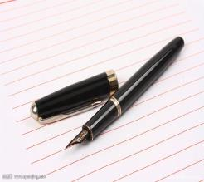
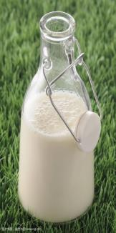
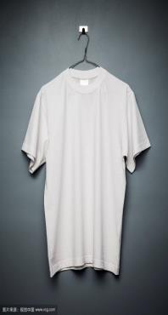
Review
Let’s go to the…to…

Slide 4
Presentation
This is China’s flag.
This is Canada’s flag.
It’s red and yellow.
It’s red and white.

Slide 5
This is U.S.’s flag.
This is U.K.’s flag.
It’s red, white and blue.
It’s red, white and blue.

Slide 6
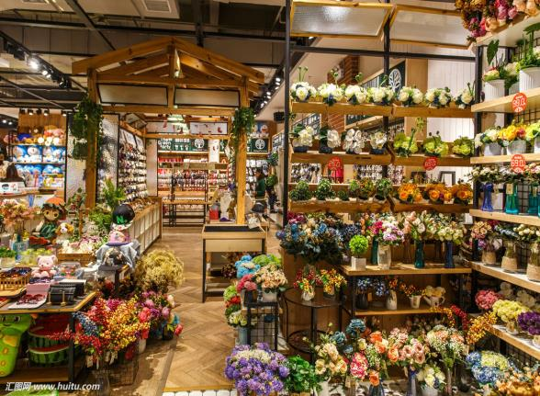
There are so many gifts in this shop.
I want to buy a surprise for my mother.

Slide 7
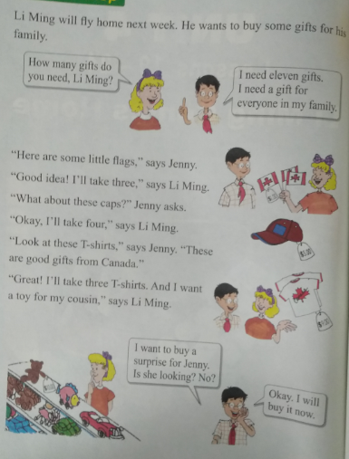
At the shop

Slide 8
Questions:
How will Li Ming go home next week?
He will fly home next week.
How many gifts does Li Ming need?
He needs eleven gifts for everyone in his family.
How many T-shirts will Li Ming take?
He will take three T-shirts.
What does Li Ming want to buy for his cousin?
He wants a toy for his cousin.

Slide 9
Practice
1.替换练习：
How ____________________?
How many books do you have?
How much is your pen?
How old are you?
How tall is she?
2.自编对话，在商店购物。

Slide 10
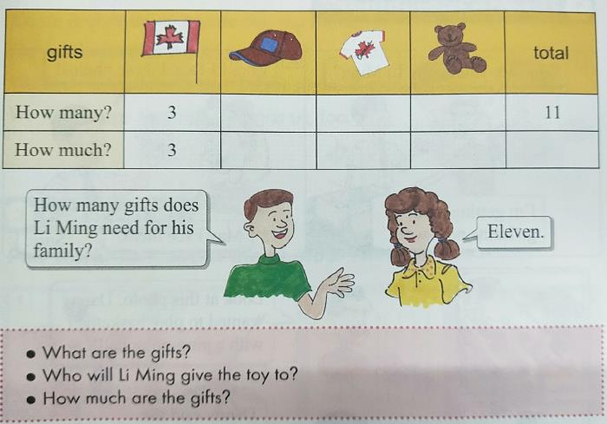
Consolidation and Extension
Talk and write.

Slide 11
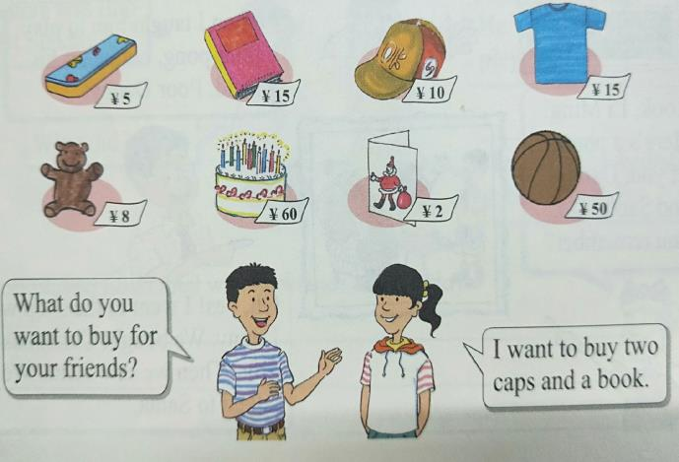
Ask and answer.

Slide 12
Homework
1.学生分组活动，要求根据自己不同的活动和动作，说出与本节相关的词语和句子。
2.做完本课配套的课后练习题。

Slide 13
Thank You!

