Slide 1
Unit 8
Is there a post office near here?
R 七年级下册
第4课时
WWW.PPT818.COM

Slide 2
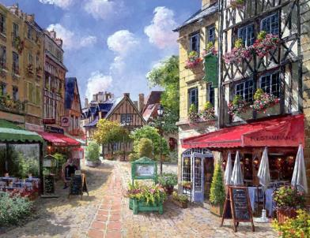
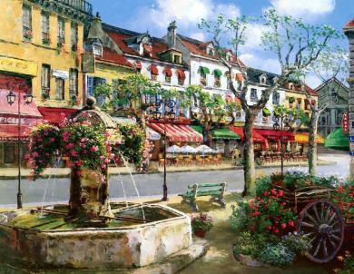
Lead-in
Introduce your neighborhood to others.

Slide 3
Check (√) the places near your home. Tell your partner where they are.
2a
clothes store post office bookstore school supermarket bank
√
√

Slide 4
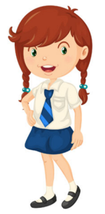
There is a clothes store and a bookstore near my home. The bookstore is across from my house.
The clothes store is next to the bookstore.

Slide 5
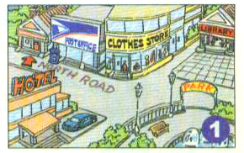
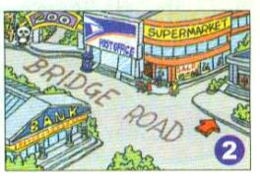
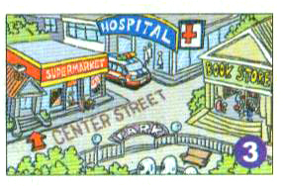
Read the passages. Match each passage with a map.
2b
Anna
John
Lisa

Slide 6
在我家附近
Anna
There is a zoo in my neighborhood I like to spend time there on weekends. I love to watch the monkeys climbing around. The monkeys sometimes fight. They look like my friends and me when we fight!
To get there, I usually walk out and turn right on Bridge Road. Then I walk along Bridge Road. The zoo is on the right.
动词不定式短语放在句首作目的状语，意为“为了……”
看起来像

Slide 7
Language points
1. There is a zoo in my neighborhood.
在我家附近有一个动物园。
neighborhood(名词): 街区；街坊
in the neighborhood 在附近
in the neighborhood of… 在……的附近
= near here
某些名词+hood可以构成另一个意思相近的名词。
child (孩子）+ hood = childhood (幼年，童年）

Slide 8
3. I love to watch the monkeys climbing around.
我喜欢看猴子们爬来爬去。
watch … doing … 观看……正在做……
watch sb. doing sth.
观看观看某人正在做某事
强调所做的事正在进行中。
watch sb. do sth.
观看某人做了某事
强调所做的事经常发生或已完成。

Slide 9
例: 我看见孩子们在阳光下开心地玩耍。
I watched the children ________ in the sun happily.
我看见那个男孩出去了。
I watch the boy ________.
playing
go out
see, find, hear等词的用法与watch类似：
see/find/hear sb. do sth. 看见/发现/听见某人做过某事；
see/find/hear sb. doing sth. 看见/发现/听见某人正在做某事。

Slide 10
John
I live near a supermarket. My parents usually shop there. There is a big park across from the supermarket. I often exercise at the park because I love the clean air and sunshine. The best things in life are free!
To get to the park，you just have to cross Center Street.
在……的对面
生活中，一生中。作定语，修饰名词things。

Slide 11
Language points
2. The best things in life are free！
生活中最美好的东西是免费的！
in life 生活中，一生中
life（名词） 一生；终生
in one’s life 在某人的一生中
例: 他在这里住了一辈子。
He’s lived here all his life.

Slide 12
Lisa
I live in a noisy neighborhood. There is a post office between my house and a clothes store. But my favorite place is the library. It is very quiet and I enjoy reading there. When I read books, time goes quickly!
You can get to the library easily. Just go down North Road and turn left. It is across from the park.
住在……
到达。后接表示地点的名词。

Slide 13
Language points
3. It is very quiet and I enjoy reading there.
那儿（图书馆）很安静，我喜欢在那里看书。
enjoy（动词） 喜欢，享受……的乐趣
常用短语：
enjoy (doing) sth. 喜欢（做）某事
enjoy oneself
玩得开心；过得愉快
= have a good/great time

Slide 14
Read the passages again and answer the
questions.
2c
1.What does Anna like doing in the zoo?
2.Does Anna think monkeys are like people? Why?
She loves to watch the monkeys climbing around.
Yes. Because she thinks that monkeys look like her friends and her when they fight.

Slide 15
3.What does John like to do at the park?
4.John thinks the best things do not need money. Do you think so, too?
5.How does Lisa get to the library from her home?
He likes exercising at the park.
Yes, I think so.
She just goes down North Road and turns left. It is across from the park.

Slide 16
Exercise
1. We enjoy _____ Jay Chou's songs.
A. listen to B. listening
C. listening to D. listen
2. I spend two hours _____ his homework every day.
A. does B. do C. to do D. doing
C
D
3. That mountain in Guilin ______ an elephant.
A. looks up B. looks like C. looks for D. looks after
B

Slide 17
4. We find there is much noise ______.
A. near B. in the neighbor
C. next to D. in the neighborhood
5. I saw some boy students ______ basketball when I passed
the playground.
A. played B. plays C. playing D. to play
D
C

Slide 18
6. ______ English well, one must have a lot of practice.
A. Speaks B. To speak C. Spoken D. Speak
7. —When did you ______ Beijing ?
—I ______ there last Monday.
A. get；got to B. get to；got to
C. get to；got D. get；got to
B
C

