Slide 1
Unit 2
I think that mooncakes are
delicious!
Section A 1a-1c
WWW.PPT818.COM

Slide 2
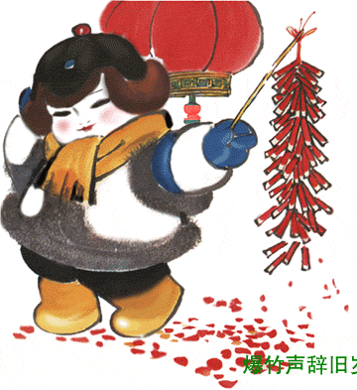
Guessing Competition:
Guess what festival it is according to the
picture you see as quickly as you can.
Spring Festival
January 1

Slide 3
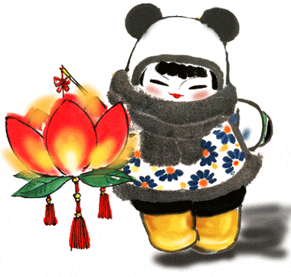
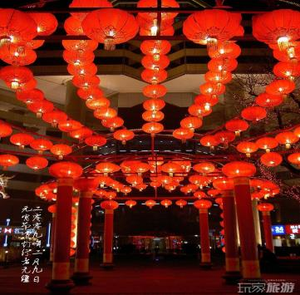
Lantern Festival, January 15

Slide 4
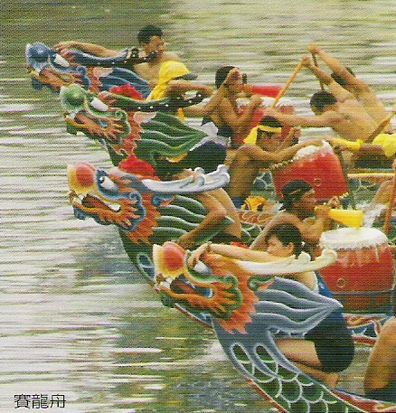
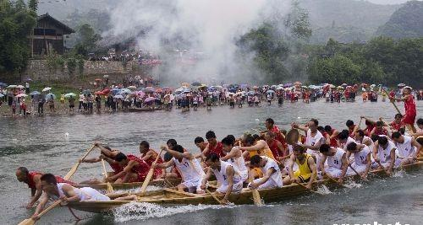
Dragon Boat Festival, May 5

Slide 5
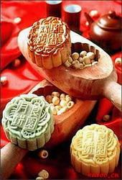
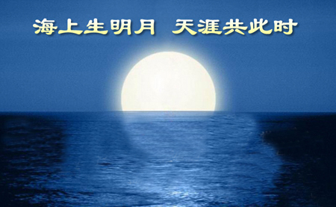
Mid-autumn Day, August 15

Slide 6
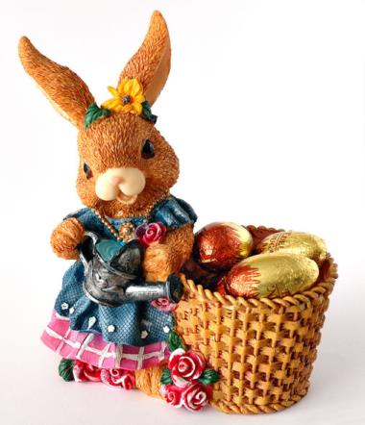
Easter
around March 22---April 25

Slide 7
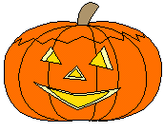
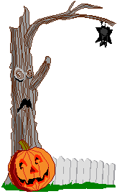
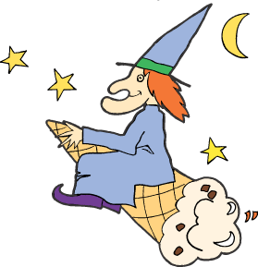
Halloween
October 31

Slide 8
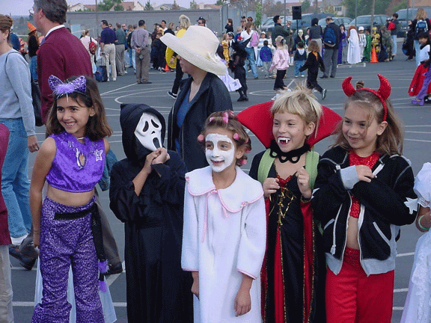
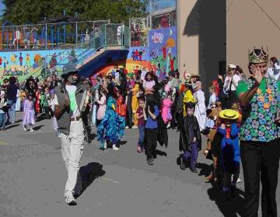
Halloween Parade(游行)

Slide 9
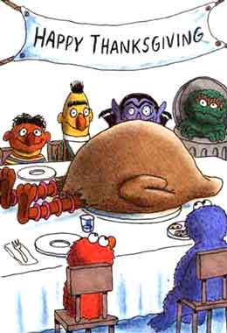
Thanksgiving Day
the last Thursday of November

Slide 10
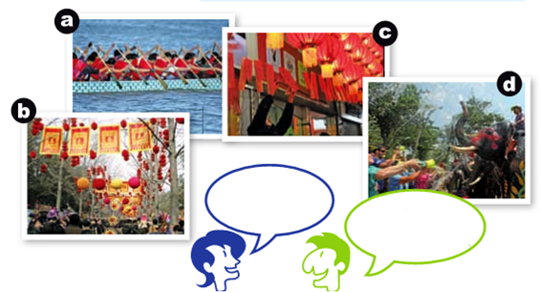
1a Match the pictures with the descriptions.
What a great day!
What did you like
best?
I loved the races!
But I guess it was a
little too crowded.

Slide 11
1. _____The Water Festival in Thailand
2. _____The Dragon Boat Festival in Hong
Kong
3. _____ Chinese Spring Festival in Beijing
4. _____ The Lantern Festival in Jiangxi
d
a
b
c

Slide 12
1b Listen and circle T for true or F for false.
1. Bill thinks that the races were not that
interesting to watch.
2. Mary thinks that the teams were fantastic.
3. Bill wonders whether they’ll have zongzi
again next year.
4. Bill and Mary believe that they’ll be back
next year to watch the races.

Slide 13
Watch and read

Slide 14
1c Talk about the festivals in 1a.
A: What do you like best about the
Dragon Boat Festival?
B: I love the races. I think that
they’re fun to watch.

Slide 15
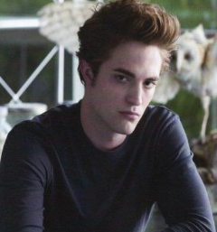
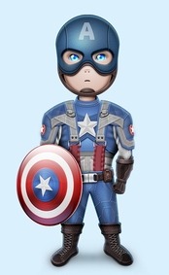
Talk about the festival in 1a with your partner.
What do you like best about the Dragon Boat Festival?
I love the races. I think that they’re fun to watch.

Slide 16
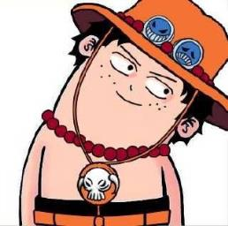
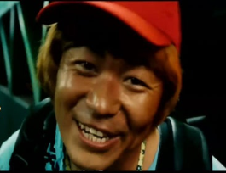
What do you like best about the Chinese Spring Festival?
I love the food, I think that they are delicious.

Slide 17
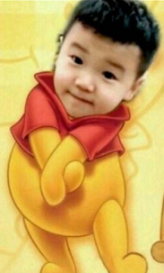
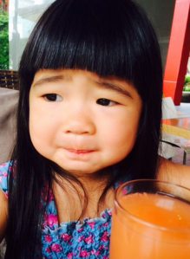
What do you like best about Water Festival?
I don’t like Water Festival, I think that getting wet is terrible.

Slide 18
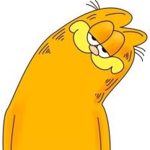
What do you like best about …?
I love... I think...
Now let’s talk about the festival with your partner and make your own conversation.

Slide 19
Language Points
1. –What a great day! 多么美好的一天！
What a great day!是由what引导的感叹句。
What 意为“多么;真;太”，用作定语，修饰名词。
此处句式结构为:What+a/an+形容词+可数名词单数
形式(+主语+谓语）! 口语中常可以省略主语和谓语。
e.g. What a new watch ( it is)!
多么新的一块手表啊！

Slide 20
2. Bill wonders whether they’ll have zongzi again next year
⑴ wonder作动此处意为“想知道; 想弄明
白”，相当于 want to know。
I wonder what the new teacher will be like
我想知道新老师是什么样。

Slide 21
⑵I wonder whether…意为“我想知道是
否…”,相当于I wonder if 是一个请求允许的交际用语，询问对方是否允许自己做某事。
“I wonder whether /if I could use your bike.
我想知道我是否能用一下你的自行车。

Slide 22
whether VS if
Whether : “是否”；是…(还是), 表示迟疑或两个可能性之间的选择或两种情况都真实，其后可与or ( not) 连用。可引导主语从句、表语从句、宾语从句、让步状语从句等，引导主语从句时可置于句首
If : “是否”, 引导宾语从句。一般不与or (not)
连用。也可引导状语从句，意为“如果”

Slide 23
Fill in the blanks.
I wonder ______ it is similar _____ the
Water Festival of the Dai people in Yunnan Province.
if
to
2. I think that we ate five meals a day! I’ve
_______ five ________.
put on
pounds
3._______ well you sing but _______ badly he dances!
How
how
the
4. —Listen! Someone is playing ______ piano. —Wow! ________beautiful music! I like it
very much.
What

Slide 24
1.Can you tell me ________they will come back?
A. where B. when C. which D. who
2.—_______ weather! It’s raining!
—Bad luck! We can’t go climbing today.
A. What bad B. What a bad
C. How bad D. How a bad

Slide 25
3.—I wonder ____ at 8:00 last night?
—I was watching NBA. 【2013北京】
A. What were you doing
B. What did you do
C. What you were doing
D. What are you doing

Slide 26
Homework
Make a conversation about the Chinese Festivals.
Preview the new words we will use in the next lesson.

Slide 27
Thank You!

