Slide 1
At the shop
WWW.PPT818.COM

Slide 2


shop

Slide 3
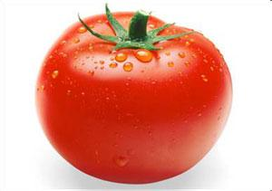
tomato

Slide 4
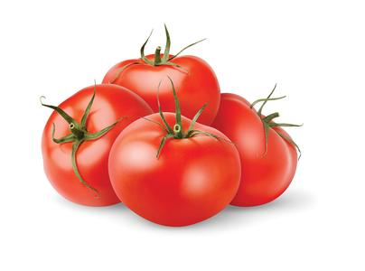
tomatoes

Slide 5
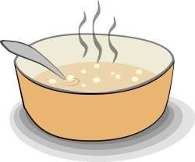
soup

Slide 6
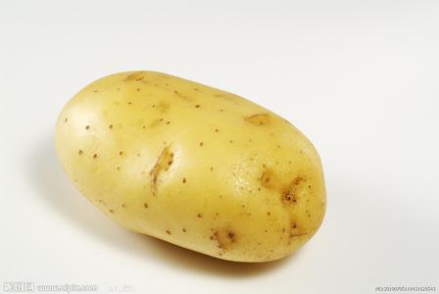
potato

Slide 7
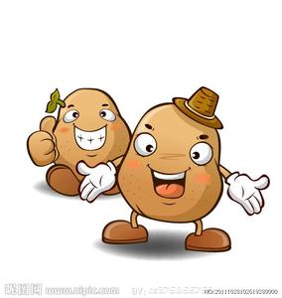
potatoes

Slide 8
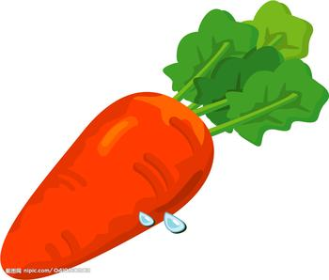
carrot

Slide 9

thirty

Slide 10
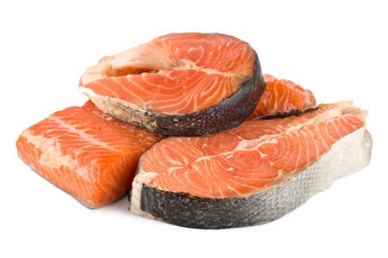

fish

Slide 11
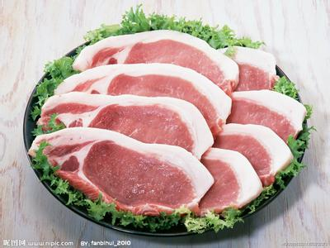
meat

Slide 12
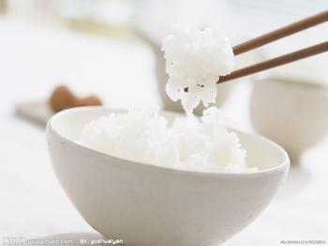
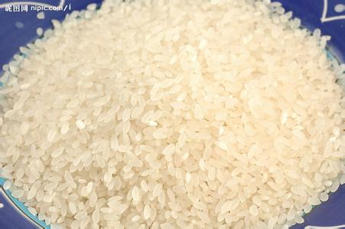
rice

Slide 13
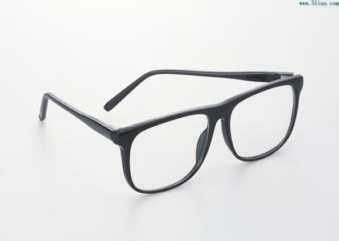
glasses

Slide 14
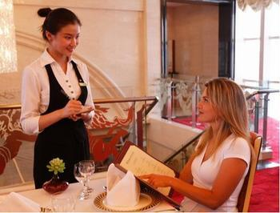
want

Slide 15
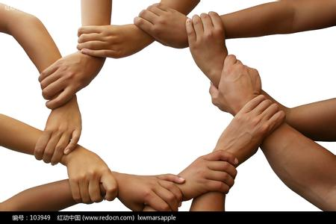
together

Slide 16

magic

Slide 17

Look and learn
At the shop

Slide 18
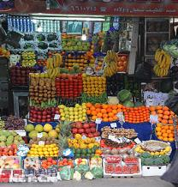
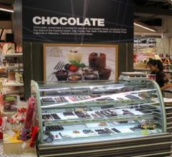
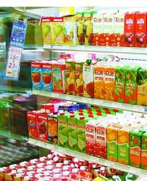
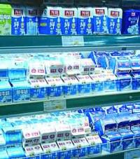
Look and say
at the shop
We can buy food _________.

Slide 19
Look and say
candy/orange juice/soup/bread/water/milk/rice/meat/
fish
tomatoes/potatoes
apples/oranges/carrots
S1: What would you like, …?
S2: I’d like some …

Slide 20

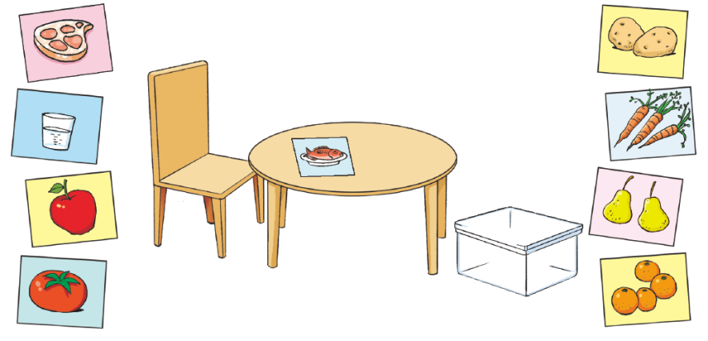


S1: What would you like?
S2: I’d like …

Slide 21
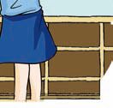
Look and say
How much …?
… yuan, please.
...
...

Slide 22






¥ 5
¥ 8
¥ 7
¥ 10
¥ 5
¥ 3

Slide 23
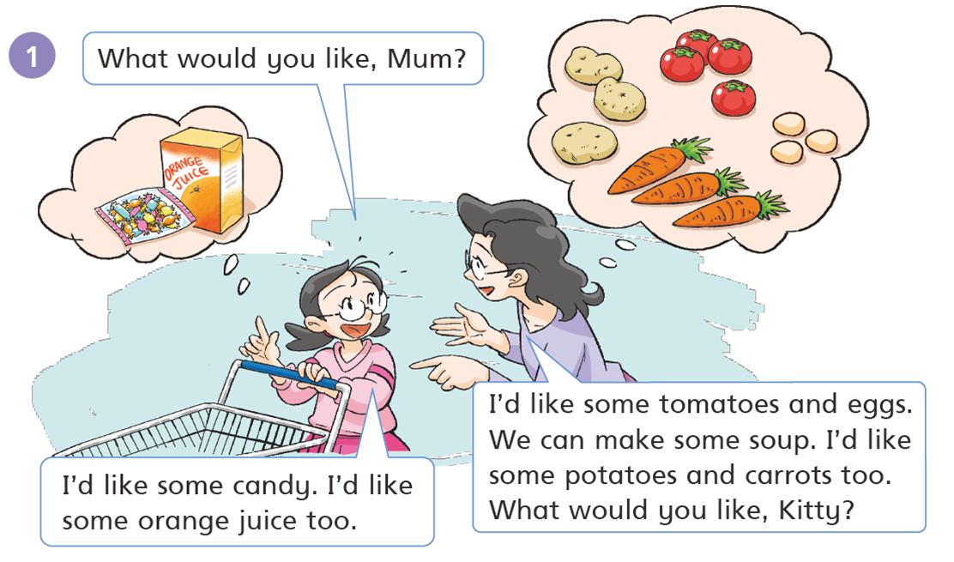
What would you like?
你想要什么？
回答是 I ‘d like……
I’d like=I would like

Slide 24
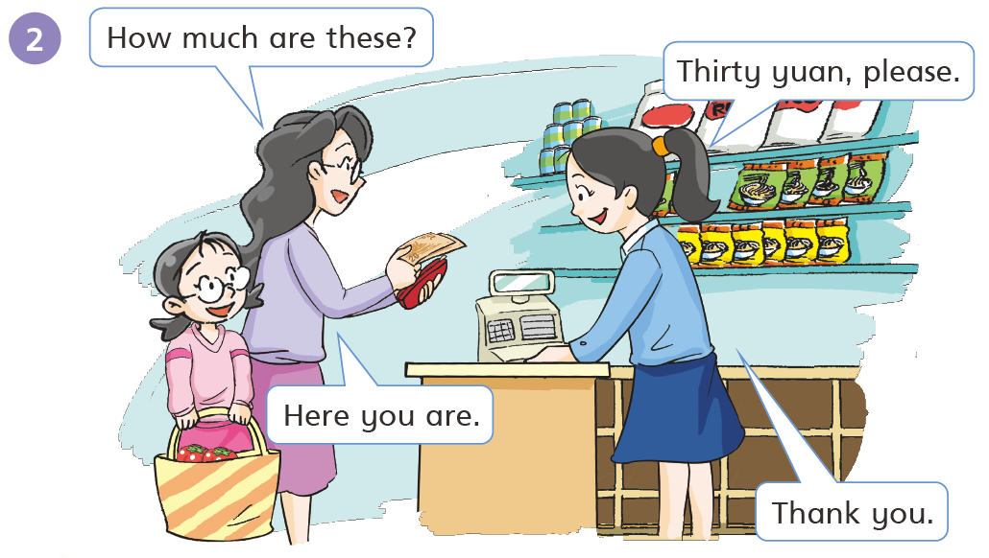
问价格时用How much，单数用is，复数用are。
Here you are .给你。

Slide 25

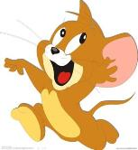
Panda’s glasses shop
The panda has a glasses shop.
The mouse and the elephant come to his shop.

Slide 26
Can I help you?
Yes, I’d like a pair of small glasses.

Slide 27
I’d like a pair of big glasses.

Slide 28
I have an idea.
The mouse and the elephant want to play together, but the mouse is small and the elephant is big.

Slide 29
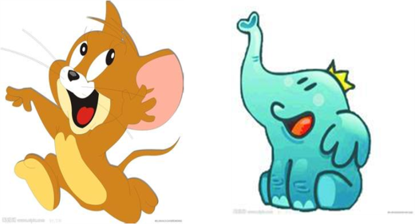


You’re not small now.
We can play together.
You’re not big now.
Look at the mouse and the elephant.
They have magic glasses.

