Slide 1
Module 6 Unit 1
When is the school-leavers’ day?
WWW.PPT818.COM

Slide 2
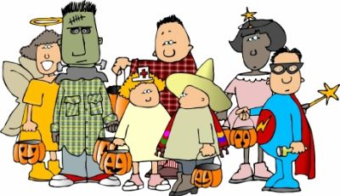
Words
Halloween party

Slide 3
birthday party

Slide 4
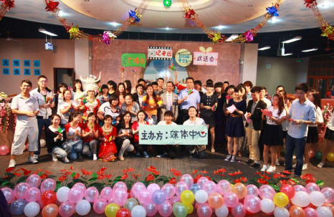
farewell party (欢送会)

Slide 5
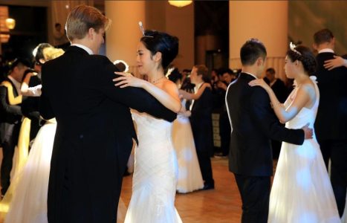
dancing party (舞会)

Slide 6
What’s a school leavers’ party?
A party for students who are completing their school education that year.

Slide 7
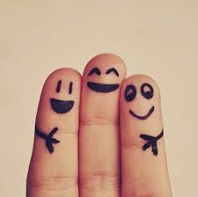
Learn some new words
invitation
finger

Slide 8
calendar
balloon

Slide 9
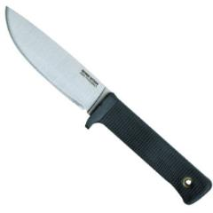
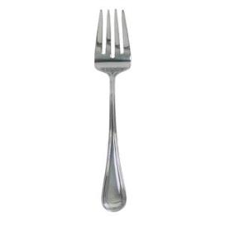
knife
fork

Slide 10
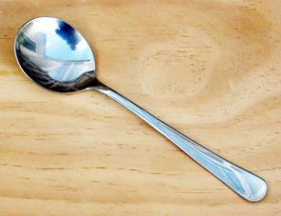
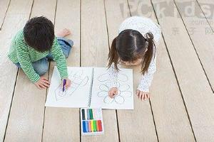
spoon
paint

Slide 11
invitation 邀请，请柬
calendar 日历
balloon 气球
paint 绘画
heat 使变热
heat up 给……加热
knife--- knives 小刀， 餐刀，刀具
fork 餐叉
spoon 匙， 勺子
cheeseburger 干酪汉堡包
Italian 意大利的，意大利语的，
意大利人

Slide 12
Talking
When is your school-leaver’s party?
2. What would you like to do on that
day?
3. If you are asked to prepare a
traditional dish from your home
country, what will you prepare?

Slide 13
Do you know how to write an invitation?

Slide 14
Learning
Lingling: When is the school-leavers’ party?
Betty: Look at the school calendar! It’ll be held
on the 30th of May. We’re all invited.
Daming: In fact, I was chosen to play the dance
music.
Tony: And I was asked to bring some balloons
and paint some pictures for the party.

Slide 15
Betty: The teachers have asked everyone to
prepare a traditional dish from their home
country.
Lingling: Can we cook it at school?
Betty: We can heat it up in the school kitchen,
but it should be cooked at home. What
are you going to make?

Slide 16
Lingling: Hot and sour soup. It’s made with chicken
and vegetables.
Betty: But the invitation says finger food! That
means you eat it with your fingers, not with
a knife, fork or spoon.
Lingling: Oh, soup’s no good then. What about you?

Slide 17
Betty: Cheeseburgers. Cheeseburgers are made
with hamburgers and cheese.
Tony: And you, Daming?
Daming: Jiaozi! My grandmother makes the best
Jiaozi!
Betty: Is she invited to the school-leavers’ party too?

Slide 18
Daming: Hmm, I see what you mean. What about
you , Tony?
Tony: A traditional English pizza with cheese,
tomato and ham.
Betty: Pizza isn’t English! It’s Italian.
Tony: But it’s eaten everywhere in England.
Daming: It’s becoming popular in China too!

Slide 19
Listen and complete the notes.
 | Dish | Made with …
hot and sour soup
Lingling
Betty
Daming
Tony
chicken and vegetables
cheeseburgers
hamburgers and cheese
Jiaozi
Not mentioned in the passage
pizza
cheese, tomato and ham

Slide 20
balloons calendar fork knife paint spoon
The day for the school-leavers’ party is an important date in the school _________. Tony is going to bring some _________ and _________
some pictures for the party. Everyone is going to bring a traditional dish that can be eaten with their fingers. Soup is no good because it is not finger food and people need a _________ for it. Anything that needs a __________ and _________ is not finger food either.
calendar
balloons
paint
spoon
knife/fork
fork/knife

Slide 21
Everyday English
Read and make a dialogue with each one.
Soup’s no good then.
And you?
I see what you mean.

Slide 22
A: I said hello to David, but he just kept
silent.
B: It’s no good trying to talk to him when
he is reading.
2) A: I’m going to send a card to Mum on
Mother’s Day. And you?
B: It’s a secret!
A: I’ve spent a whole night reviewing
English.
B: I see what you mean, but of course
learning English takes time.

Slide 23
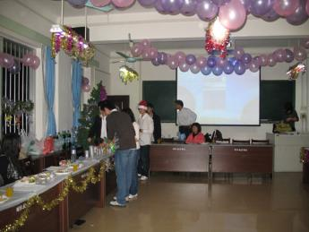
Work in pairs.
Make plans for a party.
Think about:
· food and drink
· music and dancing
· …

Slide 24
food and drink:
finger food such as potato crisps, bread, fruits, vegetables like tomatoes and cucumber
soft drinks such as soda, coca-cola and so on

Slide 25
b. music and dancing:
music such as soft music or rock
c. Where: in the living room
d. When: from 10:00 a.m. to 5:00 p.m. on Monday
e. Who: all the friends

Slide 26
Writing
Work with another pair. Talk about your party plan, and say what plans have been made. Then write down your plan.
Everyone will be asked to bring something to eat …

Slide 27
Sample
A plan for my birthday party
All my friends will be invited to my birthday party. The party has been planned to be held from 10:00 a.m. to 5:00 p.m. on Monday in the living room of my house. They are welcomed to bring small presents. Various food and drinks will be prepared, such as finger food, potato crisps, bread,

Slide 28
fruits, vegetables like tomatoes and cucumber, soft drinks such as soda, coca-cola and so on and the lunch will be served at 12:00 after we play games. Everyone will be welcomed to arrive early to help me decorate the living room with balloons, colorful strips and lights. Music will be played all the time and dancing has been planned from 3:00 p.m. to 5:00 p.m.

Slide 29
Language points
1. You are invited to the …
invite v. 邀请
I’ve invited the Smiths round for drinks next Friday.
我已邀请史密斯一家下周五来家中小酌。
I want to invite you to my party on Friday.
我想请你参加周五的聚会。
invitation n. 邀请；邀请函

Slide 30
invitation n. 邀请；邀请函
letters of invitation 邀请信
written invitation 书面邀请函
accept an invitation 接受邀请
sent sb. an invitation 向某人发出邀请
receive / get an invitation 收到请帖

Slide 31
2. The teachers have asked everyone to prepare a traditional dish from their home countries.
prepare v.
准备
My mother is preparing dinner when I get home every day.
每天我回家的时候我妈妈总是在准备晚饭。

Slide 32
根据句 ①可知：prepare sth. 意为“准备某物”，所准备的东西就是后面的宾语。
根据句 ②可知：prepare for sth. 意为“为……做准备”，指为后面的宾语做准备，所准备的东西并不是后面的宾语。
根据句③可知：prepare to do sth. 意为“准备做某事”。
prepare 与prepare for 通常用于进行时态。
注：prepare 的名词是preparation (准备；准备工作)

Slide 33
在这句话中，dish的意思是“烹制好的菜肴；一道菜；食品”。如：
When I was in Italy, I had a wonderful pasta dish.
I'll have a vegetable cold dish at first.
do / wash the dishes 表示“清洗餐具(包括盘子、杯子、碗等)”。如：
I’ll just do the dishes before we go.

Slide 34
3. We can heat it up in the school kitchen …
heat up 加热；(使)变热
Freda heated up a pie for me.
The office will soon heat up.
The room was cold when we arrived, but it soon began to heat up.

Slide 35
4. … eat it with your fingers …
with在这里的意思是“用”。
He opened the door with the key.
with的意思还有：
1) 和…一起
The old man lived with his son in the city.
2) 有，具有
The girl with golden hair looks beautiful.

Slide 36
3) 因为
He jumped up with joy.
4) 随着
With the last words, she turned away.
5) 表行为方式或伴随情况
Don’t talk with your mouse full.

Slide 37
含介词with的短语有：
fill … with
be filled with
get along with
I filled the basket with flowers.
The basket is filled with apples.
How are you getting along with your study?

Slide 38
5. Oh, soup’s no good then.
这里no good 表示“不适合”。如：
These glasses are no good for wine.
这些玻璃杯不适合喝酒。
My apartment will be no good for pets.
我的公寓将不适合于宠物。

Slide 39
no good 用法小结
A. no good doing sth. 做某事没用
It’s no good talking to him---he never listens.
B. no good for sth. 不适合某物/某事
This medicine is no good for headache.
C. no good to sb. 对某人没好处或没帮忙
A car is no good to me since I can’t drive.

Slide 40
6. What about you?
What about …?通常用来征求意见，提出建议或询问消息，
相当于How about…?
用来征求意见，提出建议等的句式还有许多。
Shall we / I do sth.? Why not do sth.? Would you like do sth?
1) Let’s play computer games, shall we?
2) Shall we play computer games?
3) Why not play computer games?
4) Would you like to play computer games?

Slide 41
Practice
Translate the phrases and sentences.
1.校毕业生晚会_______________________
2.准备一道传统食物_____________________
3.演奏舞曲___________________________
4.校历__________________
5.手抓食品_________________
the school leavers’ party
prepare a traditional dish
play the dance music
the school calendar
finger food

Slide 42
heat up
6.加热___________________
7.邀请某人做某事_____________________
8.不适合 _____________________
9.我明白你的意思。___________________
10.你呢？____________________________
invite sb. to do sth.
no good
I see what you mean.
What about you?

