Slide 1
Unit 9
Can you come to my party?
Section A Period 1 (1a-2b)
WWW.PPT818.COM
Notes:
1

Slide 2
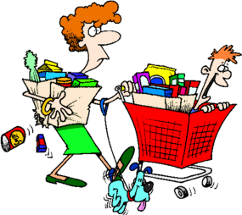
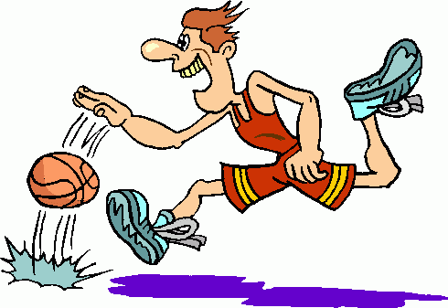

colorful weekend activities
go shopping
go to the cinema
play basketball

Slide 3
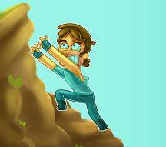

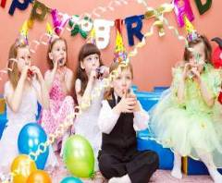

colorful weekend activities
climb mountains
surf the Internet
go fishing
go to a party

Slide 4
What do you have to do on weekdays?
I have to go to school / do homework / get up early / clean the classroom / …
PPT模板：www.1ppt.com/moban/ PPT素材：www.1ppt.com/sucai/
PPT背景：www.1ppt.com/beijing/ PPT图表：www.1ppt.com/tubiao/
PPT下载：www.1ppt.com/xiazai/ PPT教程： www.1ppt.com/powerpoint/
资料下载：www.1ppt.com/ziliao/ 范文下载：www.1ppt.com/fanwen/
试卷下载：www.1ppt.com/shiti/ 教案下载：www.1ppt.com/jiaoan/
PPT论坛：www.1ppt.cn PPT课件：www.1ppt.com/kejian/
语文课件：www.1ppt.com/kejian/yuwen/ 数学课件：www.1ppt.com/kejian/shuxue/
英语课件：www.1ppt.com/kejian/yingyu/ 美术课件：www.1ppt.com/kejian/meishu/
科学课件：www.1ppt.com/kejian/kexue/ 物理课件：www.1ppt.com/kejian/wuli/
化学课件：www.1ppt.com/kejian/huaxue/ 生物课件：www.1ppt.com/kejian/shengwu/
地理课件：www.1ppt.com/kejian/dili/ 历史课件：www.1ppt.com/kejian/lishi/
What do you have to do this weekends?
I have to …
Notes:
4

Slide 5

I have to .
prepare for an exam
/prɪ‘peə/ /ɪg'zæm/
Notes:
5

Slide 6
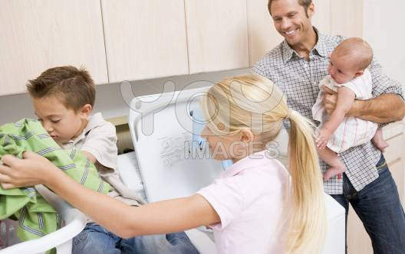
I have to .
help my parents
Notes:
6

Slide 7
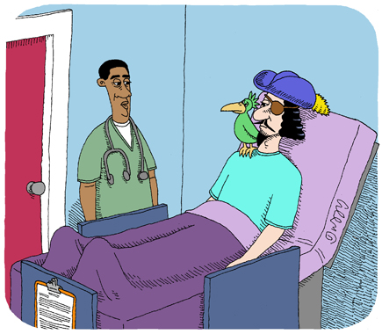
He has to .
go to the doctor
Notes:
7

Slide 8

She has to .
meet her friend
Notes:
8

Slide 9
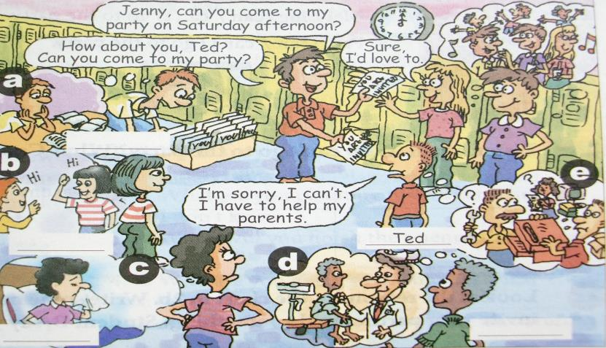
1a
Match the phrases with the pictures (a-e).

Slide 10
1a
Match the phrases with the pictures [a-e].
a
prepare for an exam _______
help my parents ______
go to the doctor ______
meet my friend ______
have the flu _____
e
d
b
c
Notes:
10

Slide 11


Slide 12
1b
Listen and write the names (Tim, Kay, Anna and Wilson) next to the correct students in the picture.
a. Tim b. Anna
c. Kay d. Wilson
Notes:
12

Slide 13
Tim
Anna
Wilson
Kay

Slide 14
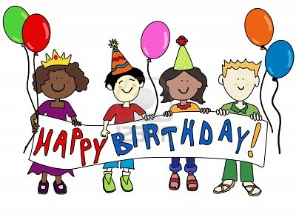
Have a birthday party
Notes:
14

Slide 15
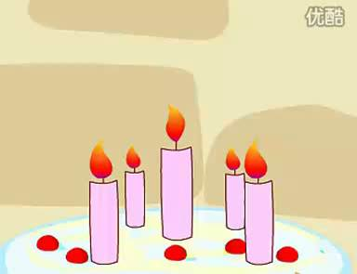

Slide 16


Can you come to my party?
Sure, I’d love to.
Sorry, I can’t. I have to …
prepare for an exam
help my parents
go to the doctor
meet my friend
have the flu
Notes:
16

Slide 17
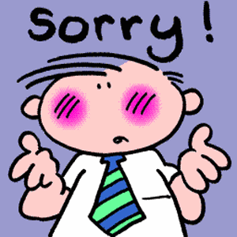
Remember:
当你拒绝他人的邀请时，要特别注意礼貌。通常你要给个理由，说明为什么无法接受邀请, 或者道歉。

Slide 18
Sorry, I'm busy.
I'm afraid I can't.
I'm sorry but I can't. Let's do it another time.
Some other time.
Sorry, I'll be busy tomorrow.
I'm sorry, but I have other plans.
Thanks for asking, but I already made plans.

Slide 19
It was very nice of you to invite me, but
I'm sorry to say that I will not be able to come.
I'm terribly sorry, but I don't think I can make it. Thank you all the same.
I'd love to spend a few days with you, but I'm afraid I can't.
Many thanks for your invitation, but I'm afraid that I will not be able to come.
I wish I could, but I've already fixed something up.

Slide 20
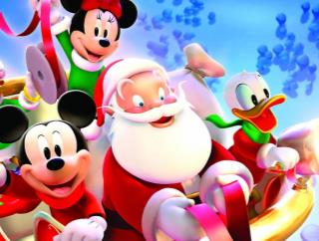
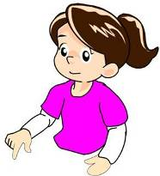
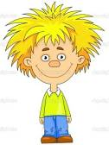
Sure. I’d love to.
Can you come to
the party?

Slide 21
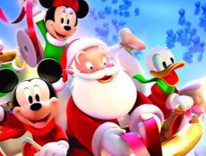

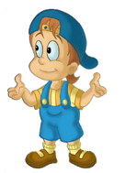

Sorry, I can’t. I have to go to the doctor.
Can you come to
the party?

Slide 22
1c
A: Can you come to my party on Saturday afternoon?
B: Sure, I’d love to.
C: Sorry, I can’t. I have to prepare for an exam.
D: I’m sorry, too. I must go to the doctor.
Notes:
22

Slide 23
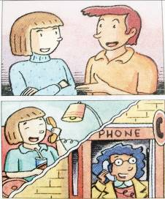
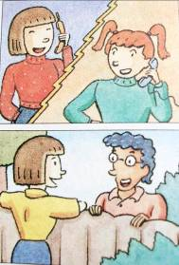
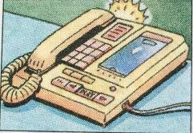
Listening
2a
Listen and circle can or can’t.
1. Jeff (can / can’t ) go to the party.
2. Mary (can / can’t) go to the party.
3. May (can / can’t) go to the party.
4. Mei Ling (can / can’t) go to the party.
5. Paul (can / can’t) go to the party.

Slide 24
2a
Listen and circle can or can’t.
Jeff (can / can’t) go to the party.
Mary (can / can’t) go to the party.
May (can / can’t) go to the party.
Mei Ling (can / can’t) go to the party.
Paul (can / can’t) go to the party.
Notes:
24

Slide 25
2b
Listen again. Who can’t go to the party? Why? Complete the chart.
Names | Reasons
1. Jeff
2. May
3. Mei Ling
1. He might have to meet his friends.
2. She has the flu.
3. She must study for a math test.

Slide 26
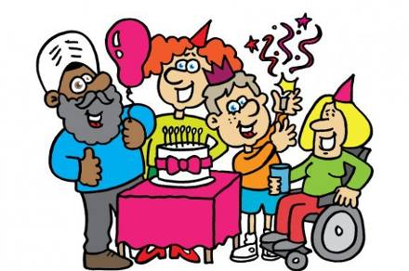
2c
Look at the reasons on the chart in 2b. Write some more. Then, Student A, invite your partner to do something. Student B, say you can’t go and why.

Slide 27
1. _______________ 2. _______________ 3. _______________ 4. _______________ | A: Hey, Dave. Can you go to the movies on Saturday? B: I’m sorry, I’m not available. I have too much homework this weekend. A: That’s too bad. Maybe another time. B: Sure, Joe. Thanks for asking.
too much homework

Slide 28
2. That’s too bad. Maybe another time.
太糟了, 也许换个时间吧。
Maybe another time.相当于Maybe next time. 译为：也许下一次 吧
another 表示三者或三者以上的 “另一”
e.g. can you give me another book?
你能再给我一本书吗？

Slide 29
3. Thanks for asking. 谢谢邀请我。
Thanks for your invitation.
Thanks for sth./doing sth. 因…而感谢

