Slide 1
Unit3 Who’s That Man?
陕旅版六年级下册
第一课时
WWW.PPT818.COM

Slide 2
>>Review
a bowl of noodles a plate of beef
a glass of juice a bottle of water
a cup of tea a piece of bread
Magic fingers

Slide 3
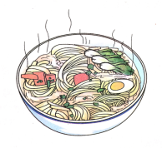
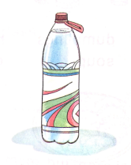
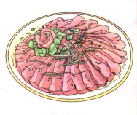
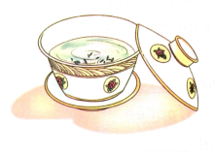
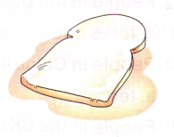
>>Review
Look and say
—What would you like?
—I’d/We’d like…

Slide 4
>>Lead-in
Review
worker
farmer
teacher
What’s missing?
driver
doctor

Slide 5
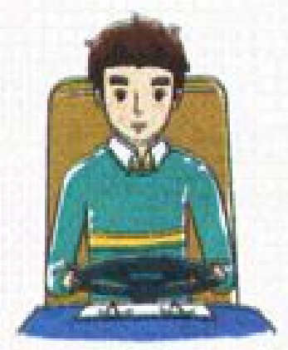
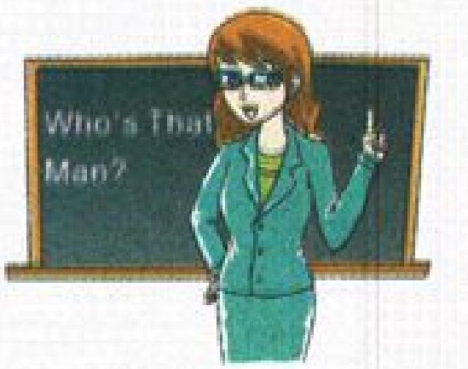
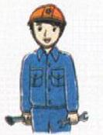
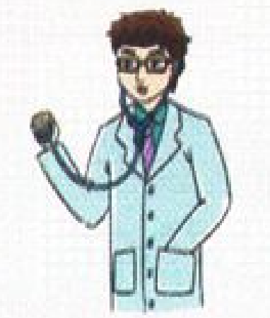
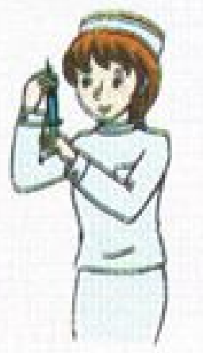
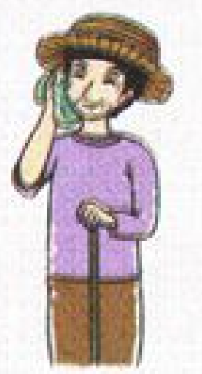
>>Presentation
Look and choose
a.
b.
c.
d.
e.
f.
f
c
b
farmer ____
worker ____
teacher ____
a
d
e
driver ____
doctor ____
nurse ____

Slide 6
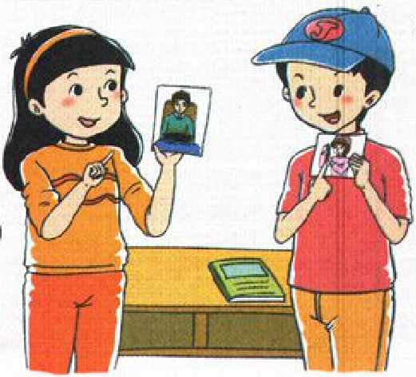
>>Presentation
Talk about the pictures above
Pair work
What is this man?t
He is a driver. What about this woman?
She is a nurse.

Slide 7
>>Presentation
Let’s learn
She is a student in a primary school.
She is not in a middle school.
So she is a pupil, too.
pupil

Slide 8
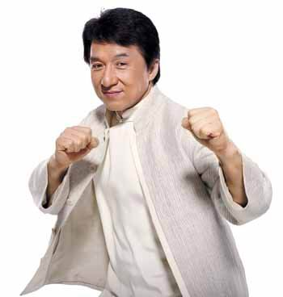
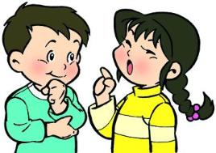
>>Presentation
Let’s learn
Chen Long is an actor.
Who’s that man?t
He is Chen Long.
actor
He can act.
What does he do?
He is an actor.

Slide 9
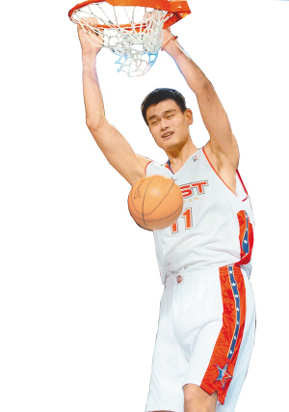
>>Presentation
Let’s learn
Who’s that man?t
He is Yao Ming.
basketball player
And he is a basketball player.
He can play basketball very well.

Slide 10
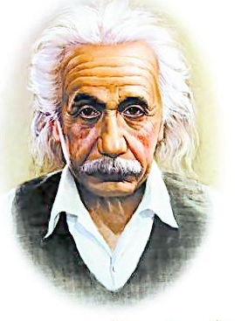
>>Presentation
Let’s learn
Einstein is a scientist.
He is a scientist.
scientist

Slide 11
>>Practice
scientist pupil
basketball player actor
Magic fingers

Slide 12
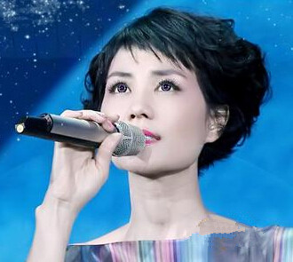
>>Presentation
Let’s learn
-What does she do?
-She is a singer.
singer

Slide 13
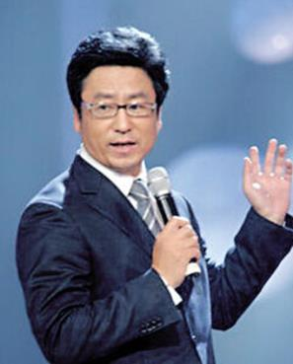
>>Presentation
Let’s learn
-What does he do?
-He is a reporter.
reporter

Slide 14
>>Presentation
Let’s learn
-What does he do?
-He is a police officer.
police officer

Slide 15
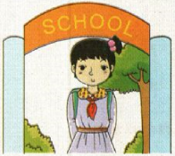
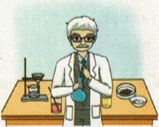
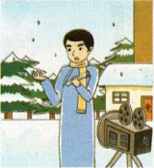
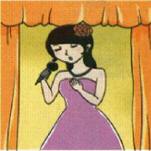
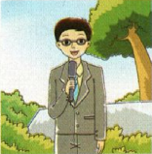
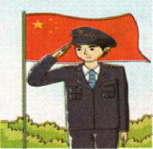
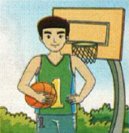
>>Practice
Game
Quick response

Slide 16
>>Practice
Remember: What’s this?
pupil
scientist
basketball
player
?
?
?

Slide 17
>>Practice
Remember: What’s this?
police
officer
actor
?
?
?
reporter

Slide 18
>>Practice
Remember: What’s this?
?
scientist
?
pupil
reporter
?

Slide 19
>>Summary
本课所学的表示职业类的单词有哪些？
pupil actor singer reporter
scientist police officer
basketball player

Slide 20
>>Homework
1.听课文录音并跟读，按照正确的语音、语调朗读并表演课文对话。 2.正确书写本课所学单词5遍，并让家长听写1遍。
3.预习A Let’s talk。
close

