Slide 1
Module 1 Unit 2
You should smile at her!
WWW.PPT818.COM

Slide 2
学习目标
一、掌握以下单词和短语：ask for, improve, basic, advise, shy, quickly, natural等。
二、能够读懂关于英语学习及学习建议的文章并获取细
节信息。
三、能够用书信的方式询问并给出英语学习建议。
四、能够发现并记录自己在英语学习方面的优势，
扬长避短。

Slide 3
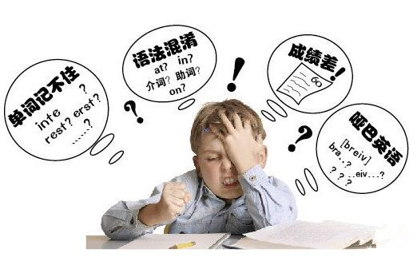
Warm up
Can you give him some advice?

Slide 4
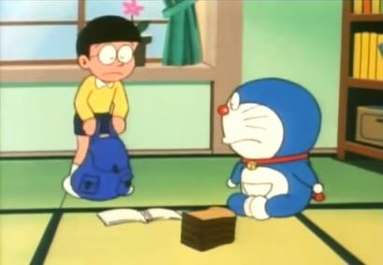
Ask and answer
I’m not good at listening.
Listen to the radio.
A: How can I improve my listening?
B: Why don’t you…

Slide 5
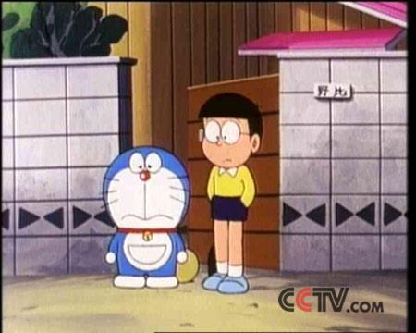
I’m not good at speaking.
Speak English in class.
A: How can I improve my speaking?
B: You should …

Slide 6
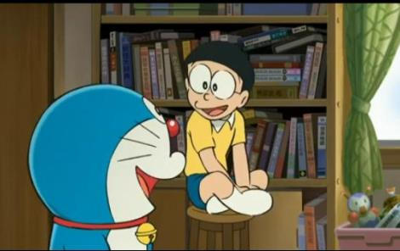
I’m not good at vocabulary.
Read and use them.
A: How can I improve my vocabulary?
B: I suggest you …
建议，提议

Slide 7
How to give advice?
Why don’t you write it down?
2) Why not write it down?
3) You should always speak English in class.
4) It’s a good idea to check your vocabulary
notebook every day.
5) How about listening to the radio?
= What about listening to the radio?
6) But try not to translate every word.

Slide 8
Discussion
What are important and good ways to learn English?
Listen to lots of recordings.
Learn a lot of grammar rules.
Keep hundreds of words in mind.

Slide 9
Talk in English with other
people often.
Read a large number of books.
Learn to sing a lot of English songs.

Slide 10
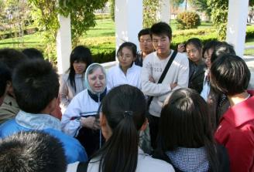
Do you have any other suggestions?
Take part in English corners.
Watch English movies.

Slide 11
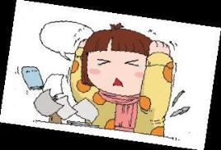
1.Work in pairs. Talk about problems in learning English and give advice.
Problems | Advice
I can’t… I don’t know… | How/ What about…? Why don’t you/ not…？
understanding English
about speaking English
learning vocabulary

Slide 12
Listen and read the passage and find out what problems the students have.
2
The answers:
1. Li Tao likes watching English films and listening to English songs, but he doesn’t understand very much.
2. Wang Fan has a foreign teacher at school but he is too shy to speak to her.
3. Zhang Lei always forgets new words quickly.

Slide 13
3
Complete the table.
 | Advice from Diana
Li Hao
Wang Fan
Zhang Lei
Watch and listen several times and guess the meaning of the new words. Talk about the films or songs with friends.
Smile at your teacher and say”Hello! How are you?” ” Do you like China?” to start a conversation.
Write four or five words a day on pieces of paper and place them in your room. Read the words when you see them and try to use them.

Slide 14
Complete the passage with the correct form of the words in the box.
4
advise basic conversation
improve meaning shy suggest

Slide 15
Diana, the Language Doctor, gives some (1)______ advice about learning English. She (2) _______ you to talk about films and songs, and guess the (3)_________ of the new words. The second piece of advice is this: Start your (4)___________ with greetings or question.
basic
advises
meaning
conversation

Slide 16
She (5)________ that you smile before you speak and do not feel (6)______. Finally, (7)________ your vocabulary with four or five new words every day.
suggests
shy
improve

Slide 17
Key words and expressions
1. guess
guess作动词, 意为"猜, 猜测"。常见用法如下:
guess (at) sth. 意为"猜测某事"
guess + 从句
She guessed the right answer at once.
她立刻猜出了正确的答案。
I guess that she is 25.
我猜她25岁。

Slide 18
guess还可作名词, 意为"猜测；猜想"。常见搭配:
make / have a guess (at sth.)
(对某事)作猜测
Do you really want to know? Make a guess!
你真的想知道吗？猜猜看!
I'll give you three guesses.
我让你猜三次。

Slide 19
2. Just enjoy yourself!
enjoy yourself意为“过得快乐”, 具体用哪个反身代词(oneself), 由前面所提到的人来决定。enjoy oneself相当于have a good time。如：
Did you enjoy yourselves / have a good time during the concert?
在音乐会上你们玩得高兴吗？

Slide 20
与oneself有关的短语还有:
by oneself 单独地, 独自地
help oneself to ... 请随便吃 / 喝……
look after oneself 照顾某人自己
teach oneself = learn by oneself 自学

Slide 21
3. remember
remember 意为“记住,记着”, 其反义词forget 意为“忘记”, 这两个词的用法相同:
(1) remember / forget +名词；
(2) remember / forget to do sth. 意为"记着/忘记要去做某事"；

Slide 22
Remember to turn off the lights before you go out.
记得在出门前把灯关了。
Don’t forget to buy a cake for me.
不要忘记给我买蛋糕。
I forgot cleaning the room.
我忘了曾打扫过这个房间了。
I still remember returning the book to you.
我仍记得把书还给你了。

Slide 23
( ) 1. —Please remember ______ the lights when you leave the room.
—OK, I will. (2010四川·广安)
A. turn off
B. to turn off
C. turning off
B
【解析】remember to do表示记得去做sth，remember doing表示记得做过sth.。根据文意知道表示“记得去做…”，所以选B。

Slide 24
( ) 2. Remember ________ the book to the library when you finish _______ it. (2011河源)
A. to return; to read
B. returning; reading
C. to return; reading
D. returning; to read
C

Slide 25
4. all the time
all the time 总是, 一直
It is raining all the time, so we have to stay at home all the day.
由于一直下雨, 我们只好一整天呆在家里。
I'll still be with you all the time.
我还是一直都会和你在一起的。

Slide 26
Check (√) what you are good at or not good at in English.
5
 | What I am good at | What I am not good at
Listening
Speaking
Reading
Writing

Slide 27
Writing
I. Write a letter to Diana asking for advice. Use the letter below to help you.
Dear Diana, I understand English in the classroom, but it is sometimes hard to understand American and British people. Can you help me?
Thanks. Lingling

Slide 28
6
Write a letter to Diana asking for advice. Use the letter below to help you.
Dear Diana,
I understand English in the classroom, but it is sometimes hard to understand American and British people. Can you help me?
Thanks,
Lingling

Slide 29
Work in pairs. Read your partner’s letter. Write your advice.
7
Student A: Read your letter to Student B.
Student B: Listen to Student A’s
message and give advice.
Dear Lingling,
You should watch films and TV
programmes in English…

