Slide 1
陕旅版小学英语三年级上册
Unit2 How Are You? 第1课时
WWW.PPT818.COM

Slide 2
教学目标
1．能听懂、会说：
Hello!／Hi!
How are you?
I’m fine. Thank you．／
This is…／Nice to meet you．
Me，too．并能在日常生活中灵活运用。
2．要求学生积极参与课堂活动，并能在活动中灵活运用所学词汇和句型。

Slide 3
Warming up
Let’s sing---How are you?

Slide 4
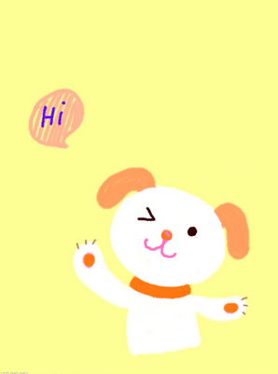
小朋友们在见面时是怎么打招呼的？
初次见面怎么说？
介绍别人怎么说？
Hello/ Hi! How are you?
Nice to meet you.
This is…

Slide 5
下面我们观看一段Donald Duck和Mickey Mouse的一段对话，看看他们第一次见面是怎么打招呼的？
Hi, Donald Duck.
Hi. Mickey, I’m Donald Duck.
How are you?
I’m fine. Thank you. And you?
I’m fine, too.

Slide 6
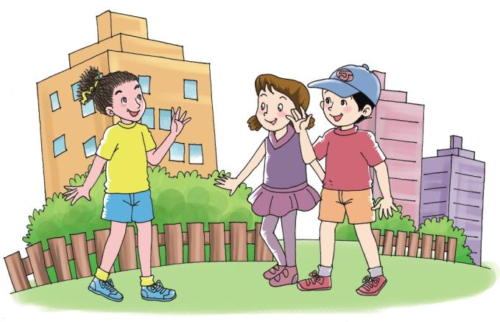
Let’s talk
Hello, Liu Zhaoyang! How are you?
I’m fine. Thank you.

Slide 7
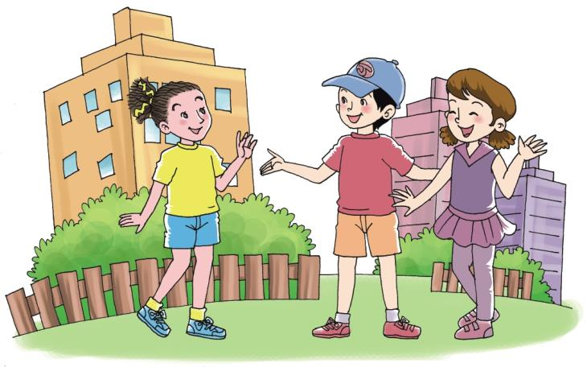
Kitty, this is Lin Lin. Lin Lin, this is Kitty.
Hello, Lin Lin. Nice to meet you.
Me, too!

Slide 8
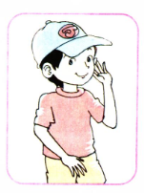
Role play
三人一组，分角色扮演
Kitty
Lin Lin
Liu Zhaoyang

Slide 9
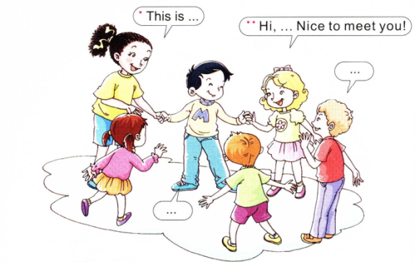
Let’s say
同学们五人为一组，围成一个圈，依次介绍一位同学。如：S1: This is…
S2: Hi,…Nice to meet you!
S3: Me, too!
然后S2说： This is… 依次介绍下一位同学。

Slide 10
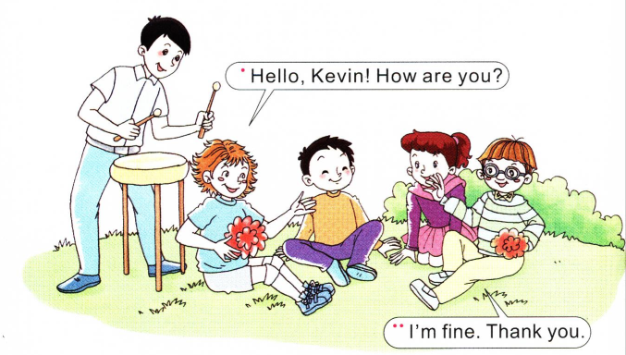
Let’s play---击鼓传花
游戏规则（观看视频）

Slide 11
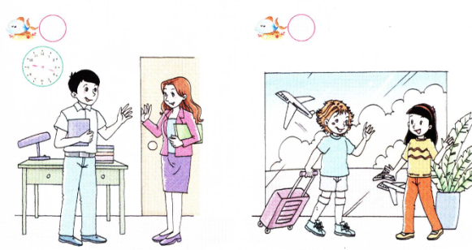
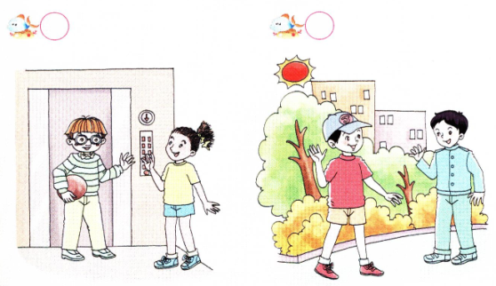
Listen and number
3
1
2
4
录音内容

Slide 12
录音内容：
1. —Hello, Colin! How are you?
—Very well, thank you.
2. —How are you，Kevin?
—I’m fine. Thank you.
3. —Hi, Miss White! How are you?
—I’m very well, thank you.
4. —Hello, Su Nan! Nice to meet you!
—Nice to meet you, too.

Slide 13
小结Let’s talk
朋友见面打招呼：
—Hello！ / Hi！ Nice to meet you.
—Me, too.
—How are you?
—I’m fine. Thank you.
向别人介绍他人用：This is…
如：This is Lin Lin.

